Slide 1
HIPAA: What We Have Learned in 20 Years
J. Kevin West
kwest@parsonsbehle.com

Slide 2
HIPAA Quiz
May health care providers leave simple appointment reminder messages at patients’ homes or mail reminders to them?

Slide 3
May health care providers use sign-in sheets and call out patient names in waiting rooms?

Slide 4
Can a provider FAX patient medical information to another physician’s office?

Slide 5
Does the HIPAA Privacy Rule allow parents the right to see their minor children’s medical records?

Slide 6
May a health care provider disclose parts of a medical record that were created by and received from another provider?

Slide 7
May doctors communicate with anyone besides the patient regarding payment of the patient’s medical bill?

Slide 8
If patients request copies of their medical records, may they be required to pay for the copies?

Slide 9
Can a patient have a friend or family member pick up a prescription for her?

Slide 10
Can a family member access someone’s medical record if they have that person’s health care power of attorney?

Slide 11
Can health care providers have confidential conversations, even if they might be overheard?

Slide 12
May students see patient information during their training?

Slide 13
If I get a subpoena, may I immediately provide a copy of the patient’s medical records?

Slide 14
Must an authorization (i.e., medical release form) include an expiration date?

Slide 15
Does HIPAA allow me to communicate by email with patients?

Slide 16
Is encryption required by the HIPAA Security Rule?

Slide 17
If a patient pays in cash for a visit and asks that documentation of the visit not be disclosed to insurers/payers, must the doctor comply?

Slide 18
Must doctors notify patients if a data breach occurs?

Slide 19
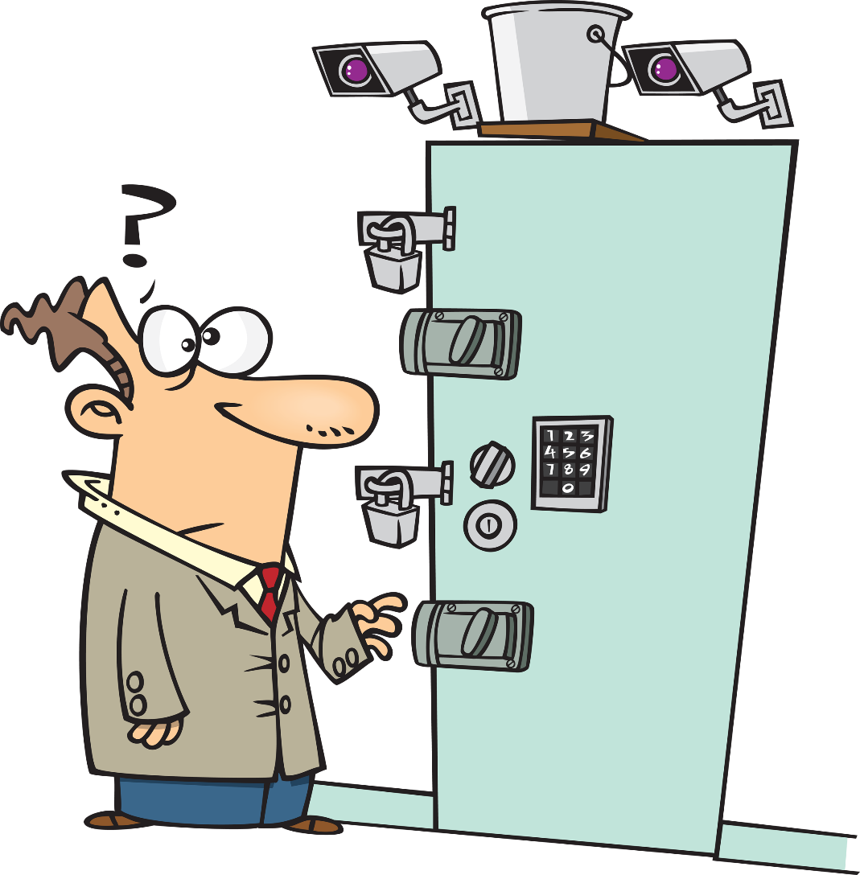
Are locking file cabinets required to store paper medical records?

Slide 20
Is texting of patient health information allowed by HIPAA?

Slide 21
How We Got Here
1996
2003-2004
2009
2016
4/5/21
HIPAA enacted by Congress
HIPAA regs take effect
HITECH Act enacted
21st Century Cures Act
Information Blocking Rule takes effect

Slide 22
HIPAA Perspectives After 20 Years
What have we learned?
What lessons going forward?

Slide 23
Violation of patient confidentiality is an ethical and legal violation in every state which may result in –
Licensure board discipline
A lawsuit for malpractice or invasion of privacy
Investigation, fines and penalties by the Office of Civil Rights (OCR)

Slide 24
Patient privacy is not unlimited; it may be circumscribed by:
Public health and safety
Individual health and safety

Slide 25
Most Common HIPAA Complaints Filed with OCR
Denial of access to patient’s own records
Inadequate safeguards in reception areas
Failure to provide or post NPP
Mailing PHI to wrong address
Allowing access to PHI to unauthorized persons
PHI visible in doctor’s offices
Providers who speak too loudly or where others can overhear
Improper medical release forms

Slide 26
What We’ve Learned Since April 16, 2003
70% of small physician practices surveyed claim to be “compliant” with Privacy (55% for Security)
85% of hospitals surveyed claim compliance with Privacy (75% for Security)
24% of healthcare providers have received a privacy complaint from a patient

Slide 27
What We’ve Learned Since April 16, 2003
Widespread misunderstanding by providers of basic concepts
Many unintended consequences
More hassles for patients/families
Greater communication difficulties for providers
Quality of care problems

Slide 28
Basic Rule of Privacy:
Patient health information may not be disclosed unless:
There is a valid release
– or –
A specific HIPAA provision allows disclosure

Slide 29
Ongoing Concerns
Social media
Texting and mobile devices
Unencrypted laptops
“Ransomware”
Failure to have operational HIPAA policies & procedures

Slide 30
Some Statistics . . .
67% of physicians use social media in some form
33% of physicians who use social media have received “friend” requests from patients
11% of blogs by healthcare professionals contain product endorsements

Slide 31
Text Messaging
Sending a short message between two or more mobile phones over a phone network
Inherently insecure because ...
Texts are generally stored on a central server of the cellular provider (or more than one) as well as on both the sending and receiving devices

Slide 32
Social Media Summary
Social Platforms were created to help people connect with one another, broadcast their ideas, and create stores of personal information online
Services like Facebook, Twitter, YouTube were built for sharing public information, not for confidential information

Slide 33
Six Do’s & Don’ts For Social Media

Slide 34
First, don’t discuss patients in a way that might identify them

Slide 35
Second, don’t “friend” patients

Slide 36
Third, don’t post patient testimonials, pictures, etc. without a proper HIPAA release

Slide 37
Fourth, don’t respond to patient complaints, or comments online

Slide 38
Fifth, do promote your practice and your services without violating patient privacy

Slide 39
Sixth, do adopt a written social media policy for your office/staff
Limits on who speaks for the Practice
Guidelines as to content of postings
Prohibitions against discrimination
Disciplinary action for failure to adhere

Slide 40
New Verbiage – Information Blocking

Slide 41
What is Information Blocking?
A practice that is likely to interfere with, prevent, materially discourage or otherwise inhibit the access, exchange or use of electronic health information (EHI)
Level of intent required
Actual knowledge (health care providers)
“Knows or should know” (health IT vendors)

Slide 42
What is Information Blocking?
Information blocking does not include practices that:
Are required by law; or
Fall within an exception to the information blocking rule

Slide 43
How We Got Here
HIPAA created a federal right of access for patients
Providers had 30 to 60 days to respond to request
No right to electronic access
HITECH Act gave patients the right to obtain access in electronic format
Access to be given as soon as possible, but not later than 30 days
Limits fees that can be charged to actual, cost-based fees

Slide 44
How We Got Here
Despite HIPAA and HITECH, patient access still had limitations
No real time access
EHR systems may limit access due to information blocking features and lack of interoperability

Slide 45
Examples
Patient had been on beta-blockers, which have a black box warning not to abruptly stop the medication; the EHR system had a warning feature, but the charting portion of the EHR and the medication orders portion did not communicate with each other. A resident stopped the medication, and patient suffered a brain bleed and died

Slide 46
Examples
A patient had an x-ray of the lung to rule out pneumonia at a hospital. The x-ray showed an infiltrate which was noted on the radiology report. Instead of sharing the report with the treating doc digitally, the radiology department faxed the image, which was severely blurred and difficult to read. The treating doctor did not learn of the findings and patient had severe complications.

Slide 47
How HIPAA and the Information Blocking Rule are Interrelated
HIPAA does not require real time access; Information Blocking Rule may require it or something close (“without delay”)
As to 3rd parties (everyone but patient), HIPAA usually specifies what may be shared. Information Blocking Rule requires access

Slide 48
Rule of Thumb
Where HIPAA permits disclosure/access of PHI, the Information Blocking Rule will likely require it

Slide 49
“We do not require the disclosure of EHI in any way that would not already be permitted under the HIPAA Privacy Rule. However, if an actor is permitted to provide access under HIPAA, then the information blocking rule would require that the actor provide that access so long as the actor is not prohibited by law by doing so.”
(Official comments to Information Blocking Rule, 4/5/21)

Slide 50
Example
A PCP asks to see a copy of your treatment records for a mutual patient
Under HIPAA you are not required to provide the records (though medical ethics may dictate otherwise)
Under the Information Blocking Rule, your records must be accessible to the PCP

Slide 51
Example
Your billing service or EHR provider refuses to grant access to you when your contract ends with them.
HIPAA allowed this to some extent
Information Blocking Rule prohibits it

Slide 52
Practices That May Result in Information Blocking
Contract terms that restrict access to or exchange of electronic health information
Charging prices or fees that make access cost prohibitive
Implementing health IT in non-standard ways that increase costs
Developing health IT in ways that “lock-in” users (i.e., makes it difficult to change vendors/software)

Slide 53
Charging for Access
HIPAA:
Patients may be charged cost-based fees for paper or electronic records
All others may be charged whatever the health care provider wishes
Information Blocking Rule:
Patients: may not be charged for access to ePHI or to export data to them
All others: may be charged a reasonable cost-based amount

Slide 54
The New Information Blocking Rule Requires Providers to –
Make technical changes
Make operational changes

Slide 55
Technical Changes
Providers must work with IT consultants and EHR vendors to correct technical restrictions on access
Check to see if your EHR software is certified to comply with the Information Blocking standards (go to http://tinyurl.com/y53sqjjt)

Slide 56
Operational Changes
HIPAA Notice of Privacy practices must be reviewed
HIPAA Business Associate Agreements may need to be revised
HIPAA policies will need to be revised
Staff must get updated training

Slide 57
Information Subject to the Rule
April 5, 2021 – October 5, 2022: data elements in the US Core Data Interoperability (USCDI) standard
Consultation note
Discharge summary note
Procedure note
Progress note
Imaging narrative
Lab report narrative
Pathology report narrative
History and physical
After October 5, 2022: ePHI as defined by HIPAA

Slide 58
Enforcement
HIPAA
Information Blocking
Office of Civil Rights (OCR)
Civil monetary penalties
OIG (for health IT vendors)
CMS (for providers)

Slide 59
Penalties for Information Blocking Non-Compliance
Health IT companies –
Civil monetary penalties, up to $1 million per violation
Providers – referral to “appropriate agency” for appropriate disincentives

Slide 60
HIPAA vs Information Blocking
HIPAA
Information Blocking
Specifies when PHI may be shared w/3rd parties (i.e., other than patient)
Grants patients the right to inspect and obtain a copy of PHI (paper or electronic) in the designated record set except for psych notes or information compiled in anticipation of litigation
Mandates that e-PHI must be accessible to patients and other 3rd parties
Grants patients/3rd parties access to e-PHI
8 types of records until 10/5/22
All e-PHI after 10/5/22

Slide 61
HIPAA vs Information Blocking
HIPAA
Information Blocking
Provider must act on a request for access to PHI within 30 days of the request
Provider may deny the request for access if:
Such would jeopardize the health, safety, security of the patient
Record refers to another person & disclosure would create a risk of harm to that person
Access to e-PHI must be available at all times
Provider may deny access if one of “8 exceptions” are satisfied

Slide 62
HIPAA vs Information Blocking
HIPAA
Information Blocking
Access must be allowed in the form (paper or electronic) requested by the patient “if it is readily producible in that form and format”
Access must be allowed in electronic format that does not impose unreasonable barriers

Slide 63
HIPAA vs Information Blocking
HIPAA
Information Blocking
Fees –
Patients: providers may charge a reasonable, cost based fee for copies, media, labor and postage
3rd parties: providers may charge whatever they wish
Fees –
Patients: providers may not charge a fee for allowing electronic access; may still charge for copies, media, etc.
3rd parties: providers may only charge a reasonable cost-based fee except for fees to “perform an export of switching health IT or to provide patients their e-PHI”

Slide 64
HIPAA vs Information Blocking
HIPAA
Information Blocking
Defines who may or must have access to PHI
Provides that access must be allowed to those who are allowed access under HIPAA

Slide 65
HIPAA vs Information Blocking
HIPAA
Information Blocking
Specifies when a release (authorization) is or is not required in order to share PHI
Does not address, but once sharing is allowed, with or without a release, access to ePHI must be allowed
“Our intent is that the information blocking provision would not conflict with the HIPAA Privacy Rule (with respect to the privacy of PHI).”

Slide 66
HIPAA vs Information Blocking
HIPAA
Information Blocking
Patient has the right to request “confidential communications” specifying that PHI may not be shared with certain parties
If provider accepts the patient’s request not to share ePHI, this is not information blocking

Slide 67
HIPAA vs Information Blocking
HIPAA
Information Blocking
HIPAA Security Rule sets a baseline for practices that must be implemented to protect ePHI
Security measures may not unreasonably block access to authorized parties even where such measures are allowed under the HIPAA Security Rule

Slide 68
HIPAA Audits & Enforcement

Slide 69
HIPAA Enforcement – The Basics
HHS’ Office for Civil Rights (“OCR”) enforces HIPAA
Enforcement process includes:
Investigating complaints
Conducting compliance reviews
Performing education and outreach to foster compliance

Slide 70
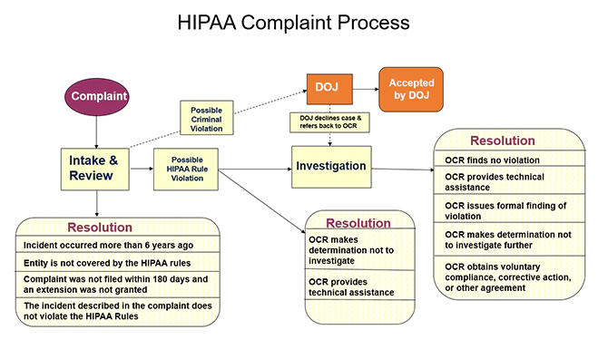
HIPAA Enforcement – The Basics

Slide 71
Compliance Reviews & Audits
OCR initiates compliance reviews based on:
Complaints
Media reports
Referrals from other state and federal agencies
Trends in complaints and/or breach reports received
Other ongoing indications of noncompliance identified by OCR

Slide 72
2016-2017 HIPAA Audits Industry Report
“The audit results confirm the wisdom of OCR’s increased enforcement focus on hacking and OCR’s Right of Access initiative. We will continue our HIPAA enforcement initiatives until health care entities get serious about identifying security risks to health information in their custody and fulfilling their duty to provide patients with timely and reasonable, cost-based access to their medical records.”
-- OCR Director Roger Severino

Slide 73
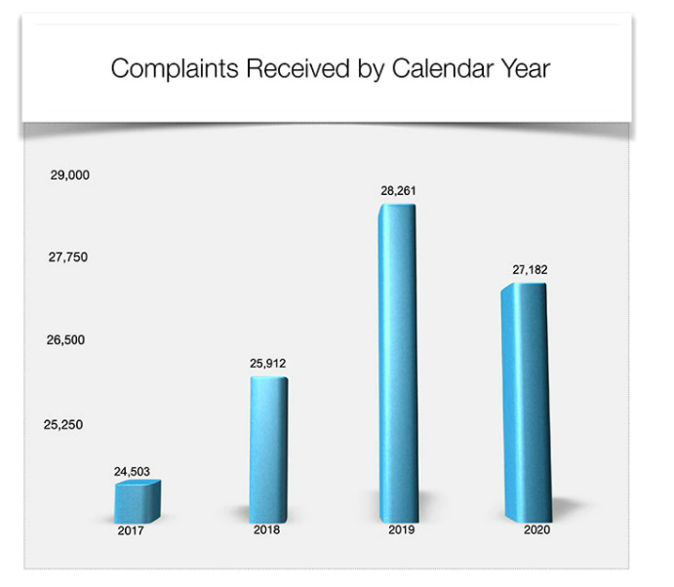
HIPAA Enforcement – Current Climate
Complaints and OCR enforcement activities have increased in recent years.

Slide 74
HIPAA Enforcement – Current Climate
2019 HIPAA Right of Access Initiative
Purpose: enforce patients’ right of access to their own health information in a timely, reasonable manner.
Not a new concept or rule, but a new focus of enforcement.
20 settlements reached since 2019
Penalties ranging from $3,500 to $200,000.

Slide 75
HIPAA Enforcement – Current Climate
Failure to perform adequate Security Risk Analysis
Increasingly common HIPAA violation often resulting in large settlements.
More on this to come as it dovetails neatly into our next and final topic: Cybersecurity

Slide 76
THE CURRENT HIPAA ENVIRONMENT
U.S. Department of Health and Human Services (HHS) announcement, June 26, 2012:
Alaska agreed to pay a $1.7 million penalty for “possible violations” of HIPAA following the theft of a portable hard drive from a car owned by an agency employee

Slide 77
HIPAA ENVIRONMENT
Massachusetts Eye and Ear Case
Theft of unencrypted laptop with health info of 3,600 patients
No HIPAA risk analysis, policies, etc.
“Long term institutional disregard” re: HIPAA
$150,000 fine paid

Slide 78
HIPAA Fines and Penalties
April 2014: $1.7 million  Concentra
May 2014: $4.8 million  NY Presbyterian Hospital
June 2014: $800,000  Parkview Health Systems
August 2014: 18 mo prison  Joshua Hippler

Slide 79
HIPAA Fines and Penalties
$275,000  Shasta Regional Medical Center
$1.7 million  Wellpoint
$1.2 million  Affinity Health Plan
$400,000  Idaho State University
$1.7 million  State of Alaska

Slide 80
HIPAA Fines and Penalties
$2.5 million  North Memorial Health System in Minnesota
$3.9 million  Feinstein Institute for Medical Research

Slide 81
OCR Chief Regional Counsel:
“We have collected over $10 million in fines under HIPAA .
You ain’t seen nothing yet . . .”

Slide 82
Cybersecurity – Current Concerns

Slide 83
HIPAA Security Rule – The Basics
Covered entities must:
1. Ensure the confidentiality, integrity, and availability of ePHI;
2. Identify and protect against reasonably anticipated threats to the security or integrity of the ePHI;
3. Protect against reasonably anticipated, impermissible uses or disclosures; and
4. Ensure compliance by their workforce.

Slide 84
HIPAA Security Rule – The Basics
Security Rule is meant to be flexible and scalable, requiring the covered entity to consider:
Its size, complexity, and capabilities;
Its technical, hardware, and software infrastructure;
The costs of security measures; and
The likelihood and possible impact of potential risks to ePHI.

Slide 85
Risk Analysis Requirement
Definition: “Conduct an accurate and thorough assessment of the potential risks and vulnerabilities to the confidentiality, integrity, and availability of electronic protected health information held by the covered entity or business associate.”
OCR Guidance – 9 elements a risk analysis must incorporate
Must be documented
Must occur “regularly” (at least annually) and be modified in a changing environment.

Slide 86
3 Types of Security Safeguards
1. Administrative Safeguards
2. Physical Safeguards
3. Technical Safeguards
For each type, the Rule identifies various security standards.

Slide 87
University of Rochester Medical Center (URMC)
PHI was impermissibly disclosed through the loss of an unencrypted flash drive and theft of an unencrypted laptop
$3 million settlement with OCR
OCR investigation made the following findings:
Failure to conduct an enterprise-wide risk analysis;
Failure to implement security measures sufficient to reduce risks and vulnerabilities;
Failure to utilize device and media controls; and
Failure to employ a mechanism to encrypt and decrypt ePHI

Slide 88
University of Texas M.D. Anderson Cancer Center
$4.3 million civil monetary penalty based on a stolen unencrypted laptop and loss of two unencrypted USB thumb drives.
However, a federal court of appeals vacated the penalty in a rare rebuke of HHS enforcement power, ruling that:
The Encryption Rule requires only that that the covered entity have “a mechanism” for encryption, and because M.D. Anderson had a “mechanism” for encryption, no violation.
A covered entity does not violate the Disclosure Rule anytime it merely loses control of ePHI. A violation requires an affirmative act of disclosure, not a passive loss of information.
Court was also critical of the size of the monetary fine and how it was calculated.

Slide 89
Takeaway from URMC & M.D. Anderson cases
Encrypting the laptops and flash drives likely would have decreased or altogether avoided the monetary fines.
The key issue in both cases was not necessarily that ePHI was stolen or lost, but rather whether the entities had implemented the required policies and procedures.

Slide 90
Current Cybersecurity Concern – Ransomware Attacks
Malicious software used by hackers to lock or encrypt the data stored on your computer or other electronic device, rendering your data unusable.
Hackers typically demand a ransom payment in exchange for their encryption key.
Often happens when victims mistakenly download malware through email attachments or links from unknown sources — which happen to be hackers

Slide 91
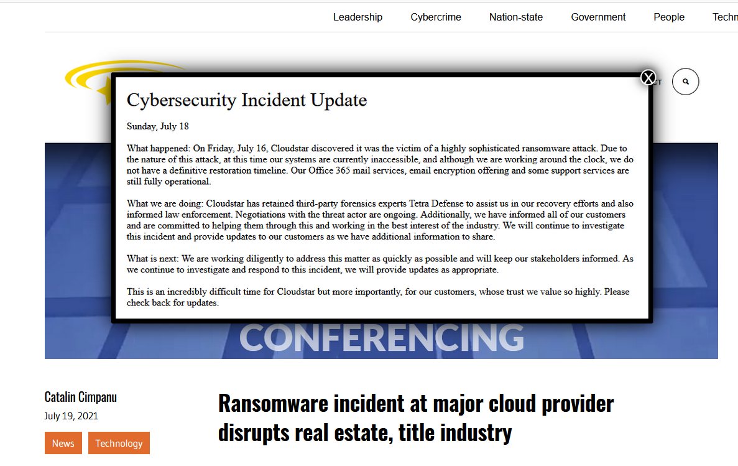
Ransomware Attack – July 2021

Slide 92
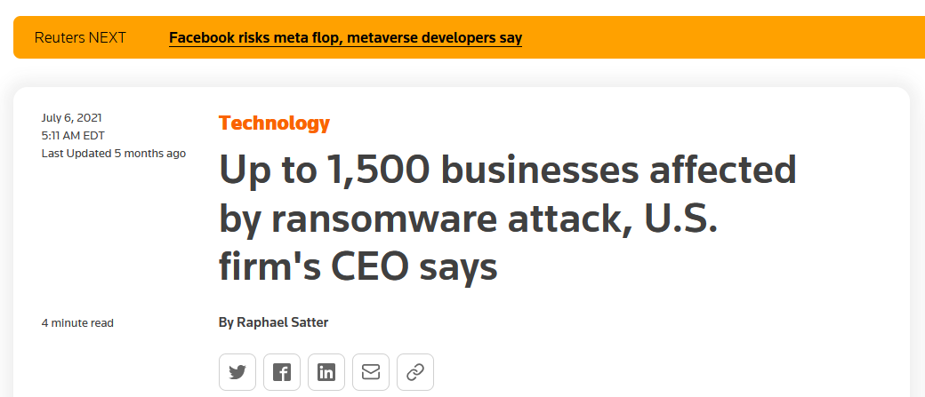
Ransomware Attacks – July 2021

Slide 93
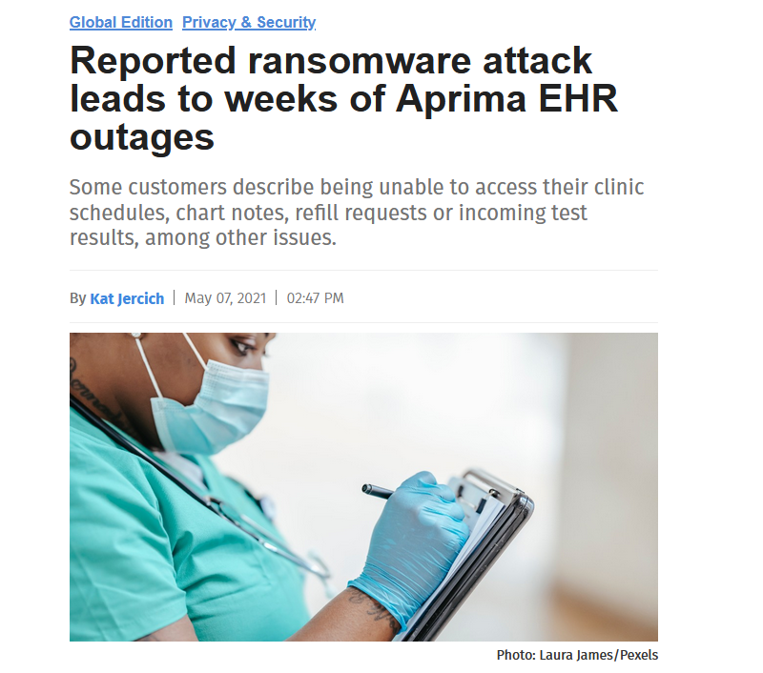
Ransomware Attacks – May 2021

Slide 94
Ransomware Attacks – September 2021

Slide 95
This is the new normal
These headlines are just the tip of the iceberg
You are at risk
If you are not prepared for downtime, your patients and your practice will suffer
Now is the time to start preparing

Slide 96
Downtime Contingency Planning
Requires doctors to plan for things they can anticipate happening
Doctors must do their best to continue to serve patients even when they do not have access to their computer systems.

Slide 97
Business Associate Agreements
Do you have a Business Associate Agreement (BAA)with everybody you share data with.
The BAA requires that the Business Associate to communicate with you when there is a problem
The BAA requires the Business Associate to treat your data with the proper security to protect your data.

Slide 98
Uptime Guarantees (Service Level Agreements)
What types of guarantees have your Business Associates provided related to their systems being available?
Do they have the insurance in place to recover from a disaster? Or to pay for damage they have caused to their clients (like you)?
If a Business Associate goes out of business and they have your data, you may lose your data – yes, this has happened to medical records in the past.

Slide 99
Insurance your BAA should have (ask them)
Business Interruption Insurance
Cyber Security Insurance
Errors and Omissions Insurance
General Liability Insurance

Slide 100
Does your contract or BAA reimburse you?
If something happens at your Business Associate that results in costs or liabilities to your practice, is the Business Associate required to cover your costs?
Does their insurance protect you as a client?
Probably Not
So, you need to have your own insurance to protect yourself.

Slide 101
Thank You

Slide 102
For more information, contact:
J. Kevin West 208.562.4908 kwest@parsonsbehle.com

