Slide 1
Alternative Vision Correction Options: SMILE+
Benjamin Buckner MD
Hoopes Vision Correction Center
Draper, UT

Slide 2
How many eye doctors does it take to change a light bulb?
One, or two?

Slide 3
Isn’t it gratifying to help people see?
Behind some ecclesiastic-cultural and familial points, helping people see is my great joy!
Don’t true passions win some opposition?
Curmudgeons, threat of law suit, Zenni, 1800Contacts
Helping people SEE brings the joy, makes EVERYTHING worth it!
First glasses MRx, first CLRx
https://www.youtube.com/watch?v=plCOPfl8Tgo

Slide 4
Kansas City Chiefs
Phil Hoopes, Sr
Parents moved to Kansas City, age 16
Thriving practice in Kansas City before “retirement”
First spherical and astigmatic PRK in USA performed at his practice
He did the first astigmatic PRK in USA
Phil Hoopes, Jr
Raised in Kansas City
Went to BYU, but prefers KU basketball
Ben Buckner
Did residency @ Mizzou

Slide 5
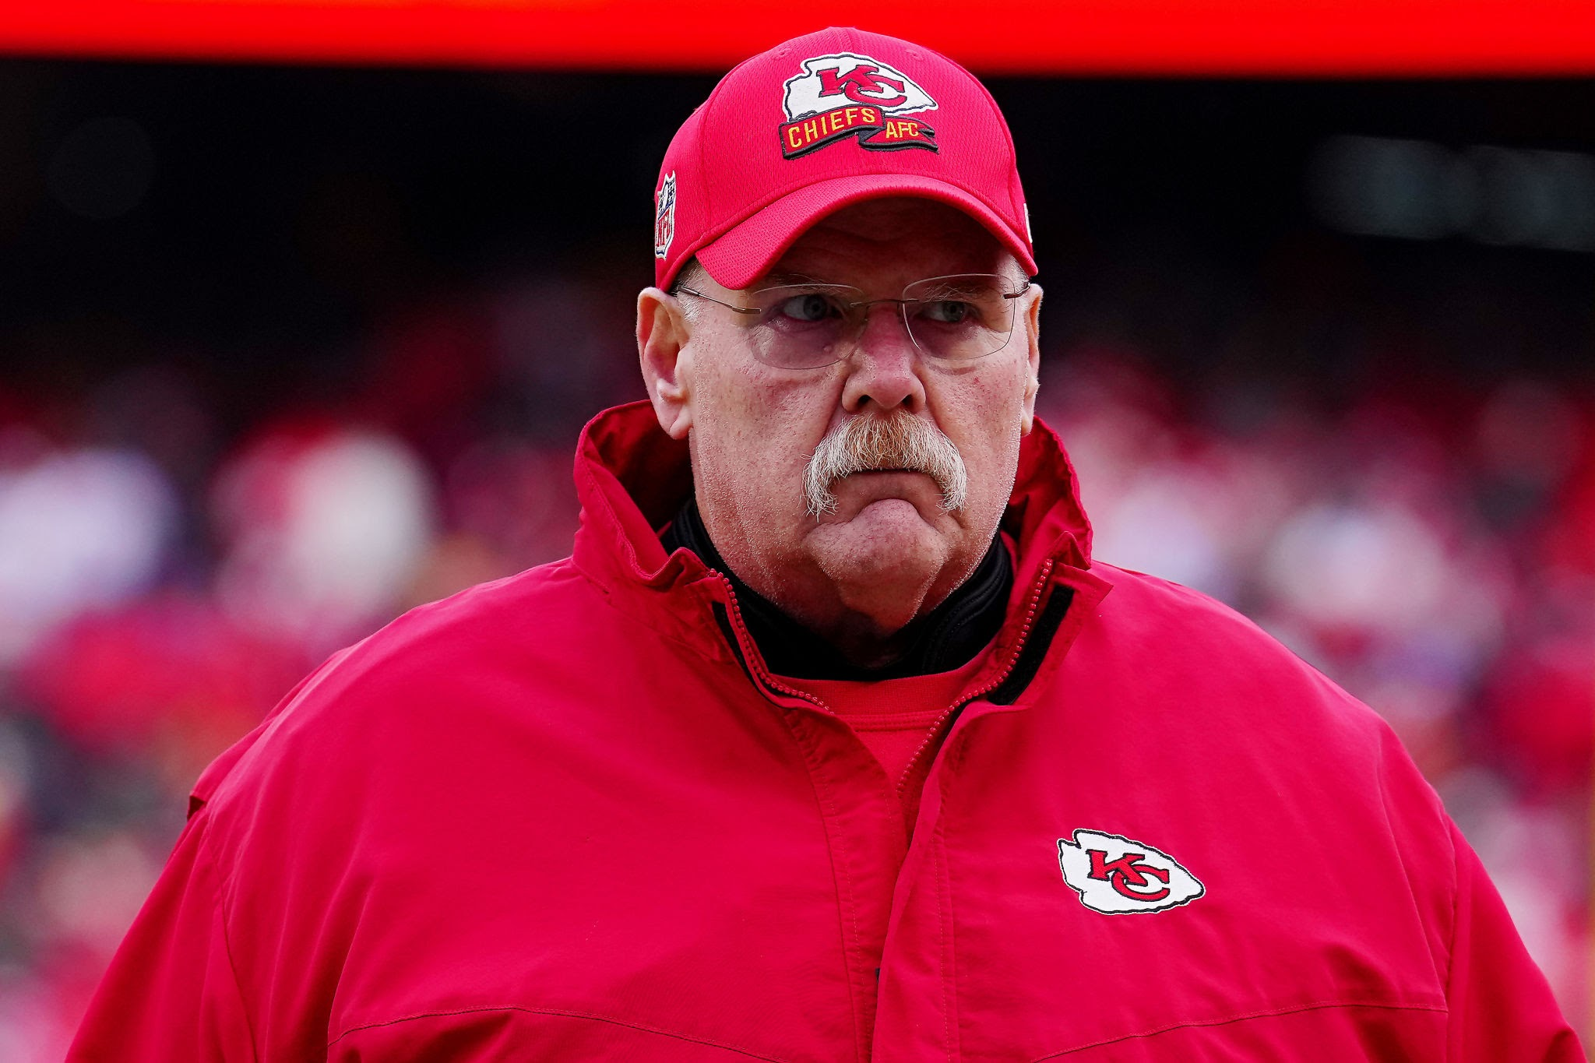
Andy Reid, Kansas City Chiefs head coach
Attended college at BYU
Won 2 Lombardi trophies

Slide 6
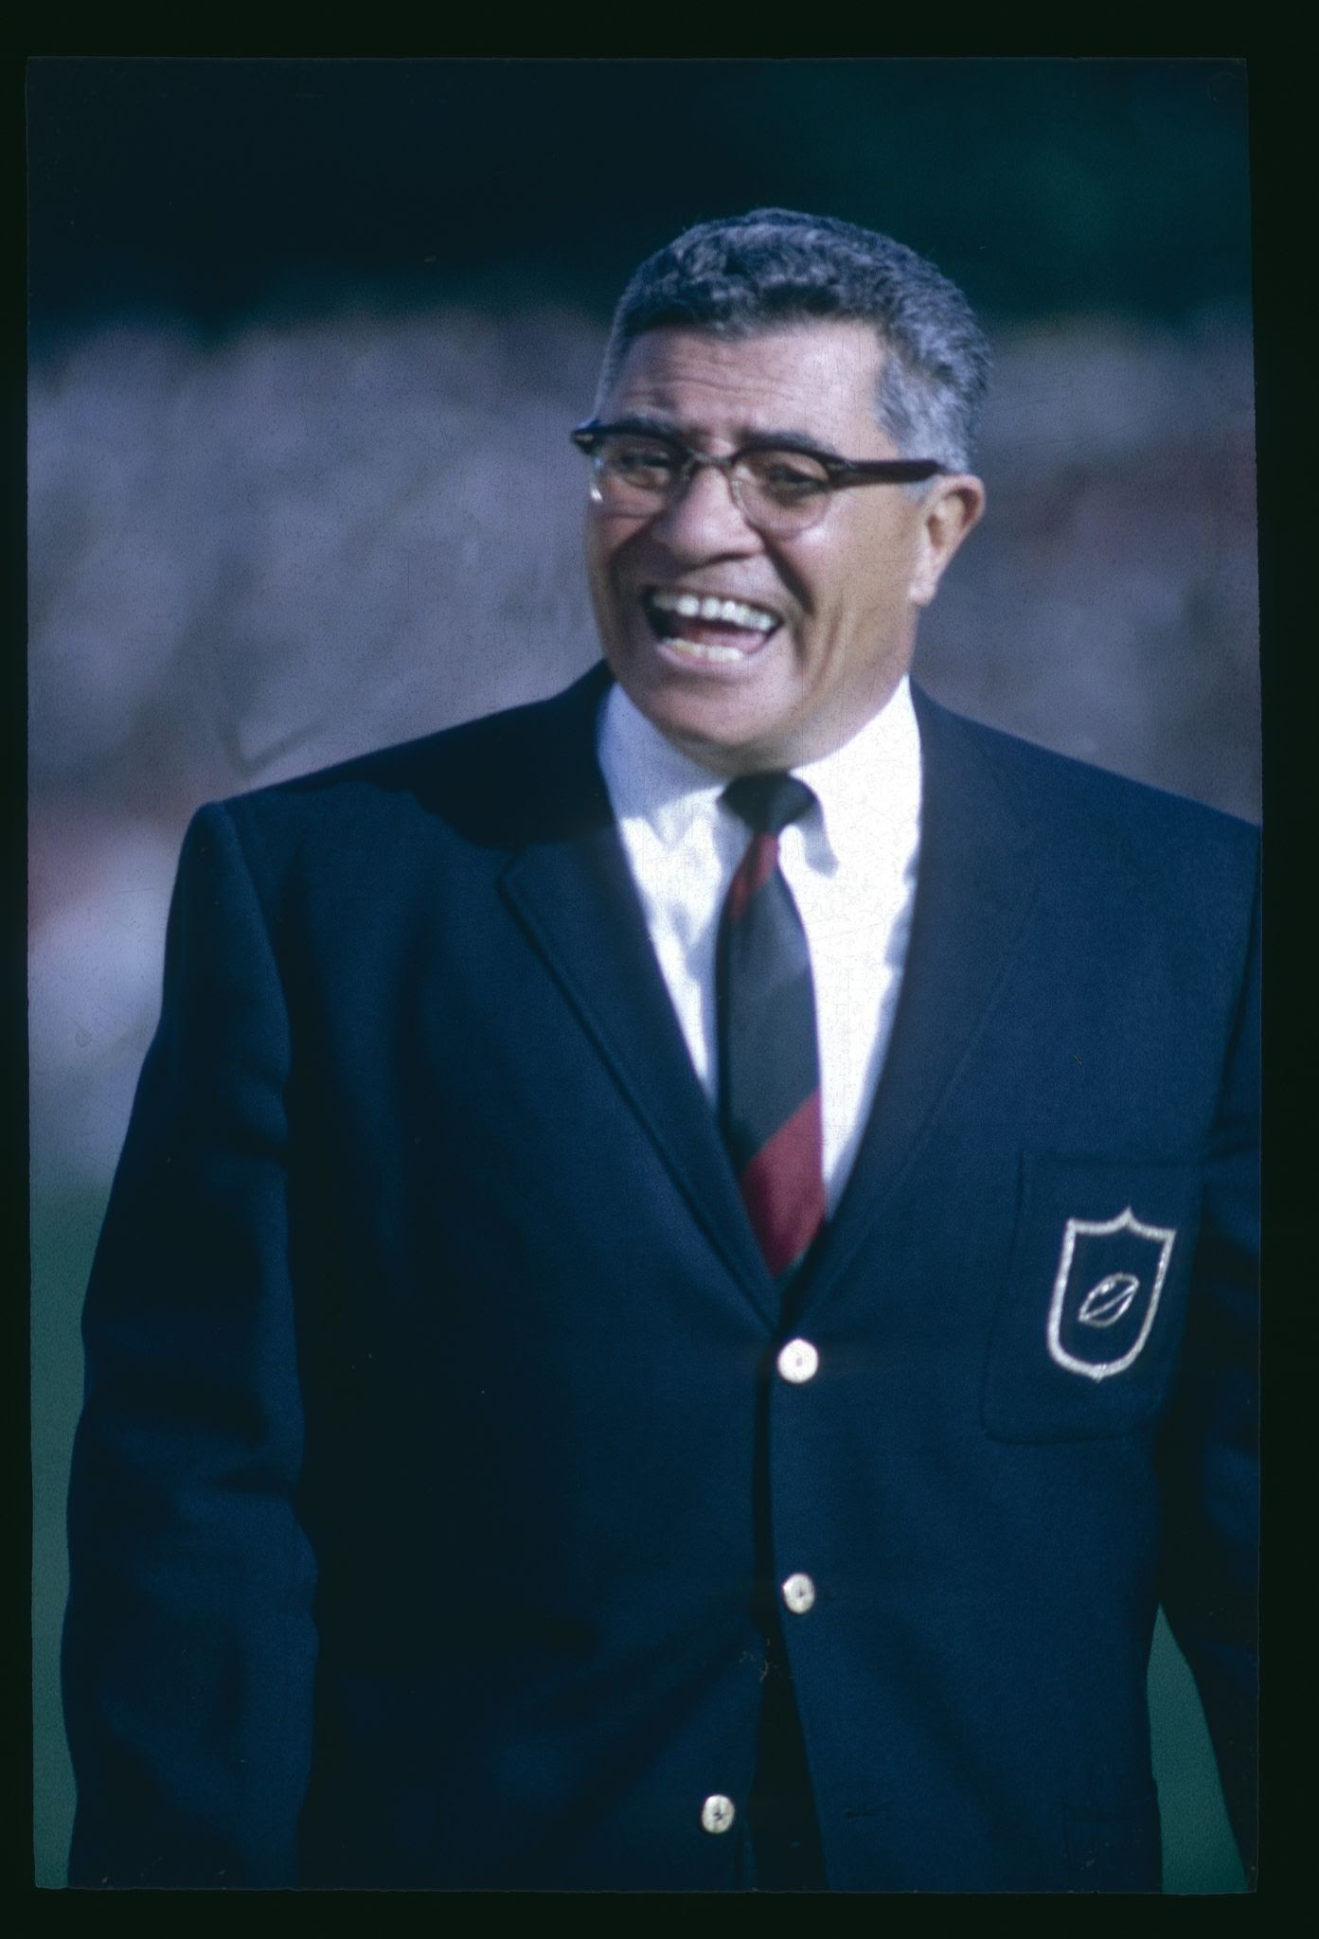
“Gentlemen, this is a football”
Vince Lombardi (1913-1970)

Slide 7
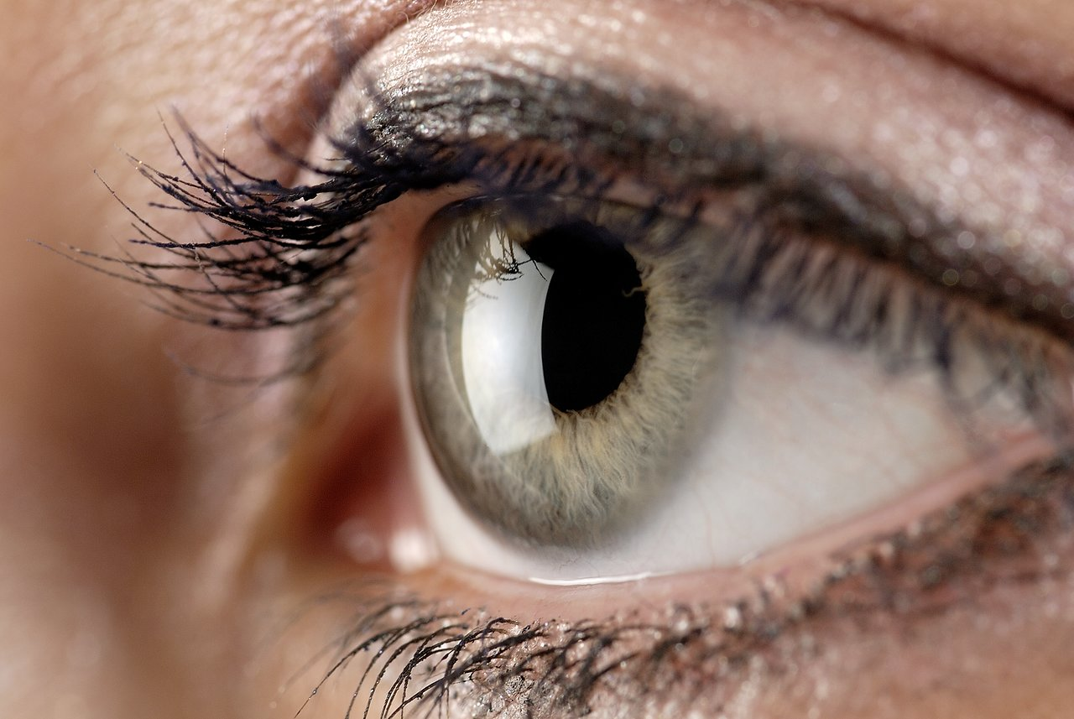
“Ladies and gentlemen, this is an eye”

Slide 8
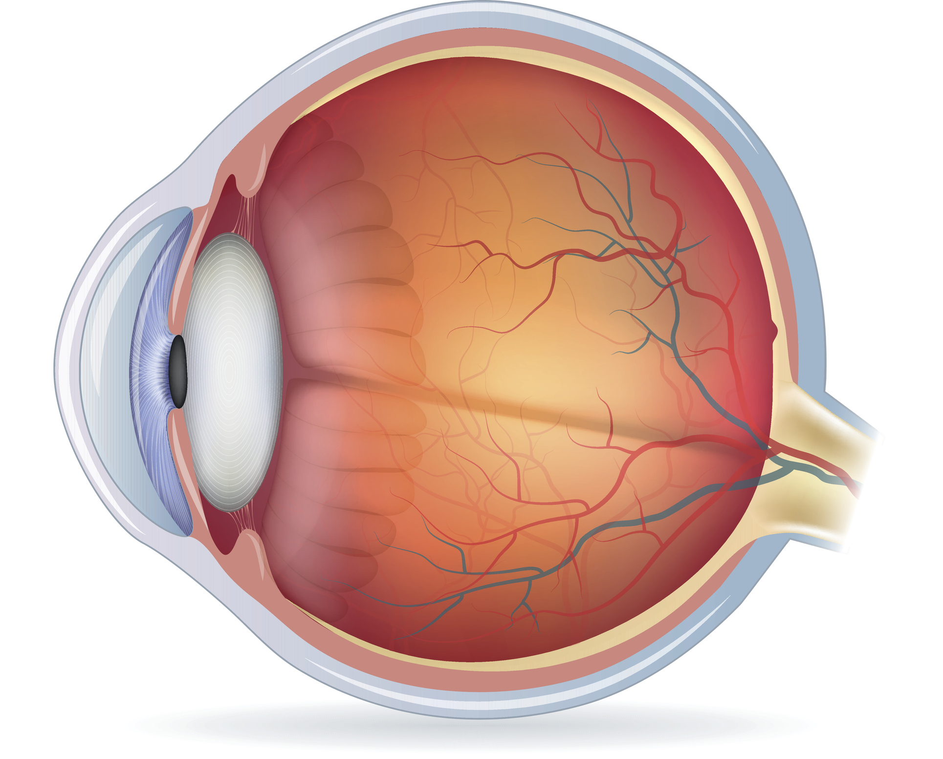
1 inch, ¼ oz

Slide 9
Eyelids
Blink around 325,000,000 times in a lifespan
Eyelashes that protect the cornea
Tarsal (meibomian) glands for corneal lubrication
Give hints about eye surface health
Irreplaceable and indispensable

Slide 10
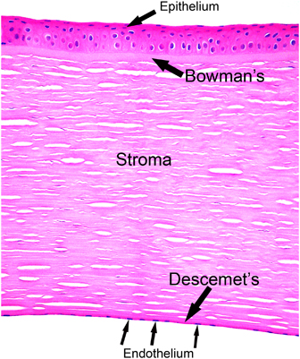
Cornea
5 major layers
Beautiful collagen organization
Just over 1/2mm thick
Remarkably strong

Slide 11
You are super!

Slide 12
Anterior chamber
Aqueous humor
Clear, less protein than serum

Slide 13
Iris
Auto-adjusts for ambient light levels
Constricts when looking up close to aid in focus
Gives a smaller pupil as ageing ensues, assisting to offset presbyopia

Slide 14
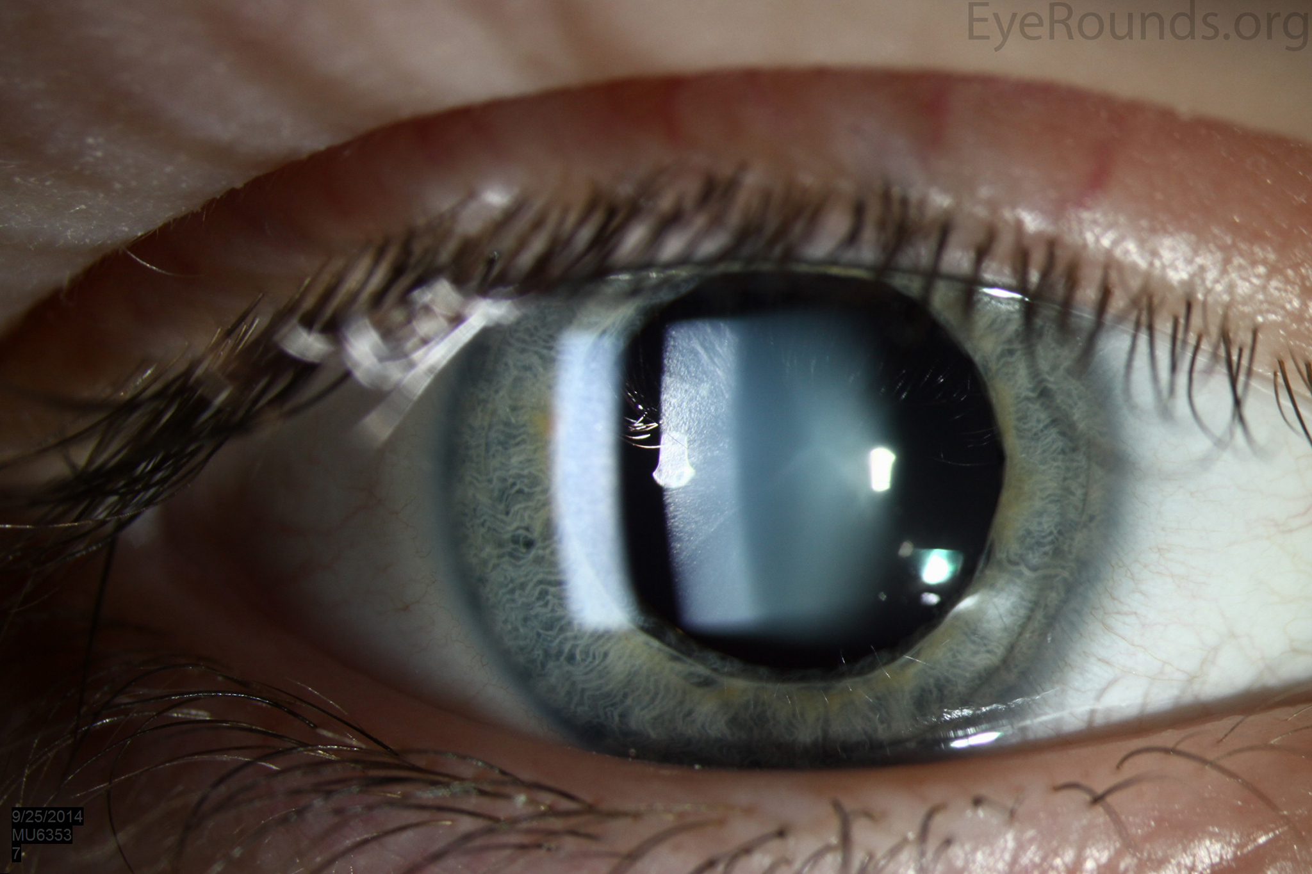
Lens
Auto-focuses to objects at different distances
Protects the retina from harmful UV rays
Scavenges free radicals, protecting the eye

Slide 15
Vitreous
Protects the lens from oxidative damage
Vitrectomized eyes develop cataracts much faster since serous fluid allows more easily for oxygen diffusion from the choroid

Slide 16
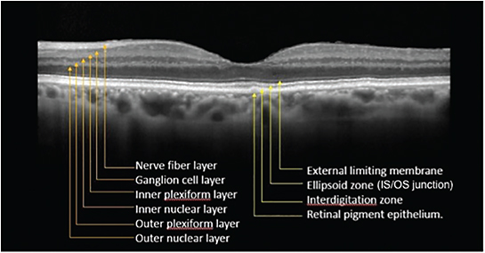
Retina
Senses light, color, form/shape and movement

Slide 17
Choroid
Nourishes and supports the retina
Heat sink

Slide 20
SMILE animation
https://www.youtube.com/watch?v=_HrAz0nZG14&t=34s

Slide 21
Celebrity patients…

Slide 22
SMILE’s niche
3 + diopters myopia, +/- astig
Better than LASIK/PRK in Mild dry eye syndrome
Better than LASIK if evidence of mild corneal weakening
Excellent for very active individuals who formerly would have had PRK
Athletes, boxers, MMA fighters
Used successfully s/p Bell palsy, etc

Slide 23
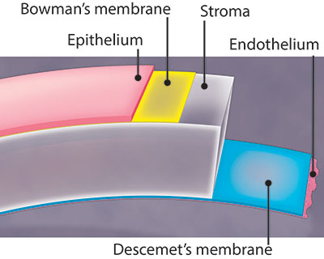
Advantages of SMILE
Majority of anterior corneal nerve plexus is preserved
LESS DRYNESS (We live in Utah) than LASIK
Bowman’s membrane and anterior stroma are preserved
STRONGER CORNEA post-surgery than LASIK
NO FLAP TO DISLODGE
Lower rates of ectasia than LASIK
PRK vaporizes strongest part of cornea
Epithelium left intact
FASTER HEALING than PRK

Slide 24
Disadvantages of SMILE
SMILE IS NEWER
FDA approved in 2016 (2018 for astigmatism) vs 1996 for LASIK
Manual centration of the apparatus
Decentered treatment possible
SLOWER VISUAL RECOVERY THAN LASIK
Not able to use topographical guidance (to reduce HOAs)
Difficult to treat < 3 diopters myopia
Is it less accurate than LASIK/PRK?
Some studies show a miniscule but measurable decrease in final UCVA compared to LASIK
Debatable significance

Slide 25
Complications of SMILE
Refractive error
PRK, Circle
Epithelial abrasions
Loss of suction/conversion to PRK
Rare
Residual lenticule pieces
Rare
Others

Slide 27
Randomly selected SMILE Case Review
26 yo M
MRx
OD -6.50 - 050 x030 20/20
OS -5.50 - 2.75 x175 20/20
Soft contact lens wearer X10 years
Schirmer (5 min)
OD 29mm
OS 35mm
Exam: normal, other than c/d ratios 0.65 OU, with excellent health

Slide 28
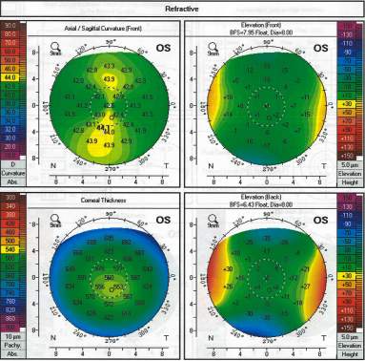
Pre-operative tomography

Slide 29
Other details
Anterior chamber depth: 3.6mm OU (plenty of room for ICL)
No amblyopia despite amblyogenic cylinder OS
Lives in Utah (occasionally difficult climate for eye surface health)

Slide 30
What is he a candidate for?
SMILE
Yes
LASIK
Yes PTA 38% OS w/6.0mm optical zone (advised to keep PTA <40%)
PRK
Yes
ICL
Yes
CLEX
No

Slide 31
Discuss with patient options, RBA
He chose SMILE
No flap, preservation of nerve plexus (less dryness), faster healing than PRK, safer than ICL (and less expensive)

Slide 32
1:00 & 3:56 & 4:55

Slide 33
1 Day post-op
OD feels gritty
OS feels fine
OD 20/25-2
OS 20/20-
A few precipitates seen in interface OD
RTC 1 month

Slide 34
1 Month post-op
Good ocular comfort OU
Vision is “Great!”
OD 20/20
OS 20/20-
OU 20/15
Exam: trace interface debris OD (likely steroid precipitate)
Visually insignificant, macrophages clean
Used to irrigate out, but found that visual recovery is faster with less edema induced

Slide 35
What are eye doctors doing?
Granting people freedom
How many people need your services to drive?
How many pilots can fly because of you?
Helping people see better now
Preserving and protecting sight for later
Same goals, same hopes

Slide 36
Random SMILE case pull #2
36 yo F
MRx
OD -3.25- 3.50 x088 20/20
OS -3.75 – 3.25 x090 20/20
Works in law enforcement: possibility of eye trauma in future
Schirmer (5 min)
OD 30mm
OS 30mm
Exam: normal OU

Slide 37
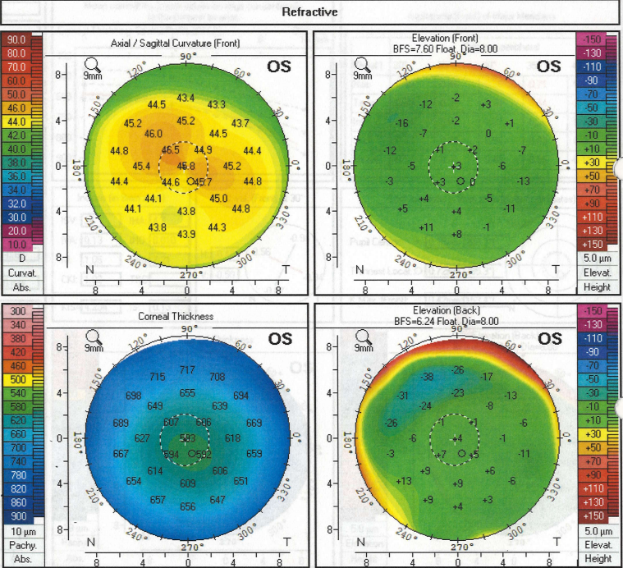
Pre-operative tomography

Slide 38
Other Details
Thick corneas
ATR cylinder
Anterior chamber depth 3.0 OU (room for ICL)

Slide 39
Discussion of RBA
ATR cylinder
LASIK risk of ectasia: 1/1000 PRK/SMILE: 1/4000-1/5000
Ectasia diagnosed on average around year 4-5 post-op
Law enforcement: trauma possible
ICL carries increased cataract and glaucoma risk
LASIK flap complications are rare, but she is higher risk
She chose SMILE

Slide 40
1 Day post-op
“I can see!”
OD 20/30
OS 20/40-
OU 20/25
Loose epithelium near SMILE entrance OD during surgery: BCL removed today
2+ SPK OS
Return 1-2 weeks for dryness

Slide 41
10 Day post-op
No pain
Mild dryness OU
Vision is “Amazing!”
OD 20/20
OS 20/20-
OU 20/20
Exam: trace interface debris OU (common/expected in SMILE as we do not irrigate it out, we let the macrophages remove it)

Slide 42
PRK randomly pulled case
29 yo F
MRx
OD -1.50 - 0.50 x167 20/20
OS -1.00 - 0.75 x004 20/20
Graphic designer
Schirmer
OD 13mm
OS 12mm
Exam: normal OU

Slide 43
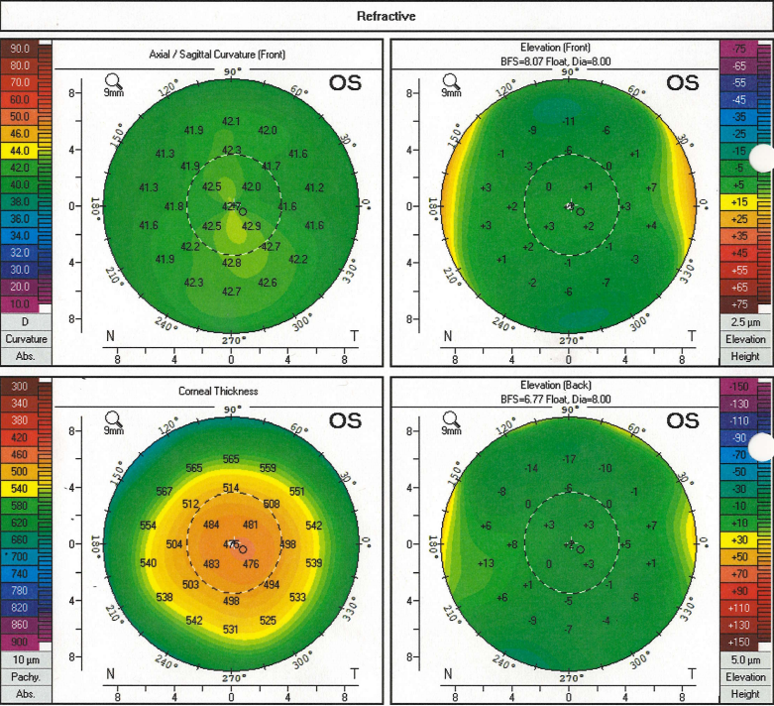
Pre-operative tomography

Slide 44
Important points
Lower than average Schirmer (dryness possible), works on computer
Thin pachymetry: 470s OU
Mild inferior steepening is insignificant and does not flag
Regularity stronger indicator of strength than is pachymetry
Well under the 3 diopters of myopia preferred in SMILE cases
Higher risk of lenticular remnants in lower corrections
Only reasonable surgical option: PRK

Slide 45
1 Day post-op
“Pretty good, but a little blurry”
Mild discomfort (are women tougher than men?)
OD 20/40
OS 20/40
OU 20/25
Bandage lenses in place OU
Return 1 week

Slide 46
1 Week post-op
“Really Good”
Mild dryness
OD 20/20
OS 20/40
OU 20/20-
Bandage lenses removed OU
Return 3 weeks

Slide 47
1 Month post-op
Vision “The best” OU “I’m so happy with it!”
Mild dryness
OD 20/20
OS 20/25-
OU 20/20-
Epithelium clear OU, exam normal
3 month post-op exam pending
81 days to proper healing s/p PRK, occasionally longer in Utah or in older patients
4 weeks is fastest I’ve seen eyes be perfect after PRK (my friend’s eyes, thank goodness)

Slide 48
The Future
Automatic or adjustable pupil centration
Must manually center eye on laser interface currently (decentered corrections possible)
In combination with corneal crosslinking
Inject riboflavin into the pocket, then irradiate with UV light
Oxygen delivery issues?
Improved laser energy allowances → easier dissections
BB’s hopes for SMILE
Better energy delivery: SILK (1st SILK in USA performed at HVCC in February)
Topography guided treatments to reduce HOAs

Slide 49
Randomly pulled Cross-linking case
42 yo M requests LASIK
UCDVA
OD CF2’
OS 20/60-
UCNVA
OD >J10
OS J2
Electrician
MRx
OD +1.00 - 8.00 x 086 20/50-
OS +1.00 - 3.75 x 089 20/20-

Slide 50
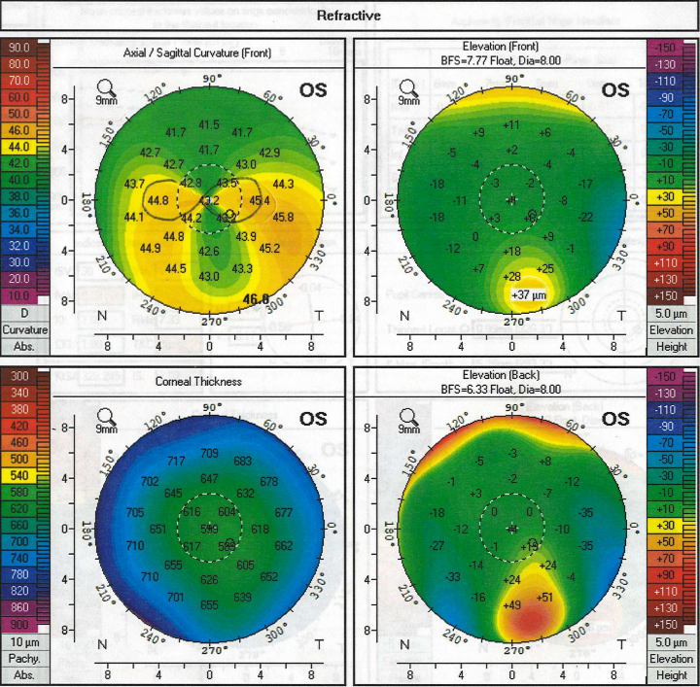
Randomly pulled Cross-linking case

Slide 51
CXL performed OD
Only approved corneal crosslinking in the USA is now owned by Glaukos
Expensive, but can bill to insurance
Our cost on Riboflavin alone: > $3100/eye
Unapproved methods of crosslinking in the USA have been shown to be safe in Europe (good genetic approximation of the Wasatch Front) and elsewhere, but providers who perform or refer for this carry additional legal exposure and medical insurance cannot be billed.

Slide 52
Patient elected to wait on OS
Good to treat all newly diagnosed KCN with CXL
Exceptions exist—OK to counsel together and use best judgement with GREAT FOLLOW-UP

Slide 53
Time for a scleral contact lens OD
Remarkable outcomes achieved with sclerals
More lifechanging than LASIK BECAUSE good LASIK candidates see great with glasses or soft contact lenses.
Thank you kindly to those of you who offer treatments for difficult cases!

Slide 54
Future of Crosslinking
Topography-guided
Can reduce HOAs, decrease Kmax, shrink the cone
Improve UCVA and BCVA
In study
Unapproved methods of crosslinking may get approved for treating corneal ulcers, allowing off-label status for more affordable CXL options.

Slide 55
Video in real time of SMILE
https://eyetube.net/videos/real-time-relex-smile-procedure-using-the-visumax-femtosecond-laser
Notice: FDA has stringent rules re: SMILE energy parameters in the USA. This video is in London, England where dissection and lenticule removal are frankly easier and smoother than in the USA due to more liberal laser energy use parameters.

Slide 56
Demonstrations of femtosecond lasers in other applications
https://www.youtube.com/watch?v=69n4lzw2JUQ

