Slide 1
Shooting Pearls: SLT, LPI, and YAG Capsulotomy
Spencer D. Johnson, O.D., F.A.A.O
Oklahoma College of Optometry
johns137@nsuok.edu

Slide 2
Selective Laser Trabeculoplasty

Slide 3
Selective Laser Trabeculoplasty
Indications:
Ocular Hypertension (can SLT be used as first-line therapy?)
Desire to reduce number of topical medications
Topical medications not effective
Non-compliance with topical medications

Slide 4
Selective Laser Trabeculoplasty
Determining who is a good candidate:
Higher vs. lower pre-treatment IOP
Current topical regimen

Slide 5
Selective Laser Trabeculoplasty
Major Studies on SLT vs. drops:
2004 Lai, et. al.
2005 Nagar, et. al.
2006 McIlraith, et. al.
2009 Nagar, et. al.
2012 Katz, et. al.
2019 Gazzard, et. al.

Slide 6
Selective Laser Trabeculoplasty
The 5 studies were analyzed by Li, et. al. and published in 2015
“Conclusions: Both SLT and topical medication demonstrate similar success rates and effectiveness in lowering intraocular pressure in patients with open-angle glaucoma.”

Slide 7
Selective Laser Trabeculoplasty
Gazzard et. al., 2019, Selective laser trabeculoplasty versus eye drops for first-line treatment of ocular hypertension and glaucoma (LiGHT)
At 36 months, 74.2% of patients in the selective laser trabeculoplasty group required no drops to maintain intraocular pressure at target
Glaucoma surgery was required in 11 patients in the eye drop group, but none in the SLT group
Notes:
356 in the SLT group
363 in the eye drop group

Slide 8
Selective Laser Trabeculoplasty
Gazzard et. al., Selective laser trabeculoplasty versus eye drops for first-line treatment of ocular hypertension and glaucoma (LiGHT)
“Interpretation: Selective laser trabeculoplasty should be offered as a first-line treatment for open angle glaucoma and ocular hypertension, supporting a change in clinical practice.”

Slide 9
Selective Laser Trabeculoplasty
At the 2018 ARVO Meeting, Gandolfi et. al. presented the long term results of their low power SLT vs conventional SLT and ALT study
Group 1: 360° low power SLT (0.4 mJ, 50-60 spots), repeated annually
Group 2: 360° conventional SLT, (70-80 spots, power increased from 0.5 mJ stepwise until an “air-bubble” was obtained; then, the power was lowered by one energy step) to be repeated PRN
Group 3: 360° ALT, (50 m spot, 0.5 – 0.8 W, 70-90 spots) performed once, with no re-treatments allowed

Slide 10
Selective Laser Trabeculoplasty
Gandolfi et. al.:
10 years after treatment, percentage of each group that did not require medication:
58% (Group A)
25% (Group B)
23% (Group C)

Slide 11
Selective Laser Trabeculoplasty
Gandolfi et. al.:
Meantime to medication was:
6.2 years (Group A)
3.2 years (Group B)
2.8 years (Group C)

Slide 12
Selective Laser Trabeculoplasty
Gandolfi et. al.:
Conclusions: An SLT low-power treatment / re-treatment schedule, timed yearly, performed better than both a conventional SLT PRN schedule and an ALT in
(a) delaying the need for medications and
(b) medication requirement to control IOP in OAG eyes

Slide 13
Selective Laser Trabeculoplasty
In light of these finding, a pair of multicenter randomized trials to evaluate outcomes of SLT performed annually at low energy are currently in the pre-enrollment phase
These trials—collectively named the Clarifying the Optimal Application of SLT Therapy (COAST) trial—were funded in late 2020 by NEI to compare standard versus low-energy primary SLT and annual versus pro re nata (PRN) repeat SLT

Slide 14
Selective Laser Trabeculoplasty
Advantages of SLT as a first-line treatment
Better compliance, leading to less IOP fluctuation
Patient convenience
Overall cost to the healthcare system

Slide 15
Selective Laser Trabeculoplasty
SLT vs. Latanoprost 1 year cost comparison:
CPT 65855, bilateral code, Medicare reimbursement: $250.53
Latanoprost 2.5 ml: $61.99
Approximately 14.6 bottles per year for bilateral therapy: $905.05

Slide 16
Selective Laser Trabeculoplasty
Consider:
SLT as first-line therapy
Low-power SLT repeated annually

Slide 17
Selective Laser Trabeculoplasty
Pre-procedure
IOP
Gonioscopy with focus on:
Most posterior structure seen in each quadrant
Degree of pigment in the trabecular meshwork
Brimonidine ~ 20 min prior to procedure

Slide 18
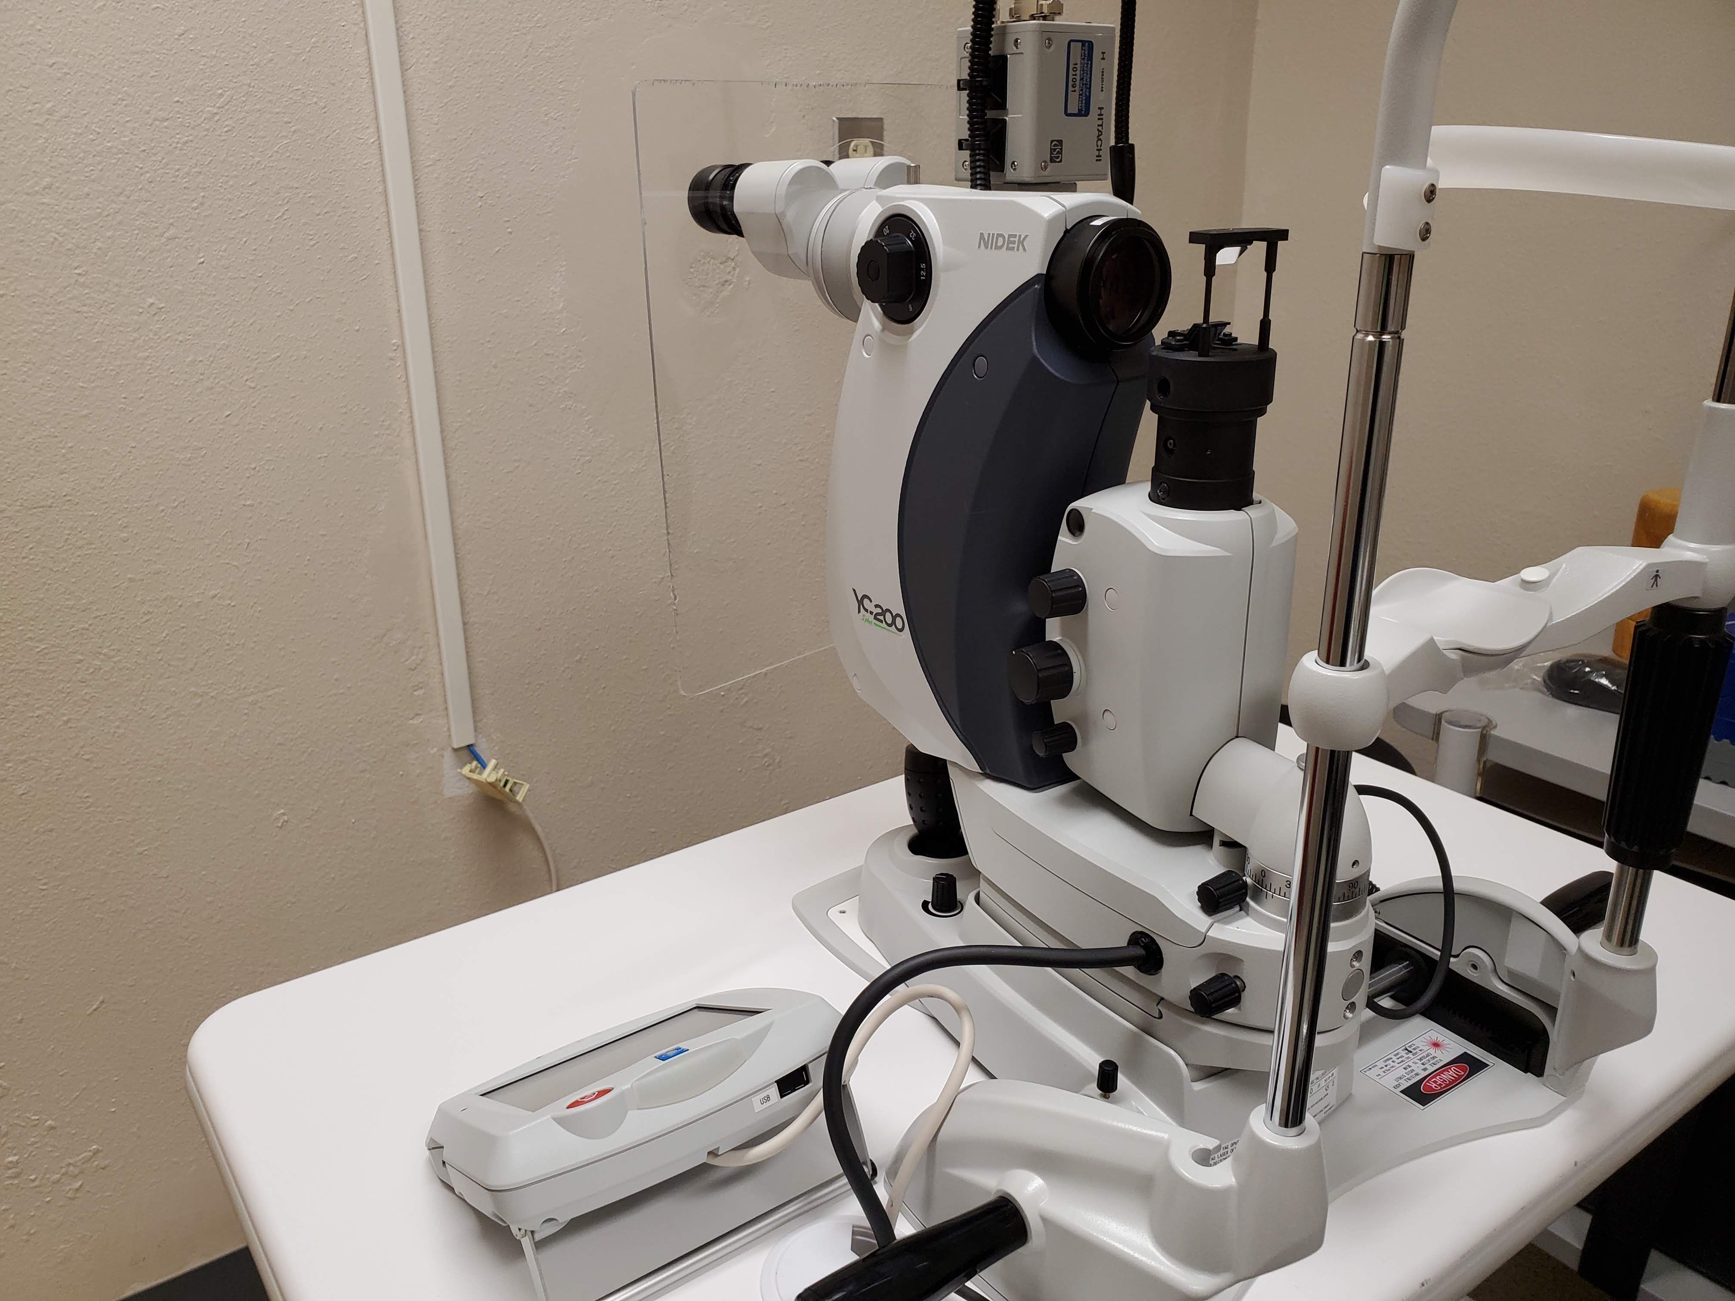
Selective Laser Trabeculoplasty

Slide 19
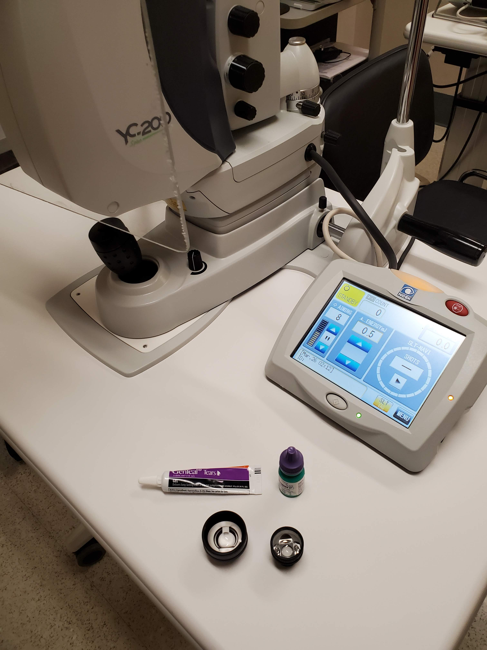
Selective Laser Trabeculoplasty

Slide 20
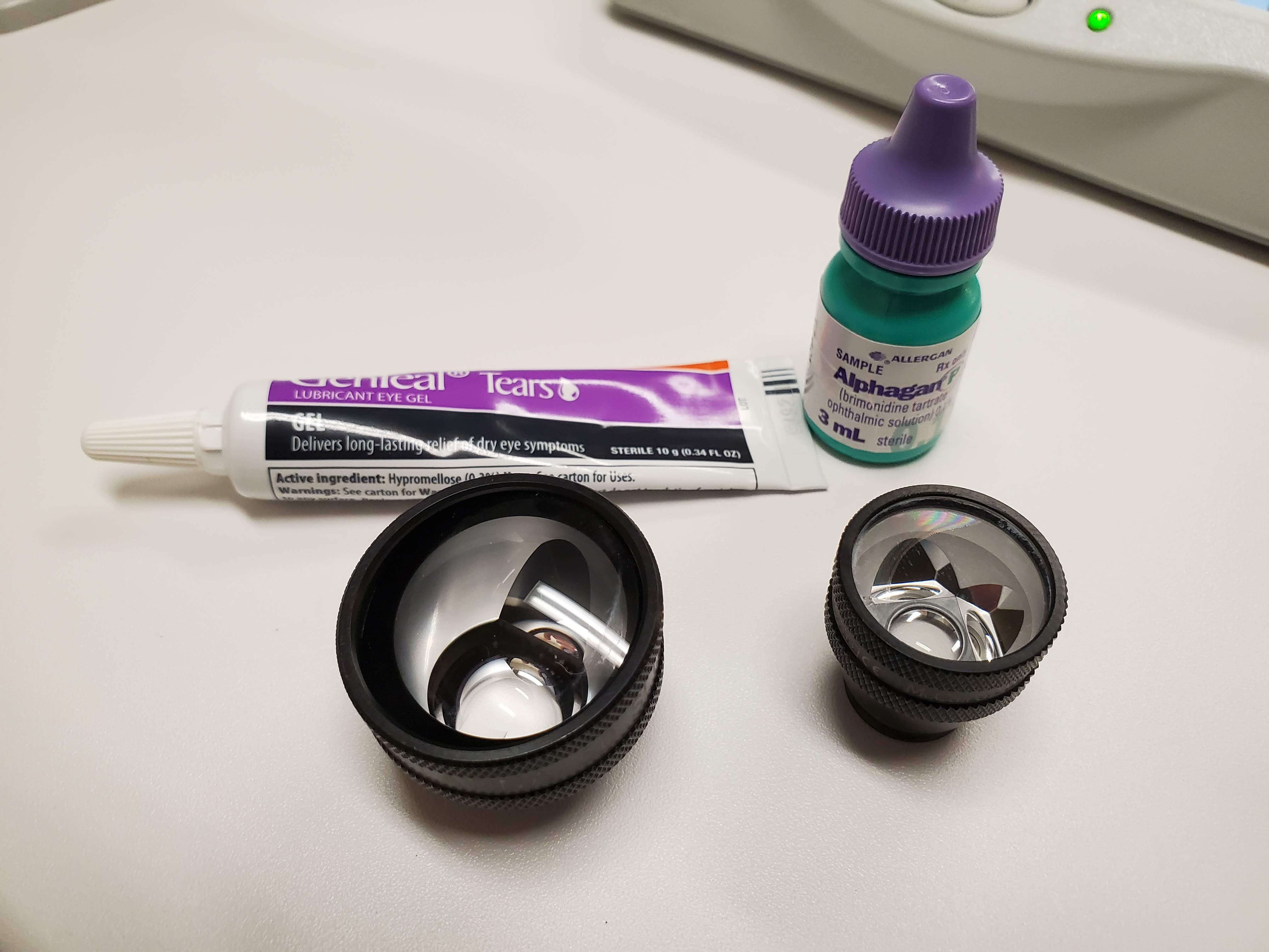
Selective Laser Trabeculoplasty
Notes:
Latina and McCall SLT lenses

Slide 21
Selective Laser Trabeculoplasty
Notes:
Latina and McCall SLT lenses

Slide 22
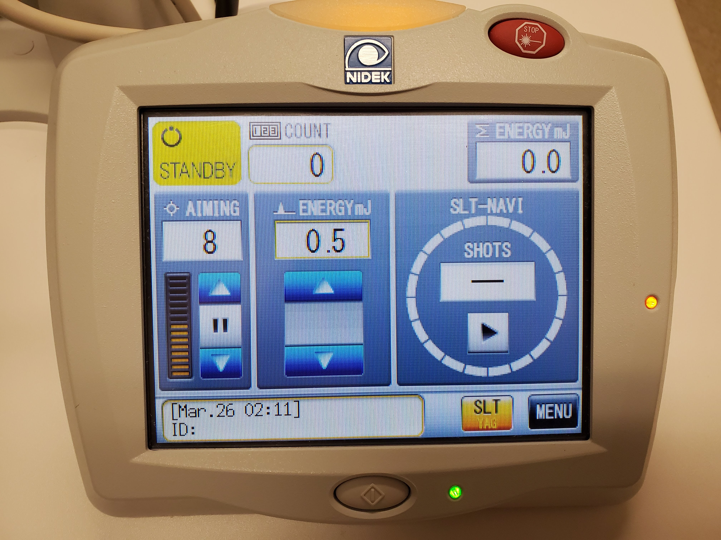
Selective Laser Trabeculoplasty

Slide 23
Selective Laser Trabeculoplasty
Procedure
Traditional
0.5-1.0 mJ titrated to first seen “champagne bubbles”, 100-120 shots, 360 degrees OU
Repeat PRN
Low Power
0.4 mJ, 50-60 shots, 360 degrees OU
Repeat annually

Slide 24
Selective Laser Trabeculoplasty
Post-procedure
Brimonidine immediately following procedure
IOP check, 20-60 minutes post procedure
Oral nsaids prn
1 week – check for inflammation and elevated IOP
6 weeks – monitor treatment efficacy

Slide 25
Laser Peripheral Iridotomy

Slide 26
Laser Peripheral Iridotomy
Indication
Acute angle closure
History of angle closure
Anatomically narrow angles
(1) Gonioscopy - trabecular meshwork not visible in 2 or more quadrants
(2) Angle measurement with anterior segment OCT is < 15 degrees

Slide 27
Laser Peripheral Iridotomy
Sowka, Review of Optometry, Dec 2020

Slide 28
Laser Peripheral Iridotomy
“Historically, the term narrow angle glaucoma has been used to connote eyes either at risk of impending angle closure or those actually experiencing it. Though this term is still used today, it is more appropriate to speak in current terms of angle closure and assign eyes to one of four categories.”
Sowka, Review of Optometry, Dec 2020

Slide 29
Laser Peripheral Iridotomy
Category I: pigmented TM not visible for 180⁰, no PAS, normal IOP, ONH, and VF
Category II: pigmented TM not visible for 180⁰, PAS and/or elevated IOP, ONH, and VF
Category III: pigmented TM not visible for 180⁰, PAS and/or elevated IOP, ONH damage and/or VF loss
Category IV: primary angle-closure attack
Sowka, Review of Optometry, Dec 2020
Notes:
PAS: peripheral anterior synechiae

Slide 30
Laser Peripheral Iridotomy
Category I: LPI or observation?
Category II: LPI recommended
Category III: LPI recommended
Category IV: LPI recommended
Sowka, Review of Optometry, Dec 2020
Notes:
PAS: peripheral anterior synechiae

Slide 31
Laser Peripheral Iridotomy He, et. al., Lancet 2019

Slide 32
Laser Peripheral Iridotomy He, et. al., Lancet 2019
889 bilateral primary angle closure suspects aged 50-70 years were enrolled
One eye of each patient was selected for treatment, and the other remaining untreated

Slide 33
Laser Peripheral Iridotomy He, et. al., Lancet 2019
The primary outcome was the incidence of primary angle closure by eyes by 72 months, defined as the composite of three study endpoints:
(1) intraocular pressure measurements above 24 mm Hg on two separate occasions
(2) development of at least one clock hour of peripheral anterior synechiae in any quadrant; or
(3) an episode of acute angle closure

Slide 34
Laser Peripheral Iridotomy He, et. al., Lancet 2019
Incidence of an angle closure event:
4.19 per 1000 eye-years in treated eyes
7.97 per 1000 eye-years in untreated eyes
This correlates to a 47% risk reduction in treated eyes, however:
The rate of developing any angle closure endpoint in primary angle closure suspects’ eyes was 1% per year

Slide 35
Laser Peripheral Iridotomy Azuara-Blanco, et. al., Lancet 2016

Slide 36
Laser Peripheral Iridotomy Azuara-Blanco, et. al., Lancet 2016
Eligible patients were aged 50 years or older, did not have cataracts, and had newly diagnosed primary angle closure with intraocular pressure 30 mm Hg or greater or primary angle-closure glaucoma
Patients were assigned to undergo clear-lens extraction or receive standard care with laser peripheral iridotomy and topical medical treatment
Interpretation: “Clear-lens extraction showed greater efficacy and was more cost-effective than laser peripheral iridotomy, and should be considered as an option for first-line treatment”

Slide 37
Laser Peripheral Iridotomy
Consider:
Monitoring patients with narrow angles and no other risk factors
Clear-lens extraction for older patients

Slide 38
Laser Peripheral Iridotomy
Pre-procedure
Brimonidine ~ 20 min prior to procedure
Pilocarpine 1%

Slide 39
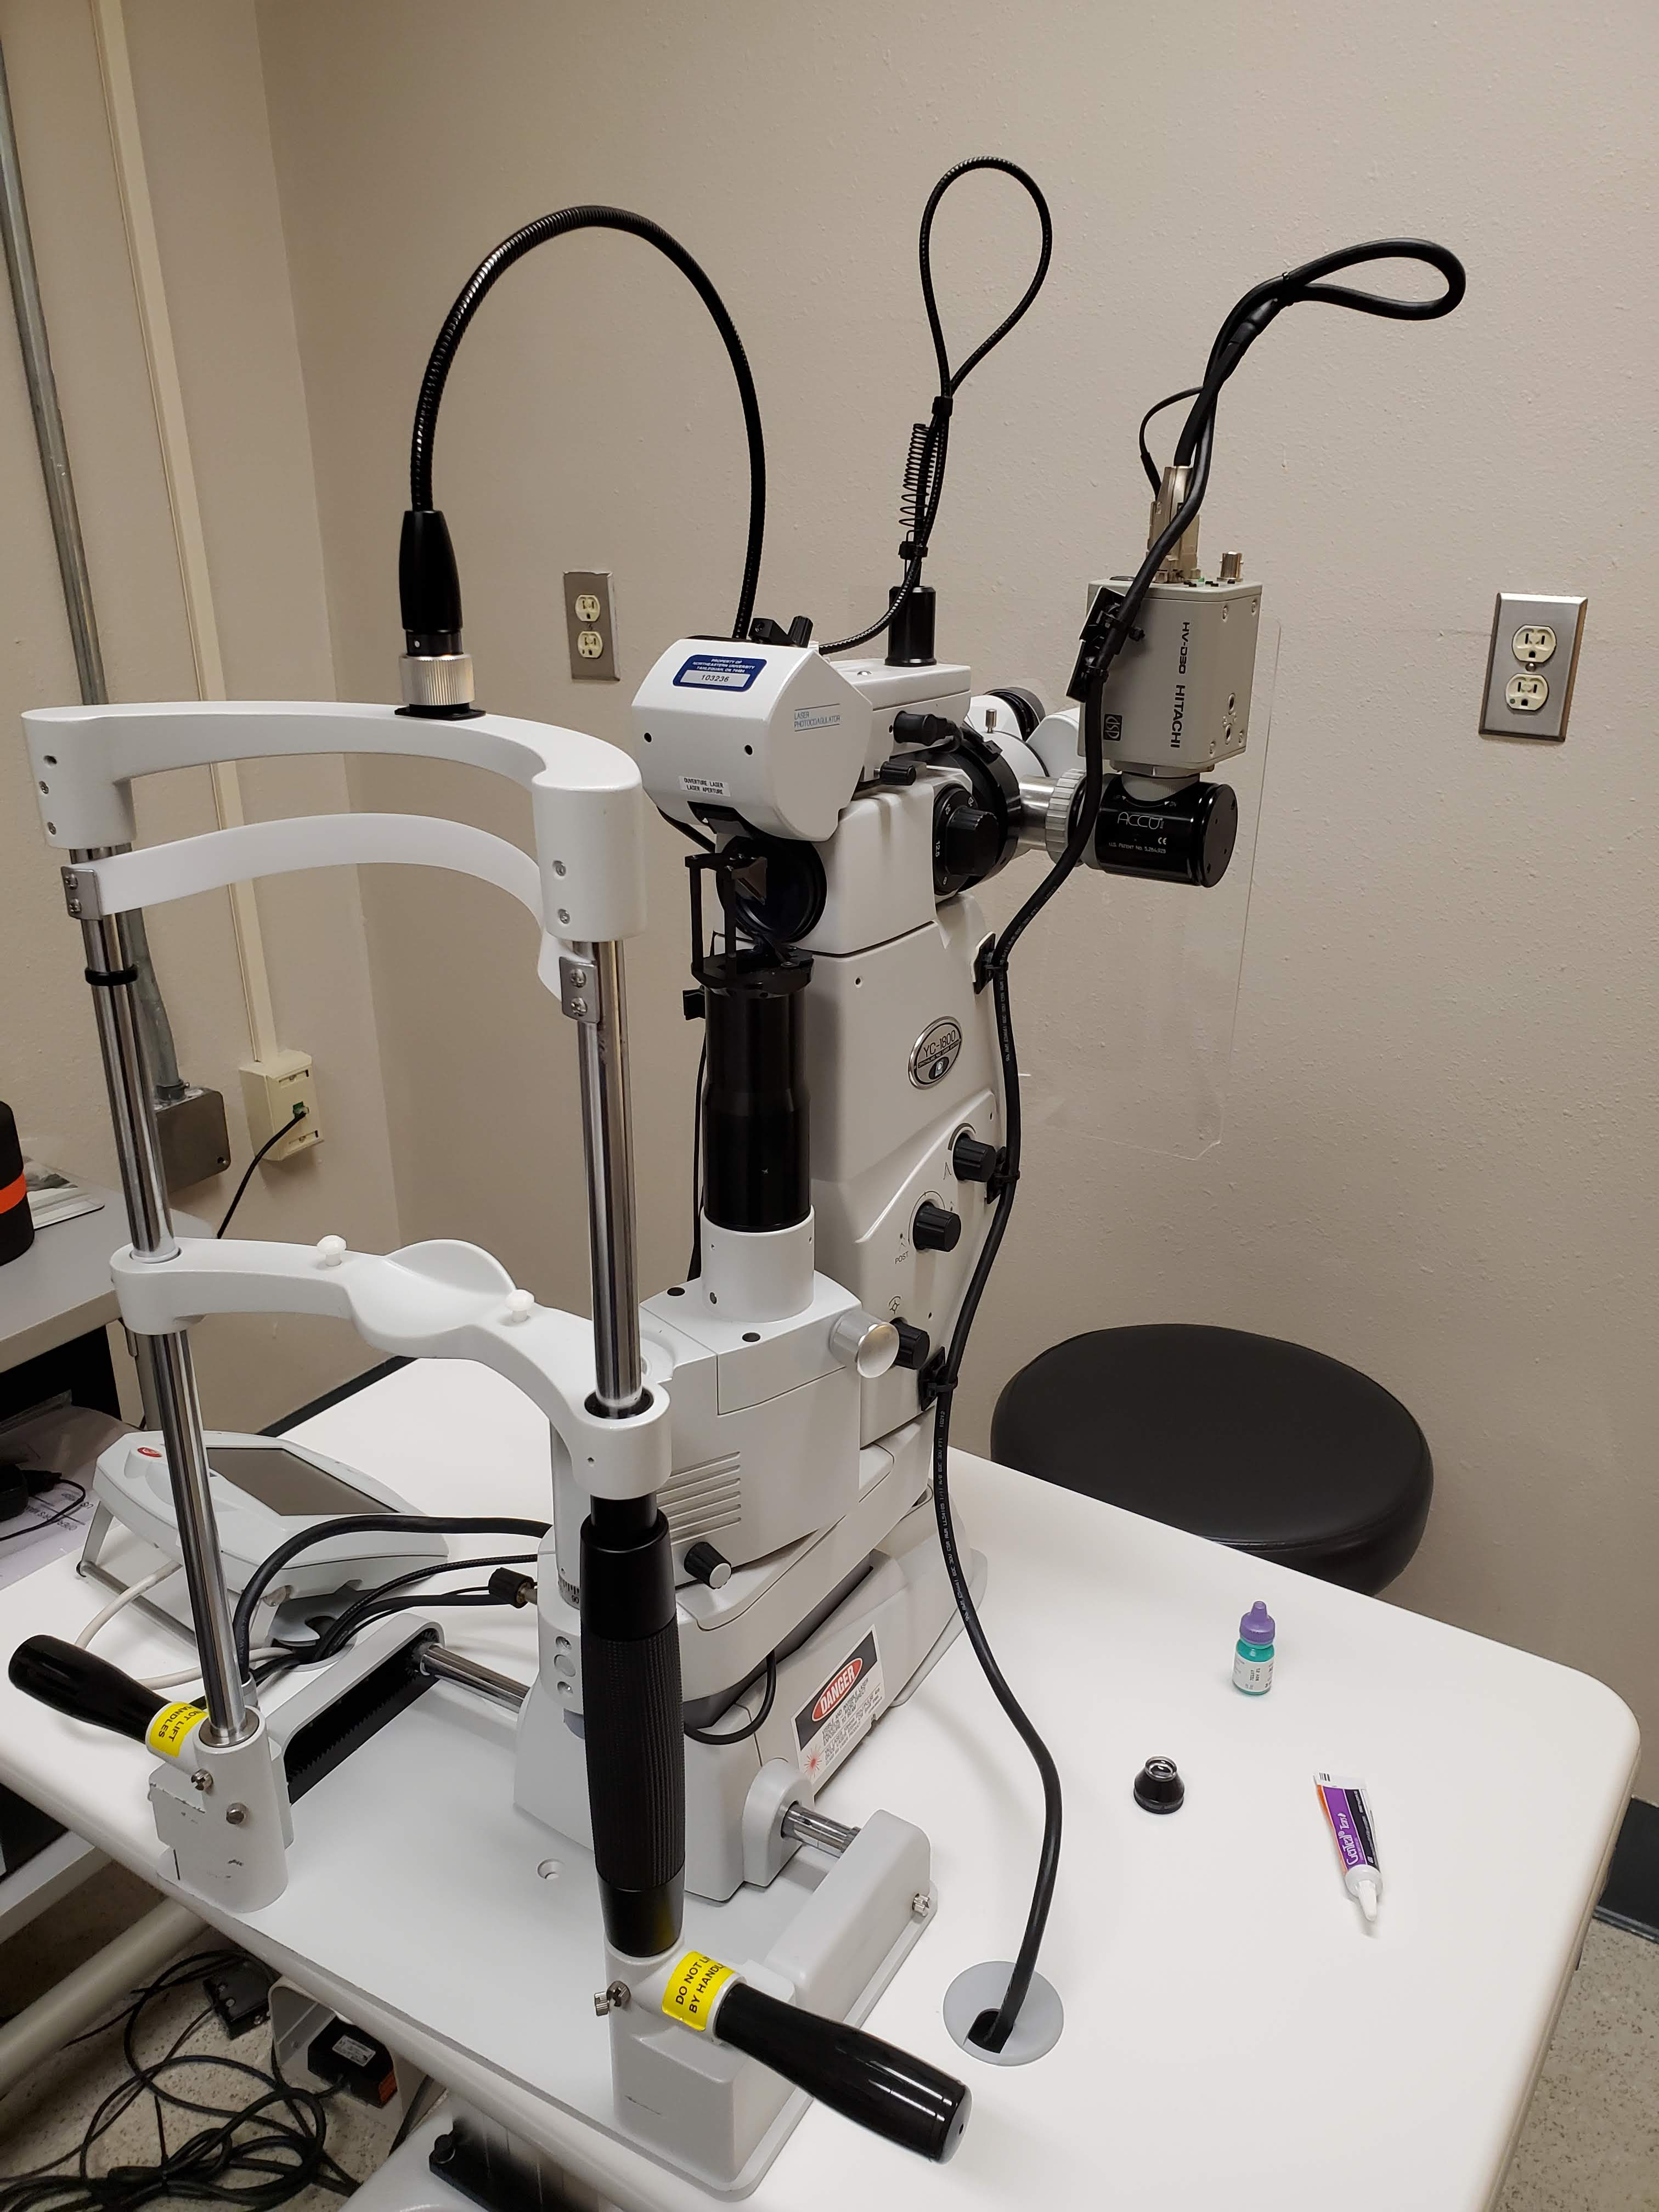
Laser Peripheral Iridotomy

Slide 40
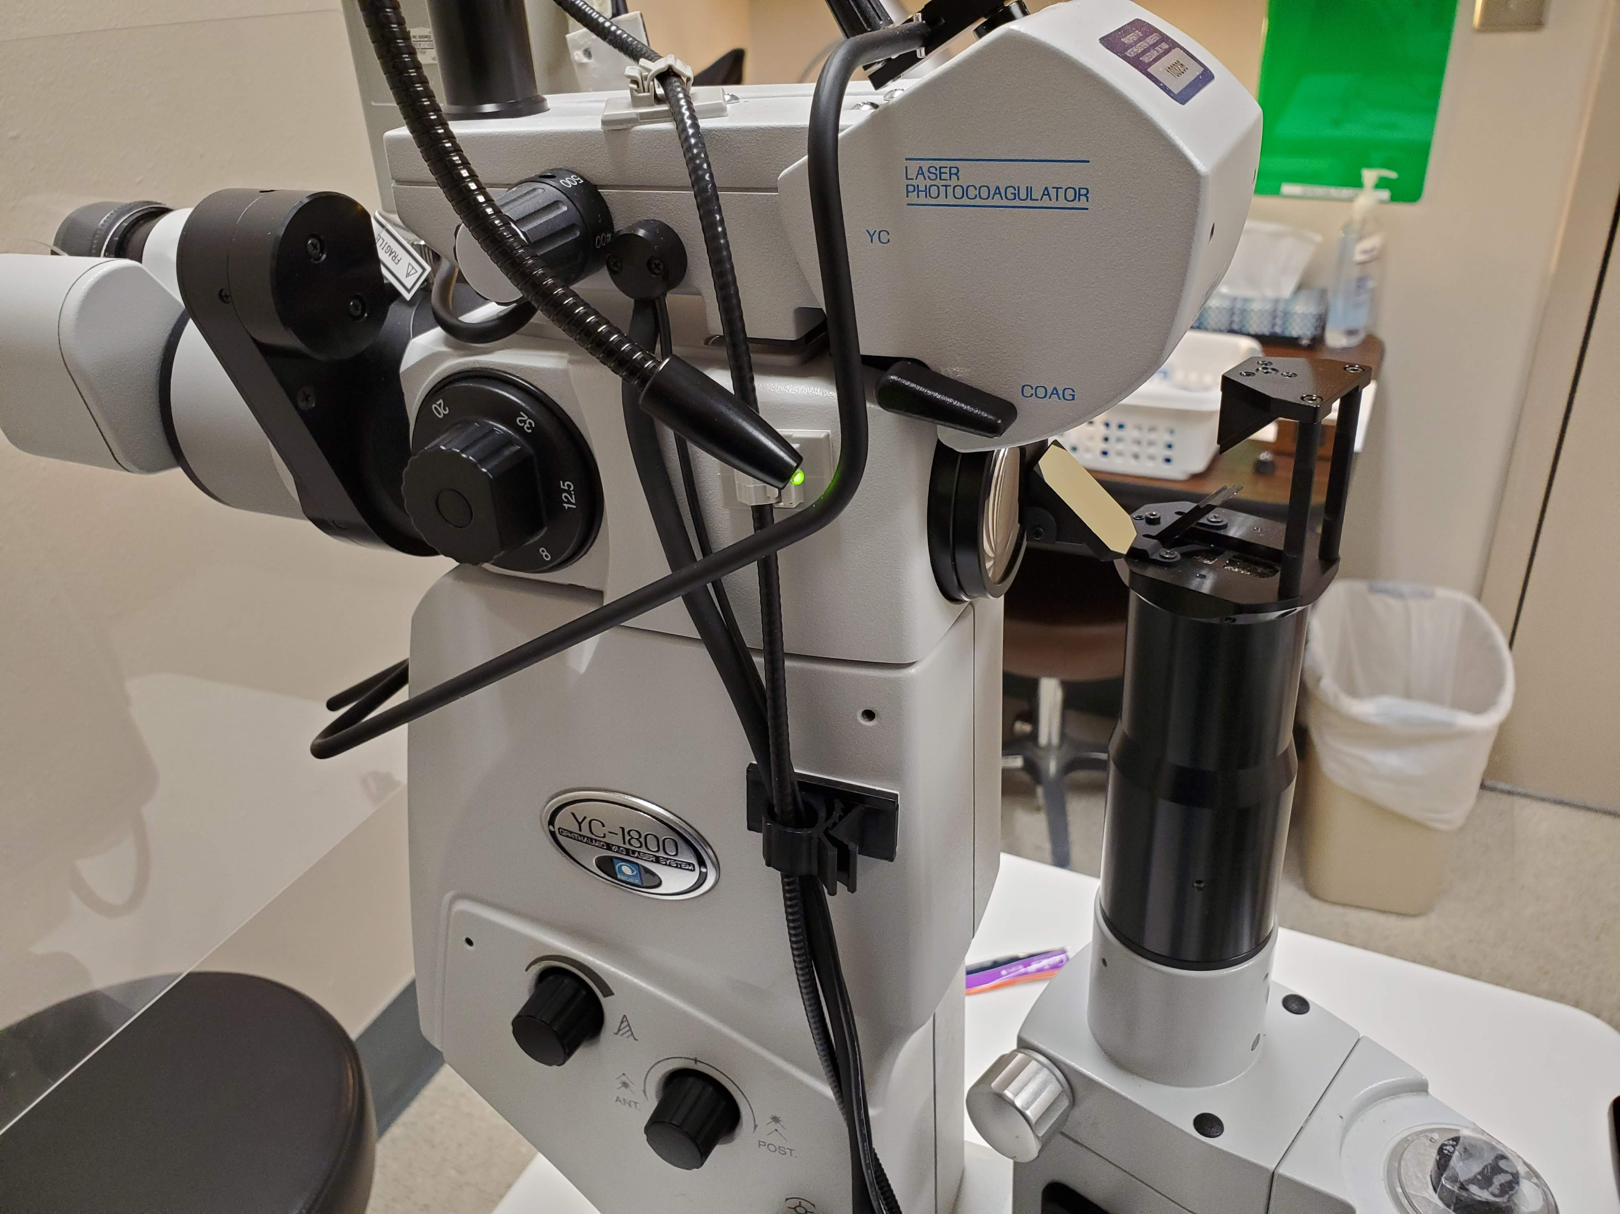
Laser Peripheral Iridotomy

Slide 41
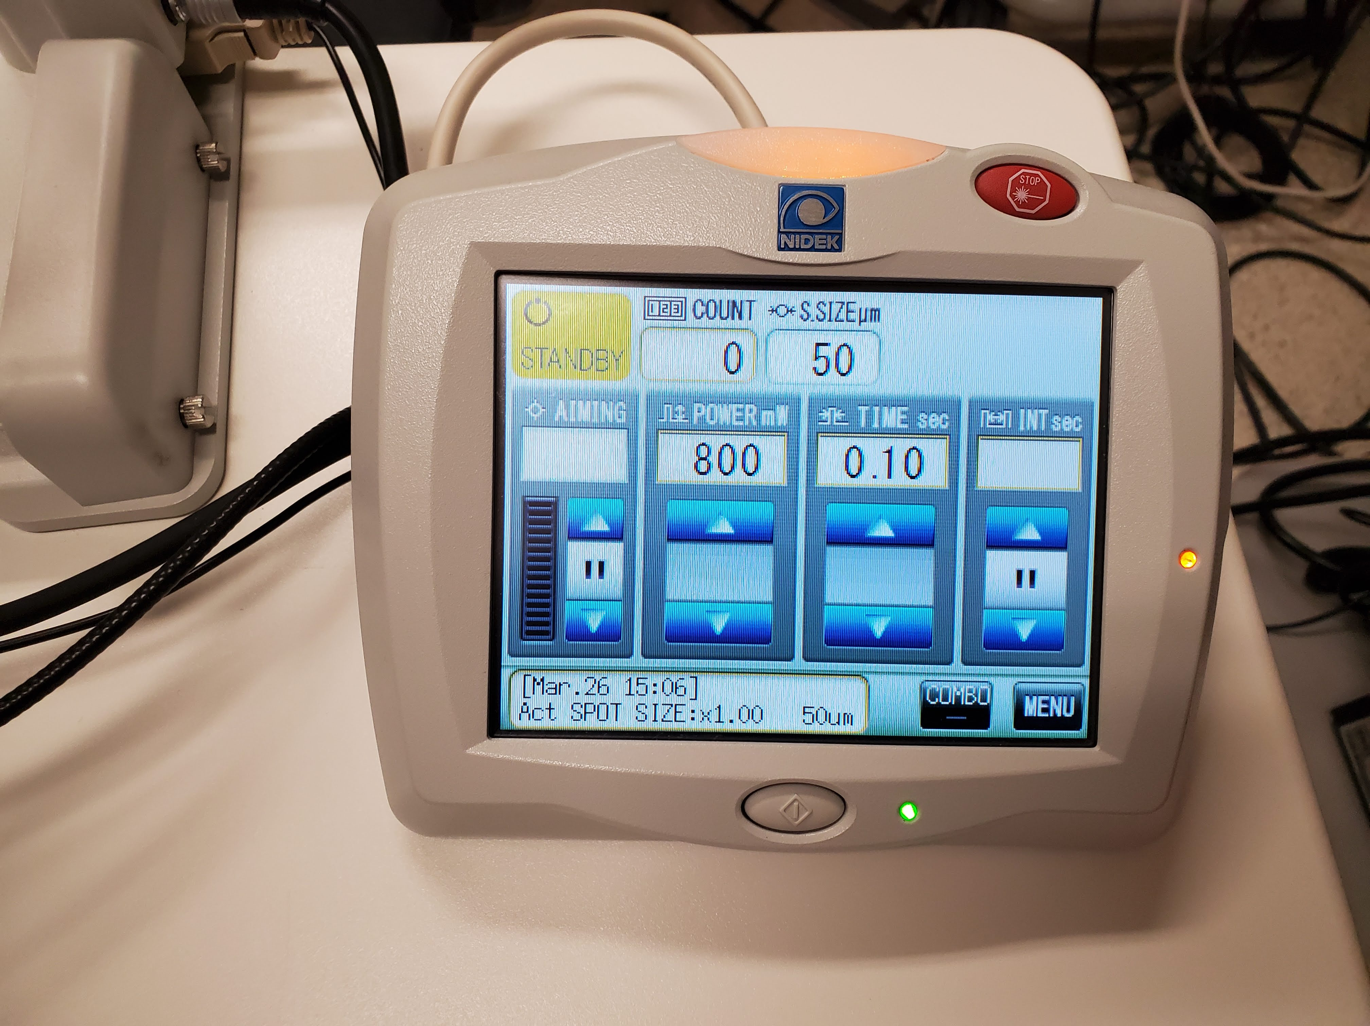
Laser Peripheral Iridotomy

Slide 42
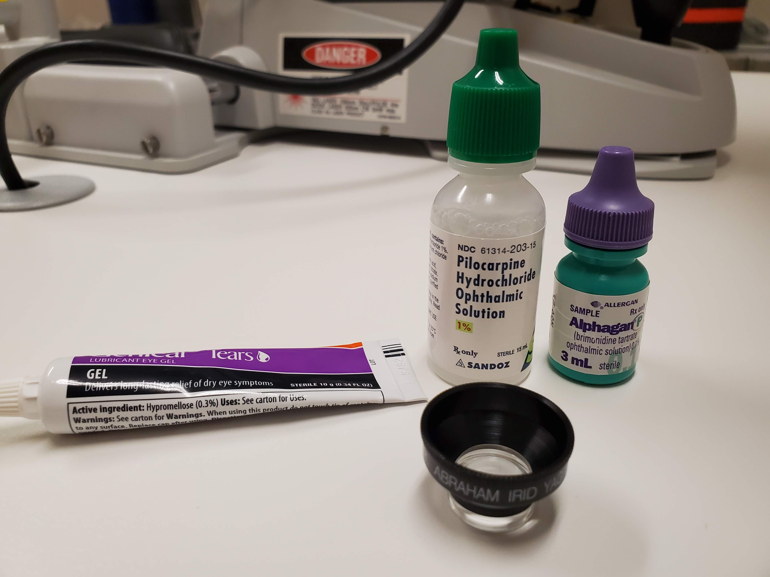
Laser Peripheral Iridotomy

Slide 43
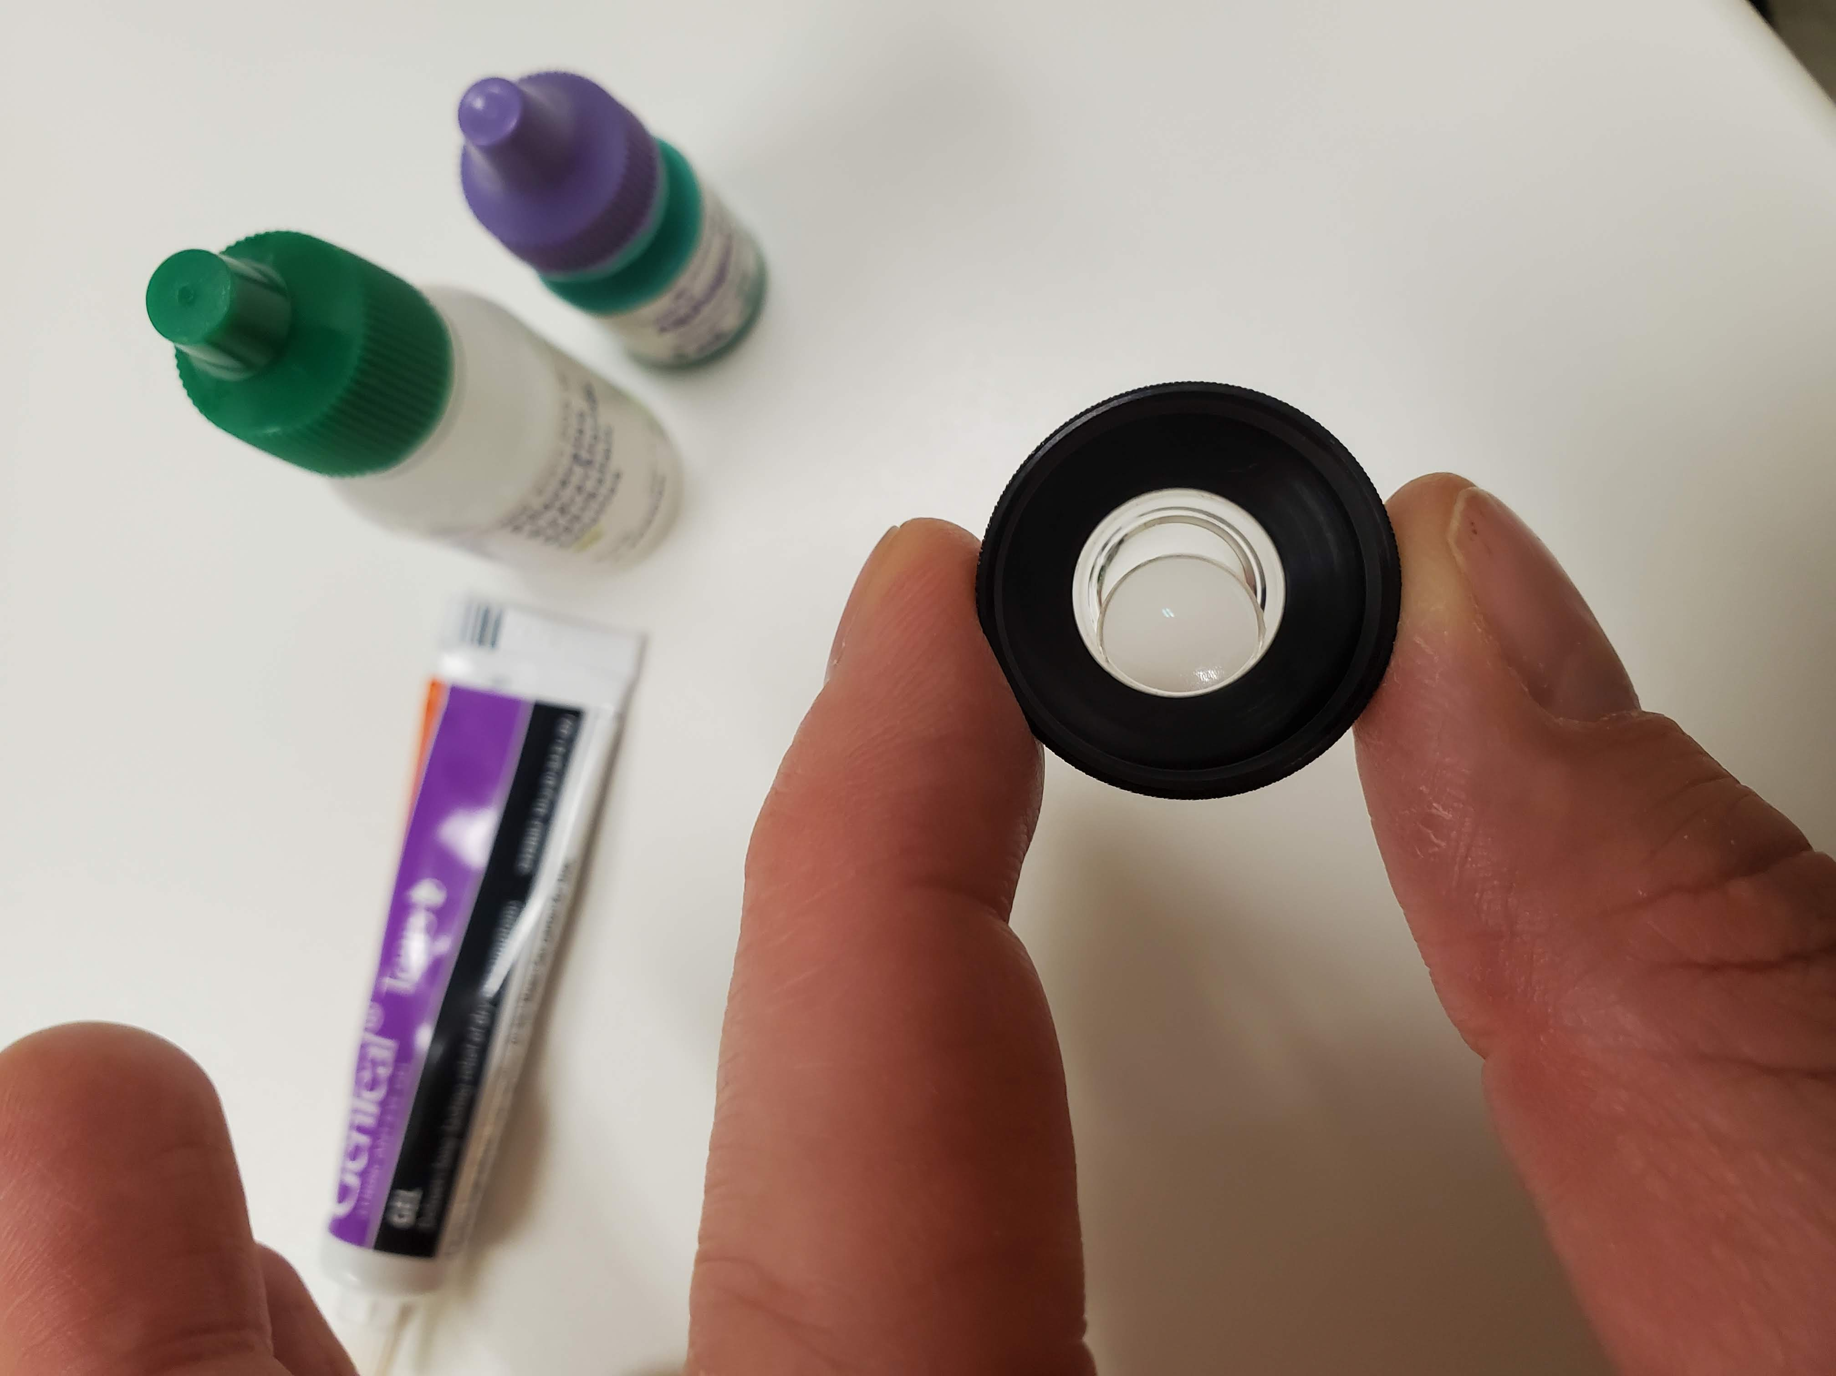
Laser Peripheral Iridotomy

Slide 44
Laser Peripheral Iridotomy
Procedure
Pre-treat more pigmented irises with argon laser first
12 shots in a petalloid pattern, total area no more than 1 mm in diameter
Able to get through with fewer shots and lower energy later with YAG laser
Reduced the risk of hemorrhage
PI placement 11 or 1 o’clock vs 3 or 9 o’clock
Power
3-4 mJ single pulse
Can go as high as 5 mJ triple pulse

Slide 45
Laser Peripheral Iridotomy
Post-procedure
Brimonidine immediately following procedure
IOP check, 20-60 minutes after procedure
Pred-forte qid or Durezol bid x 7 days
RTC 1 week
IOP
Check for patency - retroillumination
Anterior segment OCT

Slide 46
YAG Capsulotomy

Slide 47
YAG Capsulotomy
Indication
Medicare guidelines
Decreased acuity
Patient symptoms
Appearance of capsule

Slide 48
YAG Capsulotomy
Pre-procedure
IOP
Document size and location of the pupil
Dilated fundus examination
Brimonidine ~ 20 min prior to procedure

Slide 49
YAG Capsulotomy

Slide 50
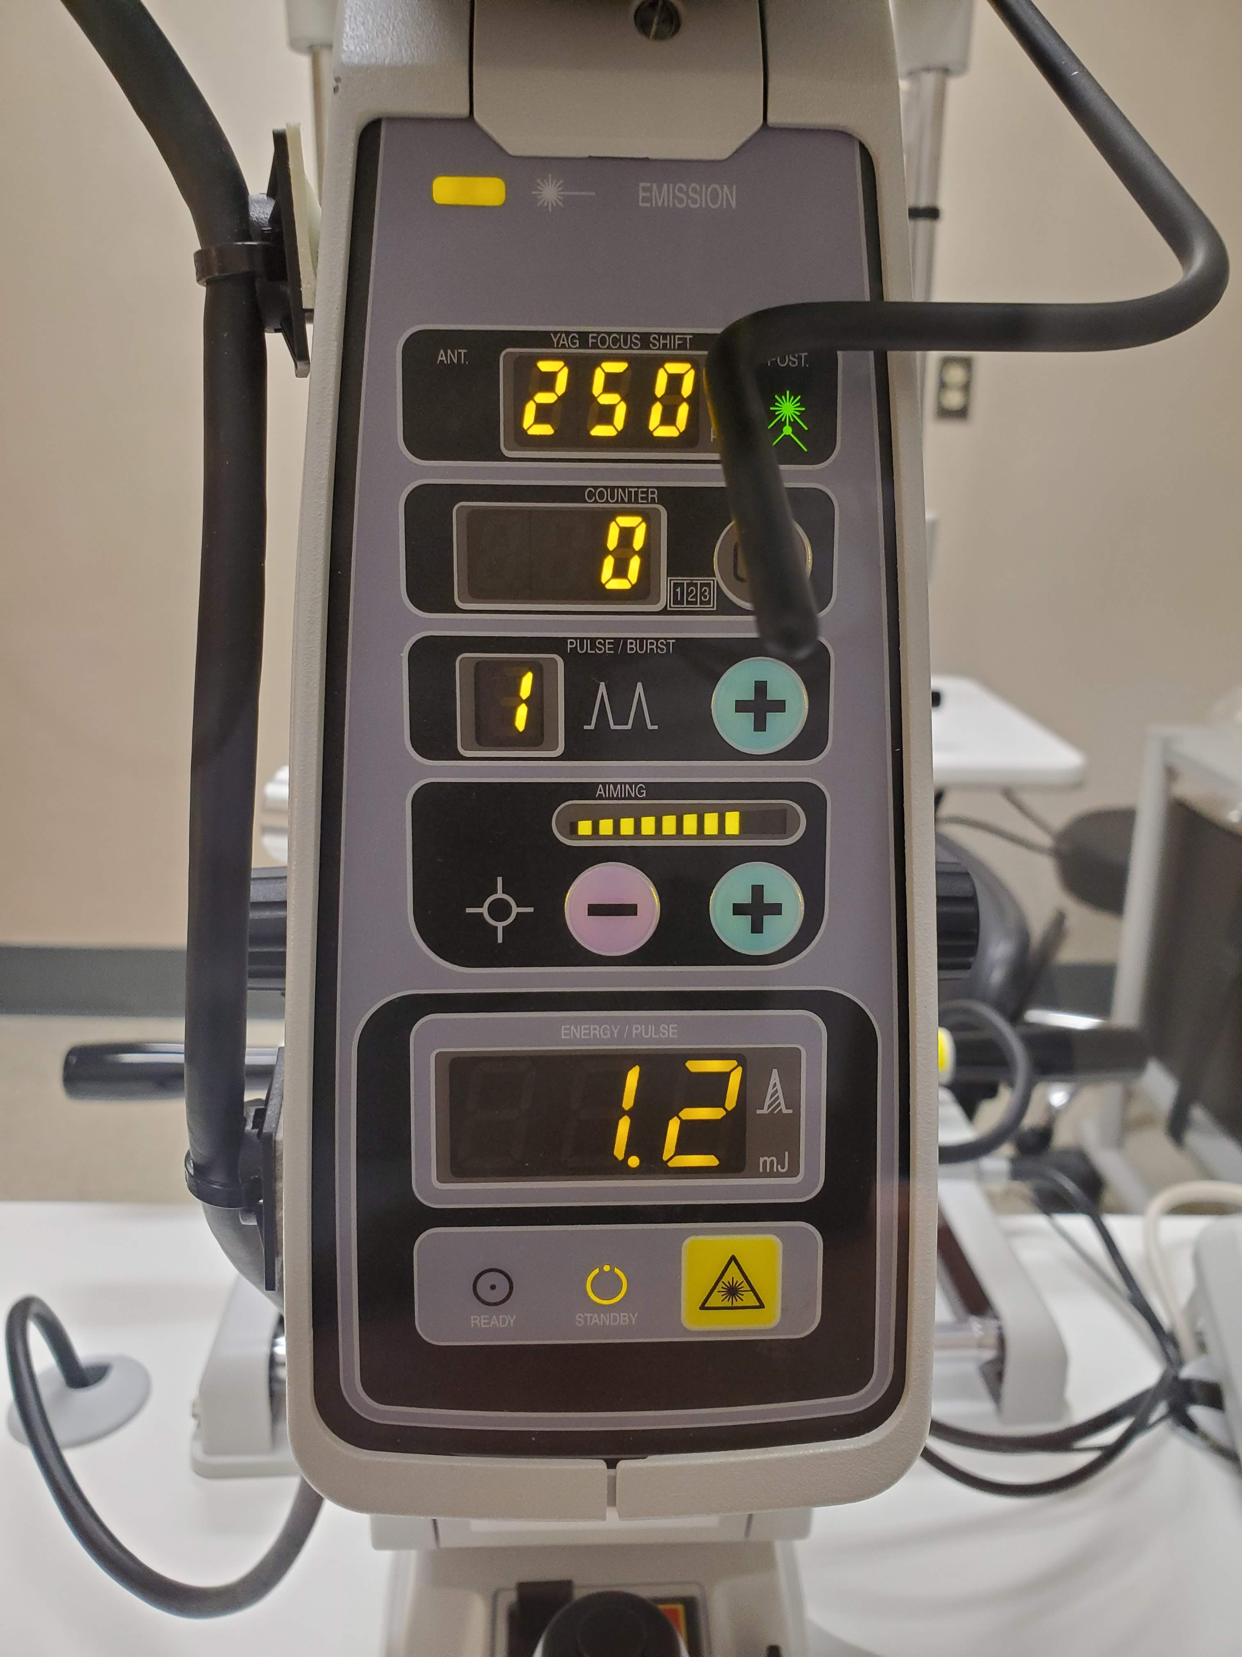
YAG Capsulotomy

Slide 51
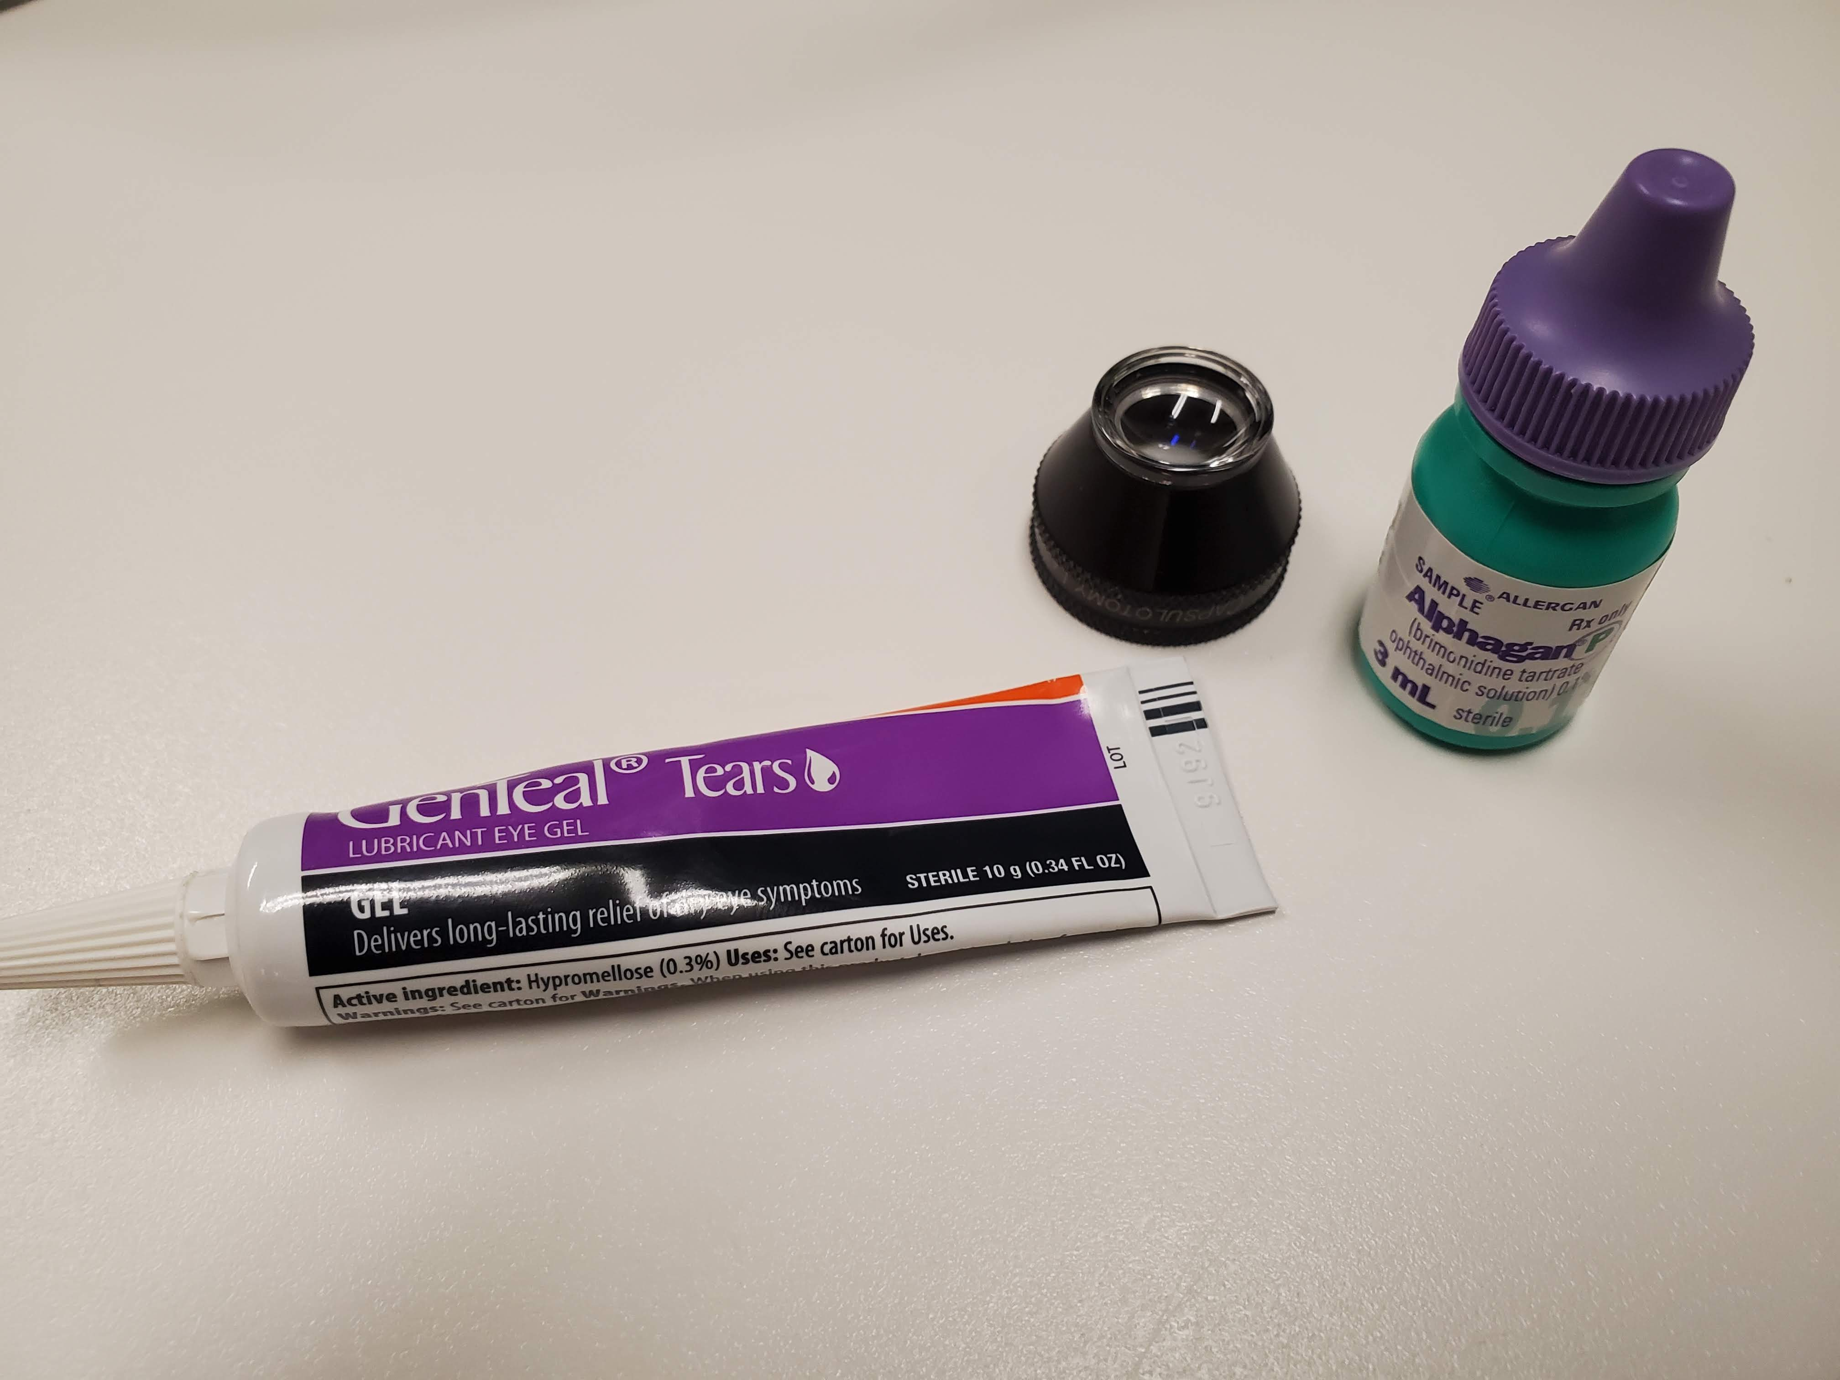
YAG Capsulotomy

Slide 52
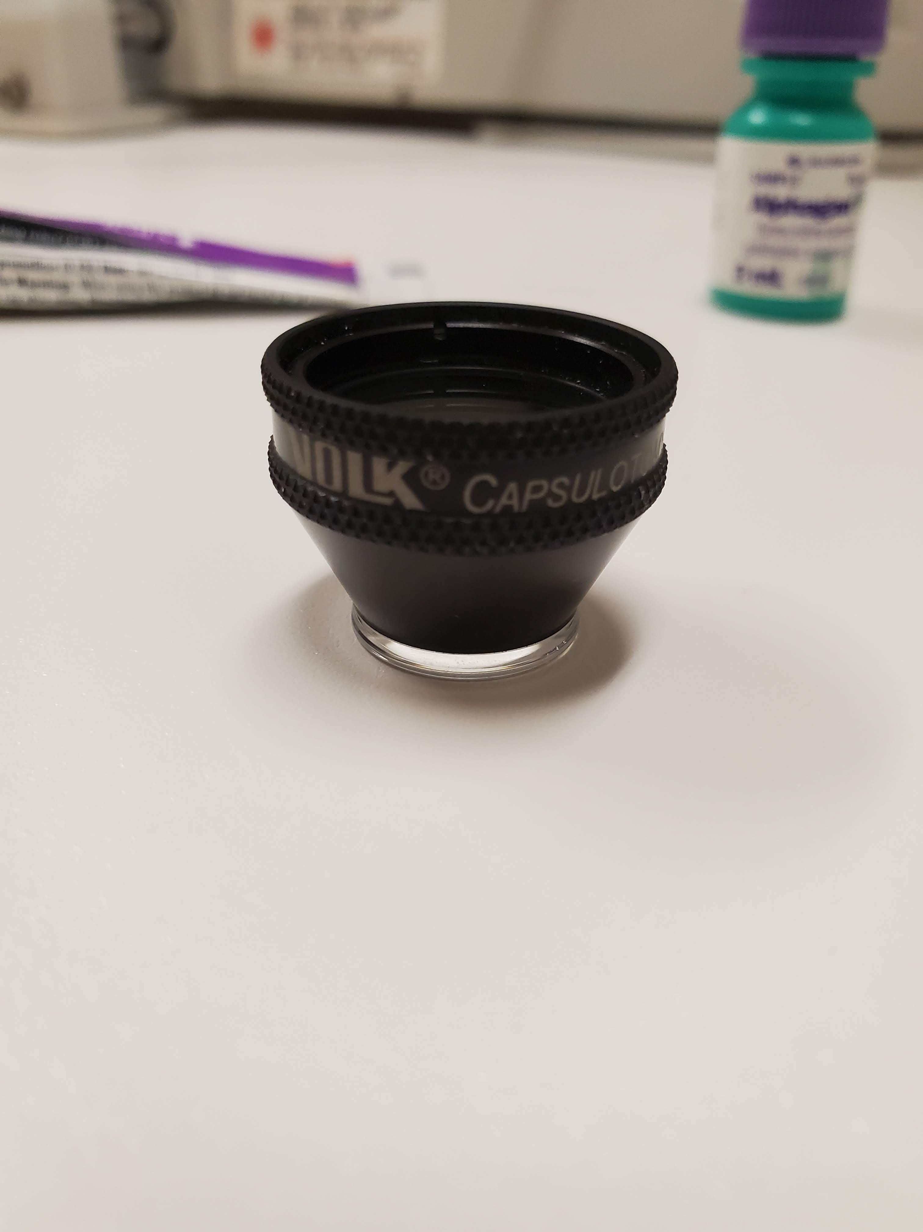
YAG Capsulotomy

Slide 53
YAG Capsulotomy
Procedure
1.0-1.3 mJ single pulse
Cruciate pattern

Slide 54
YAG Capsulotomy
Post-procedure
Brimonidine immediately following procedure
IOP check, 20-60 minutes post procedure
Pred-forte qid or Durezol bid x 7 days
1 week – check for inflammation and elevated IOP, dilate and check for any signs of holes, tears, or detachments, and well as ensuring capsular opening is complete

Slide 55
Thank You

