Slide 1
The Anterior Segment and More… Part 2
Zanna Kruoch OD, FAAO, Diplomate, Anterior Segment, FSLS
Associate Professor
College of Optometry
Rocky Mountain University of Health Professions

Slide 2
Financial Disclosures
Essilor Custom Contact Lens Specialist – speaker
The opinions in this lecture are my own

Slide 3
Objectives
Distinguish between various red eye presentations
Formulate the treatment and plan
Develop a list of differential diagnoses

Slide 4
Case
67 year old Asian Male

Slide 5
67 yro Asian Male
CC: “Swollen eyes”
HPI: Right side worse than left
Difficulties opening eyelids
Onset 5 days prior
Dx with HZ 4 days ago by PCP
OMD confirmed lack of ocular involvement 2 days prior

Slide 6
67 yro Asian Male
POH: Cataract extraction OD, OS - 2019
PMH: Herpes Zoster; HTN; prediabetes; hyperlipidemia
MED: Gabapentin, valacyclovir 1000 mg bid;
Losartan, metformin, unknown cholesterol med
ALL: NKDA, NKDA

Slide 7
Examination
BCVA: OD UTT
OS 20/50 NIPH
EOMs: UTT OD, OS
CF: UTT OD, OS
Pupils: UTT OD, SO

Slide 8
Gross Observation
Pain upon touch
Vesciular lesions on right side respecting midline
Resistance to forced opening of eyelids on right side
Edema periorbital and maxillary right side > left side

Slide 9
Case: Assessment & Plan
Orbital Cellulitis
Associated Facial Cellulitis
Management
ICD10:
H05.013
Bilateral
Likely secondary to infected vesicular lesions
Rule out sinus or intracranial extension
Immediate ER referral
IV antibiotics
Imaging

Slide 10
Orbital Cellulitis
Pathogenesis :: Clinical Features :: Management

Slide 11
Periocular Infections
Preseptal cellulitis
Eyelid pathology
Trauma
Anterior to orbital septum
Sinusitis
Eyelid pathology
Dental abscess
Hematogenous seeding
Posterior to orbital septum
Orbital cellulitis

Slide 12
Periorbital Infection
Laterality:
Mostly unilateral
Bilateral orbital: Consider intracranial extension
More common in pediatrics
Notes:
Cavernous sinus thrombosis!

Slide 13
Orbital Cellulitis
Ocular emergency
Limited ocular compartment:
Lid swelling
Fever / warmth to touch
Proptosis
Restricted EOMs
Optic nerve compression →
Decreased vision
APD

Slide 14
Differentials
INFECTIOUS
Preseptal
Orbital
Panophthalmitis
IMMUNOGENIC
Idiopathic orbital inflammation
Thyroid orbitopathy
Granulomatosis processes (GPA, Sarcoidosis)
Ptosis
Proptosis
Rhabdomyosarcoma
Retinoblastoma
Malignant melanoma
Leukemia
MALIGNANCIES
Allergic conjunctivitis
Dermatitis
Chalazion
OTHER
Edema
Diplopia

Slide 15
Proptosis Lid edema Ptosis
Preseptal cellulitis
Eyelid pathology
Trauma
Anterior to orbital septum
Sinusitis
Eyelid pathology
Dental abscess
Hematogenous seeding
Posterior to orbital septum
Orbital cellulitis

Slide 16
Complications of Orbital Cellulitis
Vision loss
Intracranial extension:
Meningitis
Dural or epidural abscess
Cavernous sinus thrombosis
Bilateral lid edema
CN 3,4,6 involvement
Retinal infarction

Slide 17
Preseptal Cellulitis Management
Broad spectrum ORAL antibiotics for 7-10 days
Examples:
Augmentin 500-875 mg bid po
Keflex 500 mg bid po
Z-pack: 5 day or Tripak 3 days
Doxycycline 100 bid po

Slide 18
Orbital Cellulitis Management
ER referral
Imaging:
CT: preferred; sinus involvement
MRI: Check for intracranial involvement
CBC with diff
Treatment:
IV antibiotics
Notes:
CBC with diff: check for leukocytosis and can monitor treatment progress with CRP

Slide 19
Consultation Report
Same day admission
CT:
Moderate soft tissue involvement of right lateral aspect of orbit
Clear ethmoid / maxillary sinuses
(-) Abscesses / fluid accumulation
Blood culture:
(-) Microbial growth
Notes:
The patient was admitted into the ER that same day. They performed a CT scan which revealed a lack of orbital or sinus involvement and his blood culture showed a lack of microbial growth

Slide 20
Consultation Report
Assessment:
Secondary facial / preseptal cellulitis
Herpes Zoster
Treatment and management:
IV acyclovir
IV vancomycin
IV cefepime
Progress:
Resolution within 5 days
Discharge at day 5
Oral clindamycin upon discharge
Notes:
Due to the lack of orbital or sinus involvement, the diagnosis was deemed preseptal and facial cellulitis. The physician assumed there likely was an association with the reactivation of VZV, but a secondary infection could not be ruled out. Because of this, the patient was started on IV antibiotics and showed significant improvement over five days. He was discharged on the fifth day with directions to start a seven-day course of oral clindamycin and to follow-up with an eye care specialist

Slide 21
Comparison
Preseptal Cellulitis
Notes:
So here is a side by side comparison of the patient when he presented to us and after his hospitalization and 5 day course of IV anibiotics. You can note there is healing and crusting of the vesicular lesions and also healing of the necrotic lesion that was seen on his upper right lid. You can also notecomplete resolution of the periobital and maxillary swelling. He was advised to continue gabapentin and valacyclovir as directed by the PCP for pain management and prevention. His next appointment was scheduled in 12 months to monitor the non-visually significant epiretinal membrane.

Slide 22
Case
61 year old Caucasian Male

Slide 23
61 yro Caucasian Male
CC: Pseudophakia evaluation – 1 day post op
HPI: CE OS 1 day prior
Has not yet begun drop therapy (steroid, NSAID, antibiotic)
Reports dull pain
Kept eye shield on since surgery
Denies eye rubbing

Slide 24
61 yro Caucasian Male
POH: Cataract extraction OS 06/14/2021
Cataract extraction OD 04/22/2021
PMH: Unremarkable
MED: None
ALL: NKDA, NKDA

Slide 25
Examination
BCVA: OD 20/20
OS 20/200 NIPH
EOMs: WNL OD, OS
CF: FTFC OD, OS
Pupils: PERRL (-) APD OD, OS

Slide 26
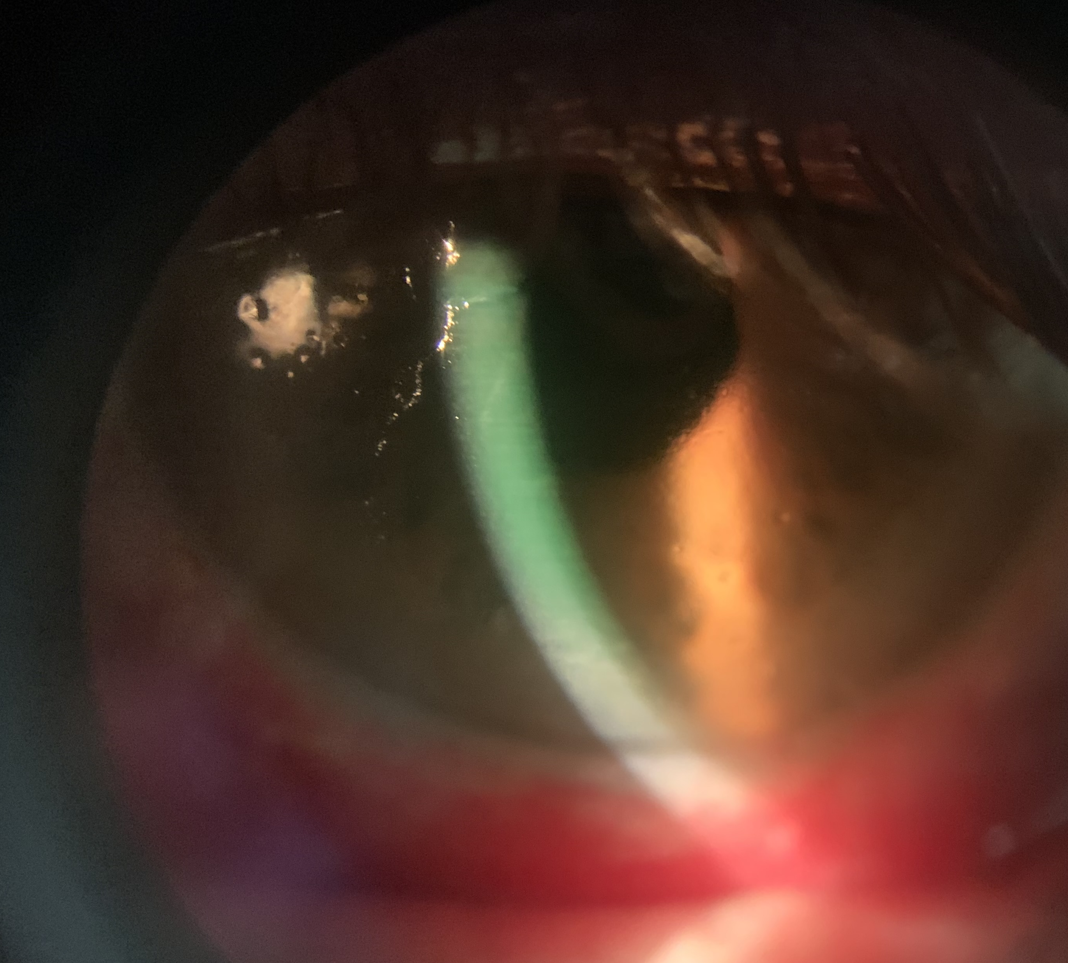
Biomicroscopy OS
Periorbital ecchymosis
Diffuse subconjunctival heme
Large, central irregular epithelial defect with nonadherent epi at borders
Trace cells/flare
Centered & clear IOL

Slide 27
Case: Assessment & Plan
Corneal Abrasion OS
Likely Trauma
Management
ICD10:
S05.02XA – Initial encounter; OS
Z96.1 - Pseudophakia
Speculum removal
Post-surgical mechanical trauma (e.g. eye rubbing)
Corneal debridement
In-office moxifloxacin x 2
In-office diclofenac
In-office BCL
Start drop therapy:
Difluprednate QD
Moxifloxacin TID
Diclofenac TID
RTC 3 days

Slide 28
Corneal Abrasion Recurrent Corneal Erosions
Pathogenesis :: Clinical Features :: Management

Slide 29
Pathogenesis
Irregular adhesion complexes
Trauma
Dry eyes
Corneal dystrophy
Diabetes Mellitus
Poorly adhering epithelium
MMP
upregulation
29
Notes:
Trauma can occur from years ago. The majority of RCEs result from mechanical trauma with about ½ of cases being from that cause. If there isn’t a history of trauma, start looking at the other eye for signs of corneal dystrophy, particularly EBMD since that is the 2nd most common reason for RCEs.
These etiologies can result in a disruption of the adhesion complexes

Slide 30
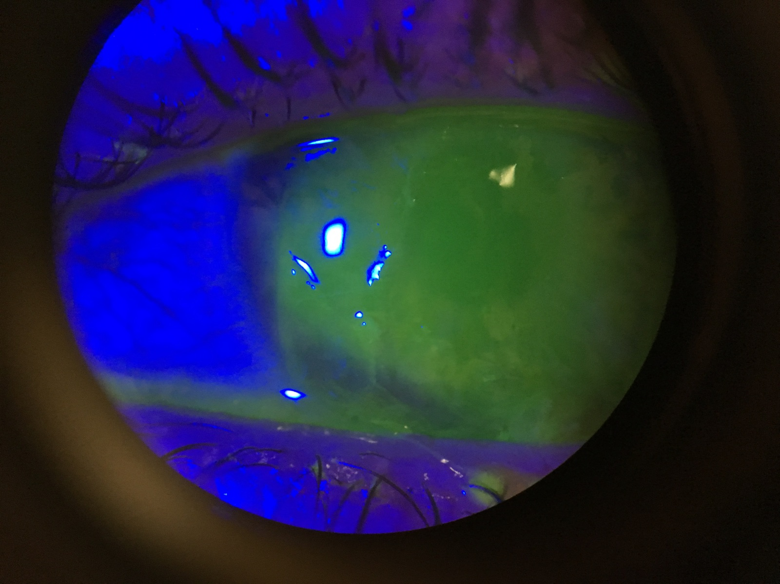
Clinical Presentation
Symptoms:
Pain (> 10/10)
Photophobia
Blepharospasm
Tearing
Signs:
Non-adhering epithelium
Relatively clear stroma
Irregular/negative staining

Slide 31
Corneal Abrasion Management
Proper care to avoid RCE!
Debridement:
Clean up loose epithelium
Consider diamond burring
Management:
Prophylactic antibiotic
Optional BCL
Topical NSAID

Slide 32
RCE Management
Supportive:
Ocular lubricants
Pressure patch or BCL
Hypertonic saline once healing
Medical:
Prophylactic antibiotic
Topical steroids
Oral tetracyclines
Biologics (e.g. amniotic membranes; autologous serum)
Notes:
Topical steroids and tetracyclines are anti-inflammatory options that will inhibit the upregulation of MMPs. This will in turn prevent break down of collagen and hemidesmosomes and therefore will facilitate healing
Amniotic membranes may be a way to jumpstart the healing process while autologous has been reserved for recalcitrant cases

Slide 33
RCE Management
Surgical:
Debridement / diamond burr polishing
Superficial keratectomy
Phototherapeutic keratectomy (PTK)
Anterior stromal puncture
Management:
Prevent infection
Patient comfort / minimize symptoms
Extended wear BCL for 6-12 weeks
Notes:
Stromal puncture is really reserved for erosions outside the visual axis. Has an 80% success rate with low cost.
Debridement with polishing has better success rate but the recovery can be longer. In addition, diamond burring can induce corneal haze so having a steroid on after therapy is important.

Slide 34
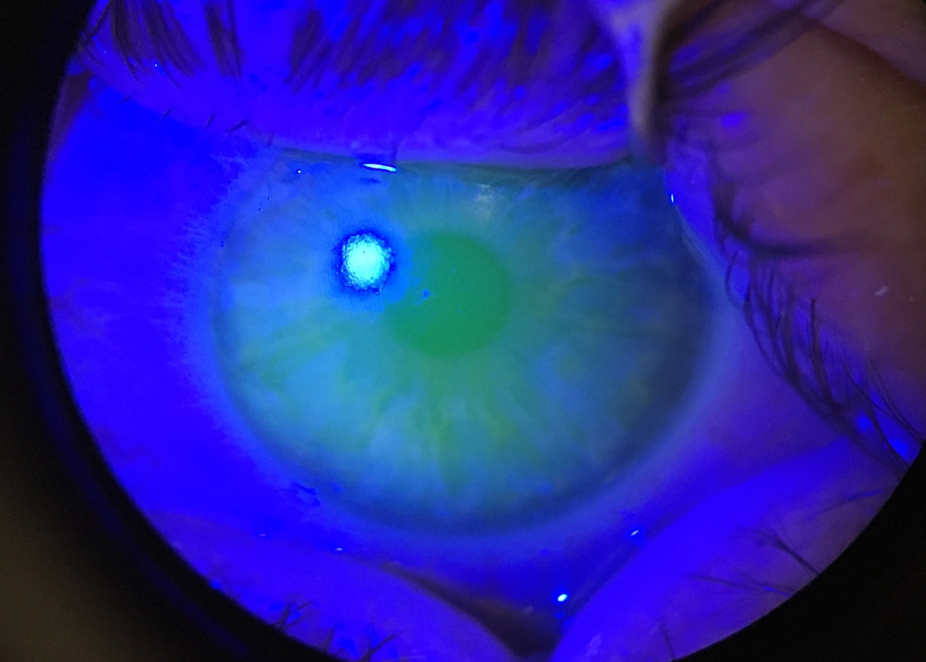

Slide 35
Case
53 year old Caucasian Male

Slide 36
53 yro Caucasian Male
CC: “Foggy vision”
HPI: Onset 3 weeks ag with worsening vision
Denies pain, recent illness
POH: Cardiomyopathy – ventricular tachycardia
Arthritis
PMH: Unremarkable
MED: None
ALL: NKDA, NKDA

Slide 37
Examination
VA(sc): OD 20/40 PH 20/20
OS 20/70 PH 20/50
EOMs: WNL OD, OS
CF: FTFC OD, OS
Pupils: PERRL (-) APD OD, OS
IOPs: OD 16 mmHg, OS 19 mmHg

Slide 38
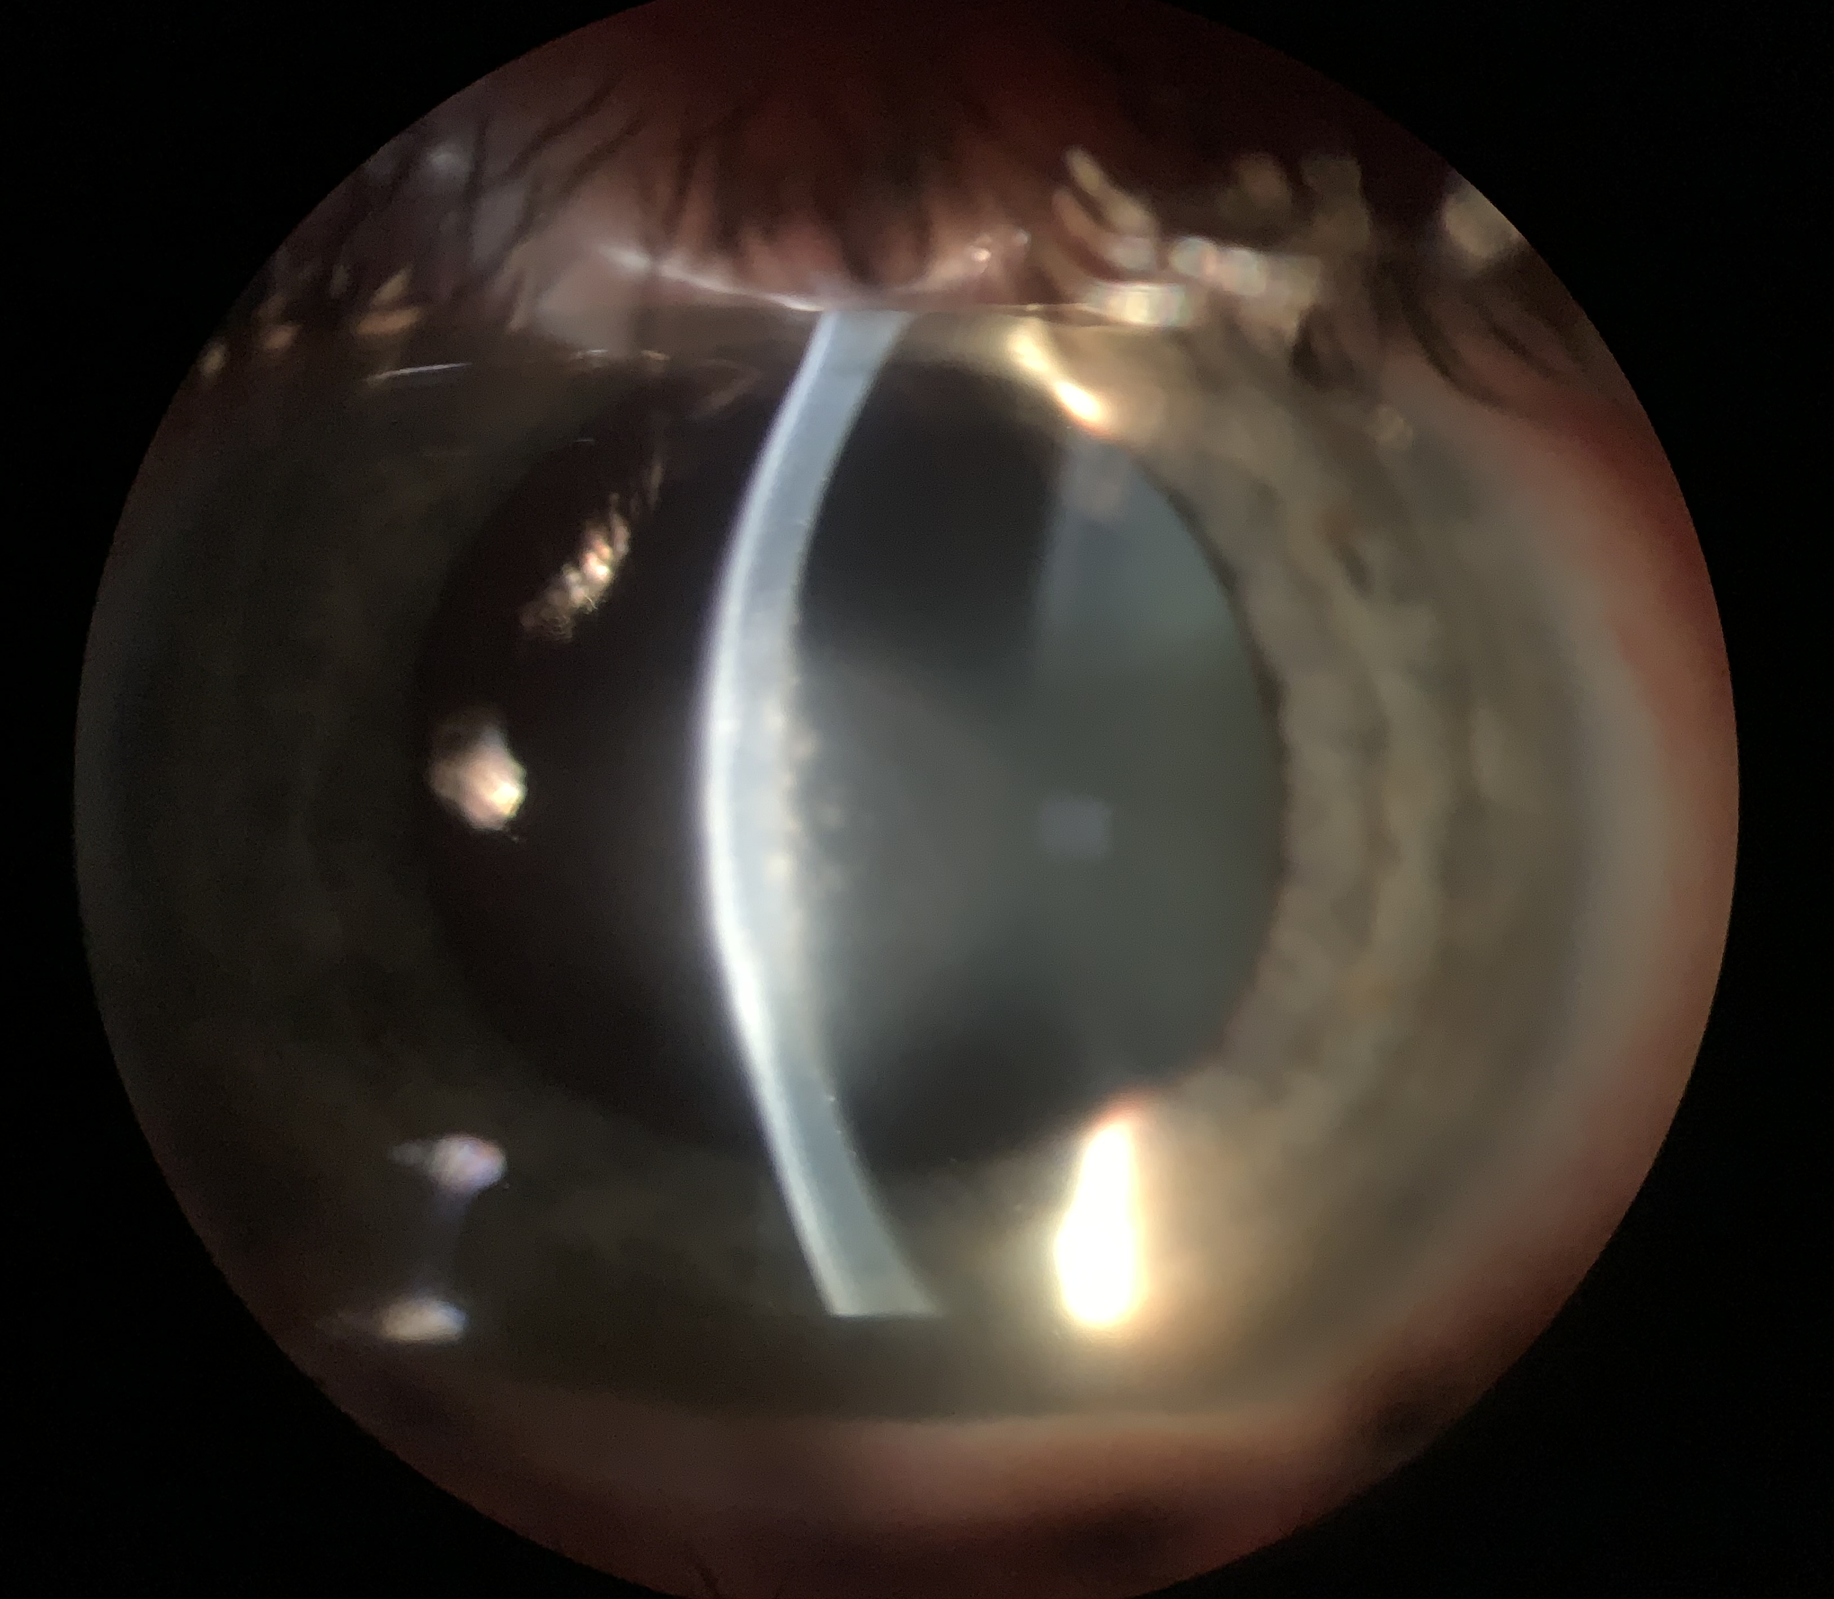
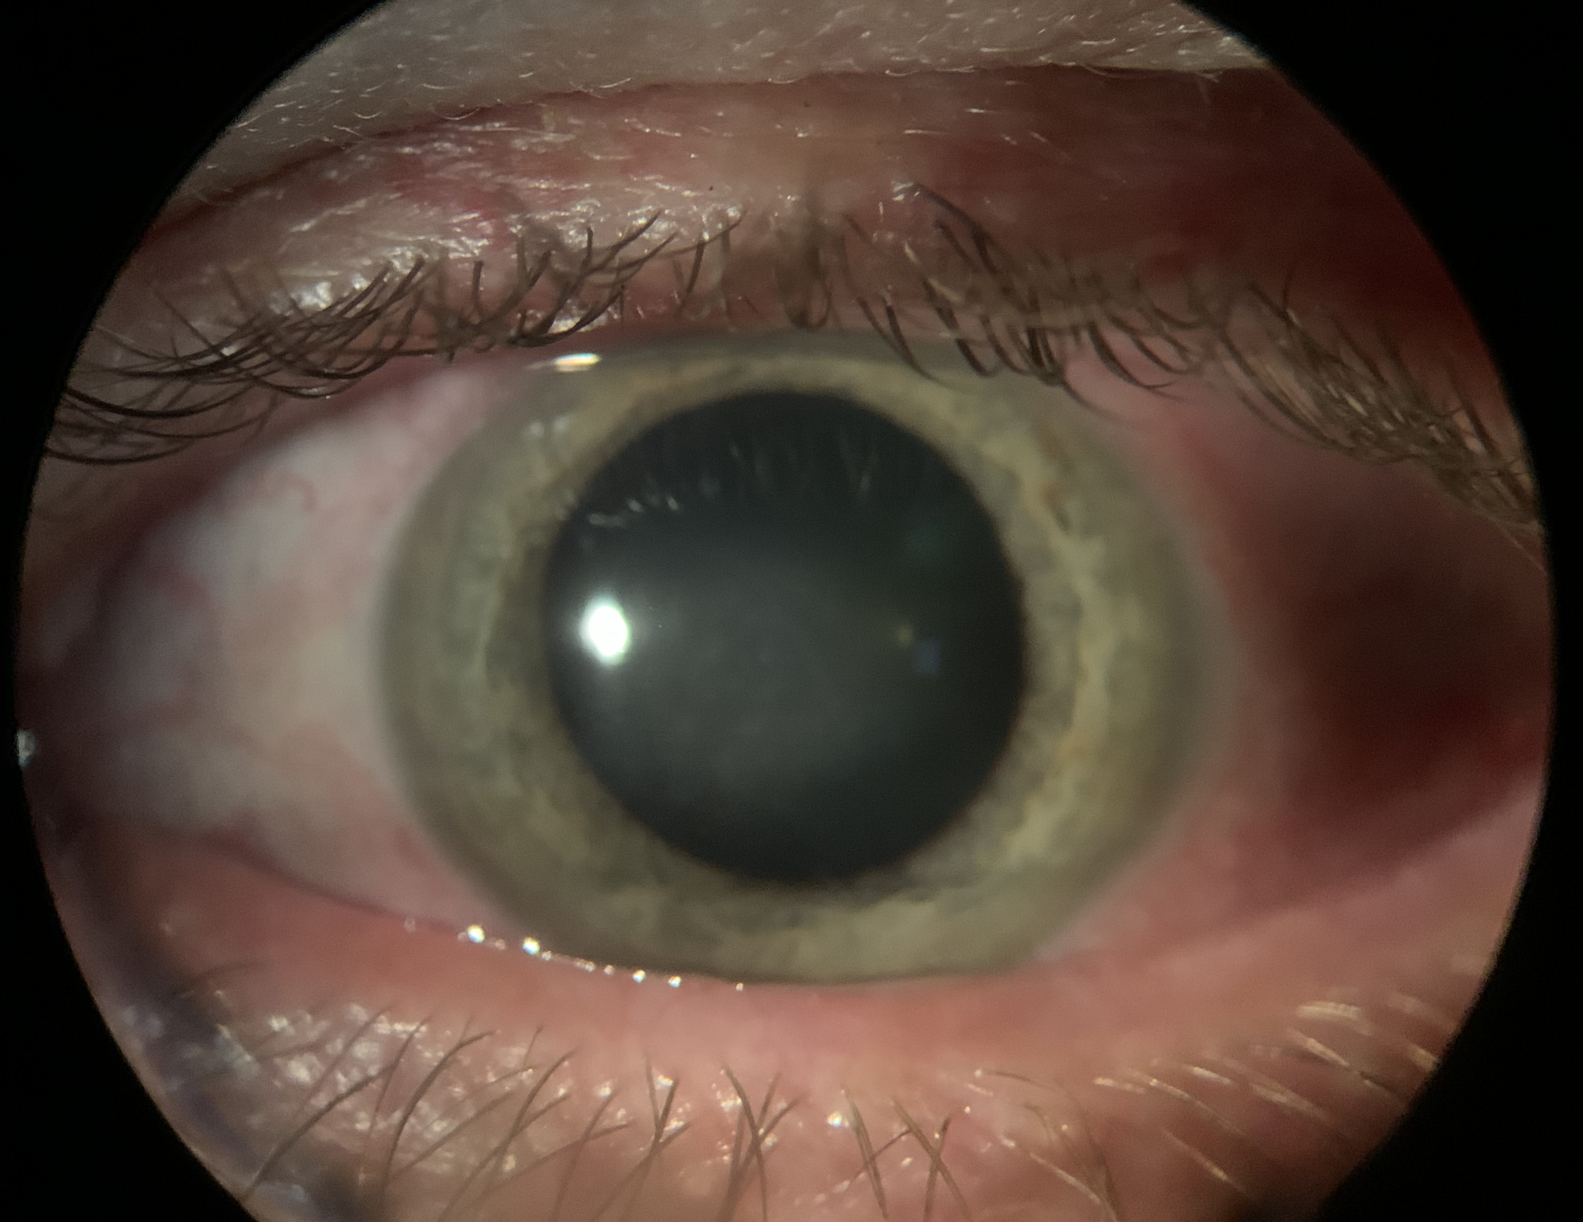
Biomicroscopy OS
Lid telangectasia
2.5 mm round, centered full thickness edema
(+) punctate staining centrally
Coin-shaped KPs on the endothelium
No apparent cells/flare
Corneal Hypothesia!
Notes:
Posterior segment was unremarkable

Slide 39
Case: Assessment & Plan
Herpesviral keratitis OS
Etiologies
Management
ICD10:
B00.52
Endotheliitis
Herpes simplex virus
Herpes zoster virus
Cytomegalovirus
Anti-inflammatory
Durezol 6x/day for 1-2 days
QID x 3 days
PCP referral:
CBC with diff
HIV testing
Oral antiviral
RTC 4 days

Slide 40
Endotheliitis
Pathogenesis :: Clinical Features :: Management

Slide 41
Corneal Endotheliitis
Circulating immune complexes in the anterior chamber → Recognized foreign antigens on cell membranes of endothelium resulting in edema
Immune response seen in:
Bacterial or fungal etiologies
Viruses (e.g. HSV, CMV, VZV, Adenovirus, COVID-19)
Corneal transplants
Corneal crosslinking

Slide 42
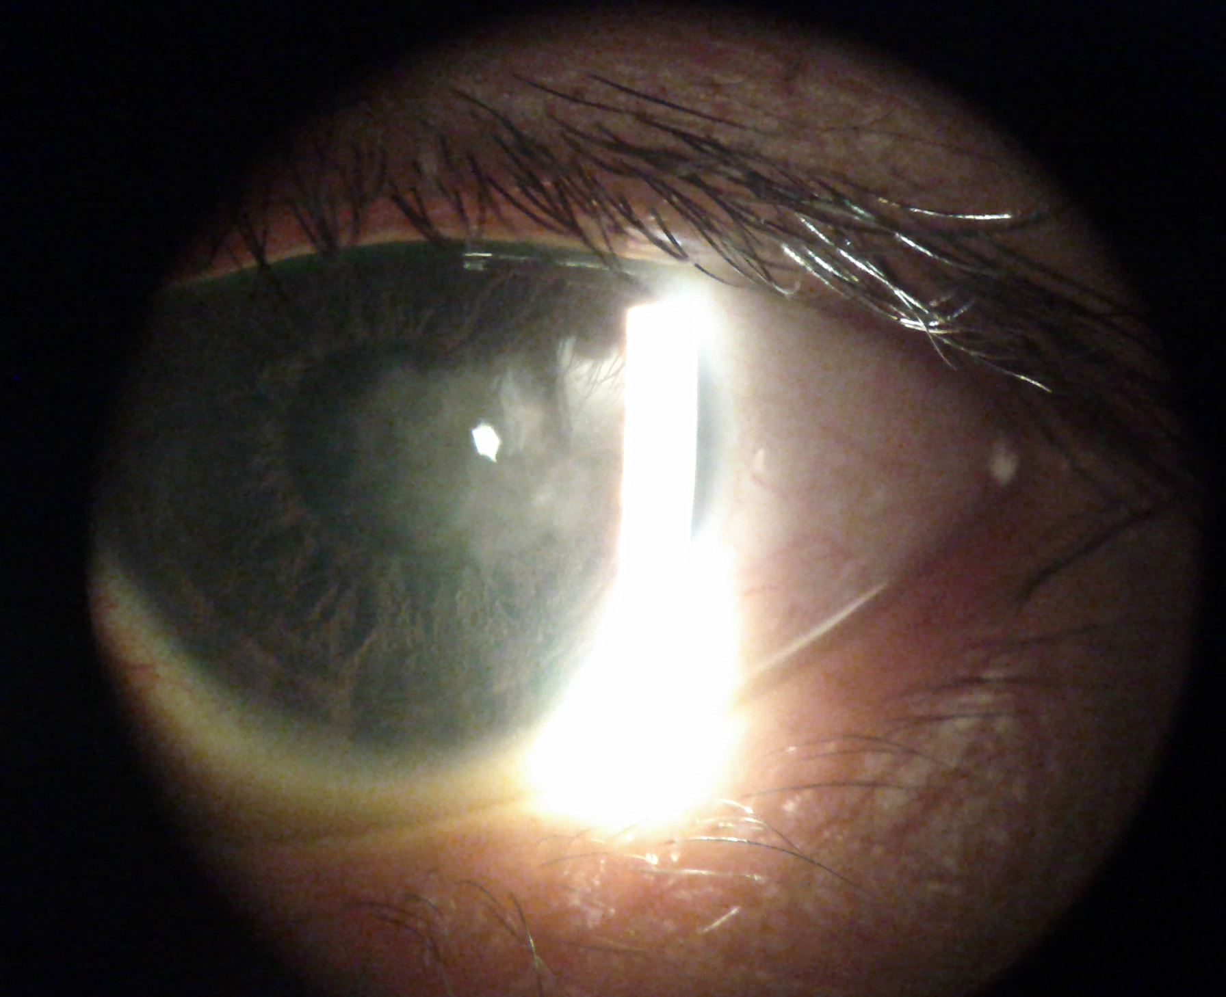
Clinical Presentation
Classified as:
Round
Linear
Diffuse
Area of edema with distinct border of edema vs. clear
Keratic preciptates in area of edema

Slide 43
Clinical Presentation
Can present as an isolated finding or with other findings
Stromal keratitis
Iritis
Trabeculitis
Complication:
Bullous keratopathy
Corneal opacity → dec VA

Slide 45
Differentials
History:
Recent ocular procedures/surgeries?
Recent illnesses?
Trauma?
Herpetic etiology:
Ocular hypertension
Iris atrophy (e.g. patchy, sectoral)
Other keratitis or iritis?
Unilateral
Decreased corneal sensitivity
Notes:
Topical steroids and tetracyclines are anti-inflammatory options that will inhibit the upregulation of MMPs. This will in turn prevent break down of collagen and hemidesmosomes and therefore will facilitate healing
Amniotic membranes may be a way to jumpstart the healing process while autologous has been reserved for recalcitrant cases

Slide 46
Endotheliitis Management
Anti-inflammatory:
Visually significant → go AGGRESSIVE!
Agents:
Prednsiolone acetate 1% q2h
Difluprednate QID to 6x/day
IOP lowering:
Decrease pressure on the endothelial pumps
Agents:
Beta-blocker
Alpha adrenergic agonist

Slide 47
Endotheliitis Management
Anti-inflammatory:
Visually significant → go AGGRESSIVE!
Agents:
Prednsiolone acetate 1% q2h
Difluprednate QID to 6x/day
IOP lowering:
Decrease pressure on the endothelial pumps
Agents:
Beta-blocker
Alpha adrenergic agonist
Notes:
Stromal puncture is really reserved for erosions outside the visual axis. Has an 80% success rate with low cost.
Debridement with polishing has better success rate but the recovery can be longer. In addition, diamond burring can induce corneal haze so having a steroid on after therapy is important.

Slide 49
Case
37 year old Caucasian Female

Slide 50
37 yro Caucasian Female
CC: “Scratchiness” OS
HPI: Onset 2 weeks ago; redness; improvement with
topical steroid use – Rx from OD
POH: Breast cancer 2018; Lasik 2002
PMH: Mastectomy 2018
Lumpectomy 2020
MED: Tamoxifen
ALL: NKDA, NKDA

Slide 51
Examination
BCVA: OD 20/20
OS 20/20
EOMs: WNL OD, OS
CF: FTFC OD, OS
Pupils: PERRL (-) APD OD, OS

Slide 52
Biomicroscopy OS
Gelatinous superifical conjunctivla lesion temporal
Iregular vascular changes
Injection noted from inferior conjunctiva to lesion
Potential sentinel vessel
Minimal LG stain
Notes:
Posterior segment was unremarkable

Slide 53
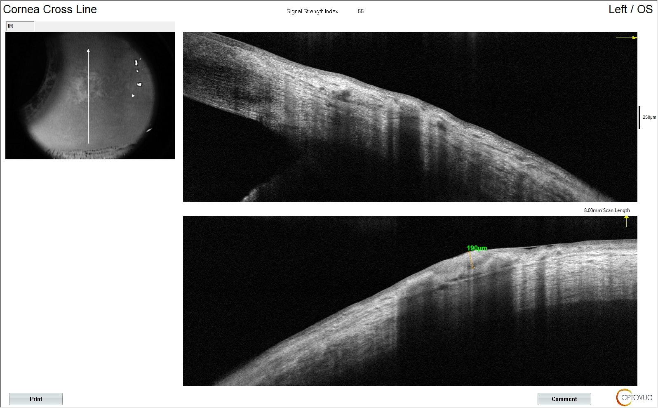
Anterior Segment OCT

Slide 54
Case: Assessment & Plan
Ocular Surface Squamous
Neoplasia (OSSN) OS
Risk fo Malignancy
Management
ICD10:
D31.00
Benign neoplasia of conjunctiva
History of cancer
Irregular clinical findings:
Sentinel vessels
Disrupted junction of epithelium noted on OCT
Irregular epithelial thickness
Referral to corneal specialist
Advise excisional biopsy
Anti-inflammatory treatment:
Advised tapering of steroid therapy

Slide 55
Ocular Surface Squamous Neoplasia
Pathogenesis :: Clinical Features :: Management

Slide 56
Ocular Surface Squamous Neoplasia (OSSN)
Spectrum of ocular surface disease including stages of dysplasia with potential to result maliginant neoplasia
Includes:
Conjunctival and/or corneal epithelial dysplasia
Conjunctival intraepithelial neoplasia
Squamous cell carcinoma
Mucoepitheliod carcinoma

Slide 57
OSSN
Highest incidence in Africa but worldwide
Can co-exist with other ocular pathologies
Associated with:
UV exposure
Human immunodeficiency virus
8-fold increase
Human papillomata virus
Hepatitis virus
Notes:
In conjunction with other pathology like LSCD, pterygia OCP, rosacea, it can be difficult to detect ossn.

Slide 58
Clinical Presentation
Frequently at nasal and temporal limbus
Various forms:
Gelatinous
Papilliform
Leukoplakic
Freely moves over the sclera
+/- Feeder vessels

Slide 59
Ancillary Testing
Ultrasound biomicroscopy
In vivo confocal microscopy
Impression cytology
Anterior segment optical coherence tomography:
Abrupt disruption
Sharp plane of cleavage
Epi thickness > 120 microns
Notes:
UBM: Usually for malignancies with intraocular extension; they studied a few of these and found that blunting of the anterior chamber and thicken uvea were consistent with malignant lesions
Confocal showed enlarged irregular clels with bright hyperreflective nucleli in corneal and conj epi cells
Impression cytology is more for superficial cells

Slide 60
Hyperreflective epithelium
Abrupt transition
Thick Epi
Abrupt transition
Atallah M, Joag M, Galor A, et al. Role of high resolution optical coherence tomography in diagnosing ocular surface squamous neoplasia with coexisting ocular surface diseases. Ocul Surf. 2017;15(4):688-695. doi:10.1016/j.jtos.2017.03.003

Slide 61
Medical Management
Mitomycin C
5-fluorouracil
Interferon therapy:
IFN-alpha2b
Topical or local injection
Cidofovir
Notes:
Mitomycin C works as primary or adjunct therapy; chemoreduction or chemopreventative
Fluorouracil is considered antineoplastic by impairing DNA/RNA synthesis of both healthy and tumor cells
Interferon - Antineoplastic due to antineoplastic, antiproliferative, and cytotoxic. Looking at doing drops QID with no agreed upon concentration; looking at resolution time of 1.5 months to 6
Cidofovir is antiviral agent that works against DS DNA incuding HPV. The molecule insertsintself directly into the DNA and promotes cellular apoptosis of the bad cells. Been used as therapy on refractory OSSN.

Slide 62
Surgical Management
Excisional biopsy
Shields’ “no touch” technique:
At least 4 mm tumor free border
Cryotherapy to conj/limbal margins → ruptures tumor membranes and occlusion of vessels
Brachytherapy or proton-beam radiotherapy
Notes:
Topical steroids and tetracyclines are anti-inflammatory options that will inhibit the upregulation of MMPs. This will in turn prevent break down of collagen and hemidesmosomes and therefore will facilitate healing
Amniotic membranes may be a way to jumpstart the healing process while autologous has been reserved for recalcitrant cases

Slide 63
Clinical Pearls
Optometry work… social work!
Changing nomenclature
Updates on management

Slide 64
Questions?
zanna.Kruoch@rm.edu

Slide 65
References
Upon request!

