Slide 1
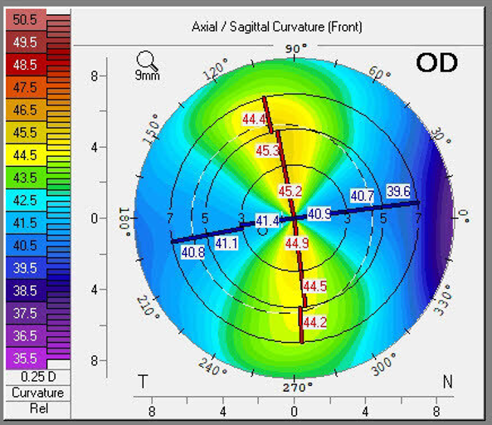
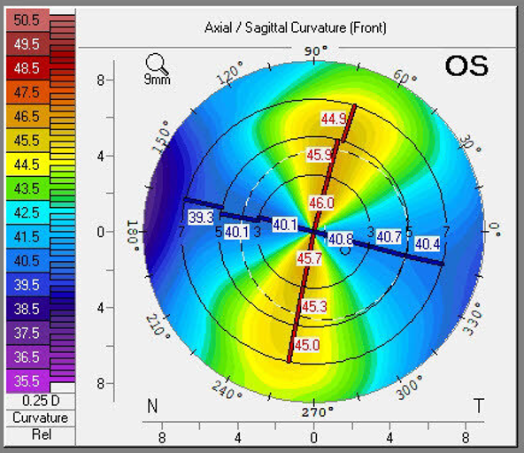
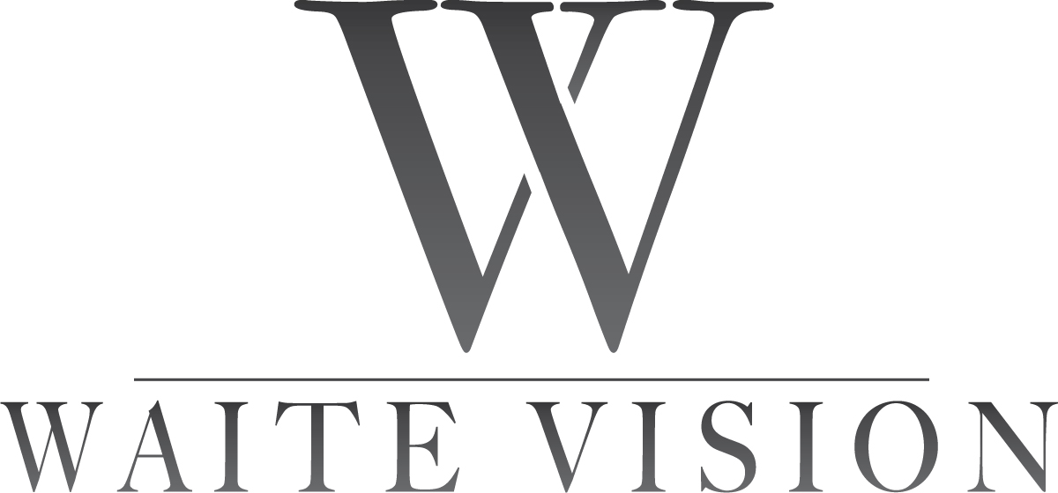
Astigmatism Management with Cataract Surgery
Aaron Waite MD

Slide 2
Financial Disclosures
None

Slide 3
Refractive Cataract Surgery
Goes beyond the pathology of a cataract
Goal is visual freedom
Myopia
Hyperopia
Astigmatism
Presbyopia
Blended Vision- Monofocal and EDOF (Spherical Aberration, IC-8 pinhole)
Multifocals- (Panoptix, Synergy, Symfony, Vivity are all multifocal optics)

Slide 4
Refractive Cataract Surgery
CPT 66984- “Extracapsular cataract removal with insertion of intraocular lens prosthesis (1 stage procedure), manual or mechanical technique (eg, irrigation and aspiration or phacoemulsification)”
In this code, there is no mention at all, of a refractive outcome. A refractive outcome is not part of the insurance reimbursement.
If the patient opts for a “basic lens,” covered by their medical insurance, they are opting to wear glasses after surgery. A refractive outcome is not part of the procedure.
If the goal is a certain refractive outcome, the patient will cover the cost of the refractive procedure above what insurance reimburses.

Slide 5
How do we decide which power lens to use?
SRK Formula (Saunders, Retzlaff, Kraff): 1st Generation
D = A - 2.5L - 0.9K
D is the dioptric power of the IOL
A is the A constant of the specific IOL
L is the axial length
K is the corneal curvature in diopters
Average human lens power is about +20 diopters
Intraocular lens powers range from -10 D to +45 D

Slide 6
Formulas
2nd Generation
SRK II
Hoffer
3rd Generation
SRK/T
Hoffer Q
Holladay 1
4th Generation
Barrett Universal II
Haigis
Holladay 2
Ray Tracing
Olsen
Artificial Intelligence with Regression Analysis
Hill RBF
Kane

Slide 7
Biometry
Measurements of the eye which are used for IOL calculations
Axial length, corneal curvature, anterior chamber depth, lens thickness
An essential part of cataract surgery
Multiple different devices
Built in formulas

Slide 8
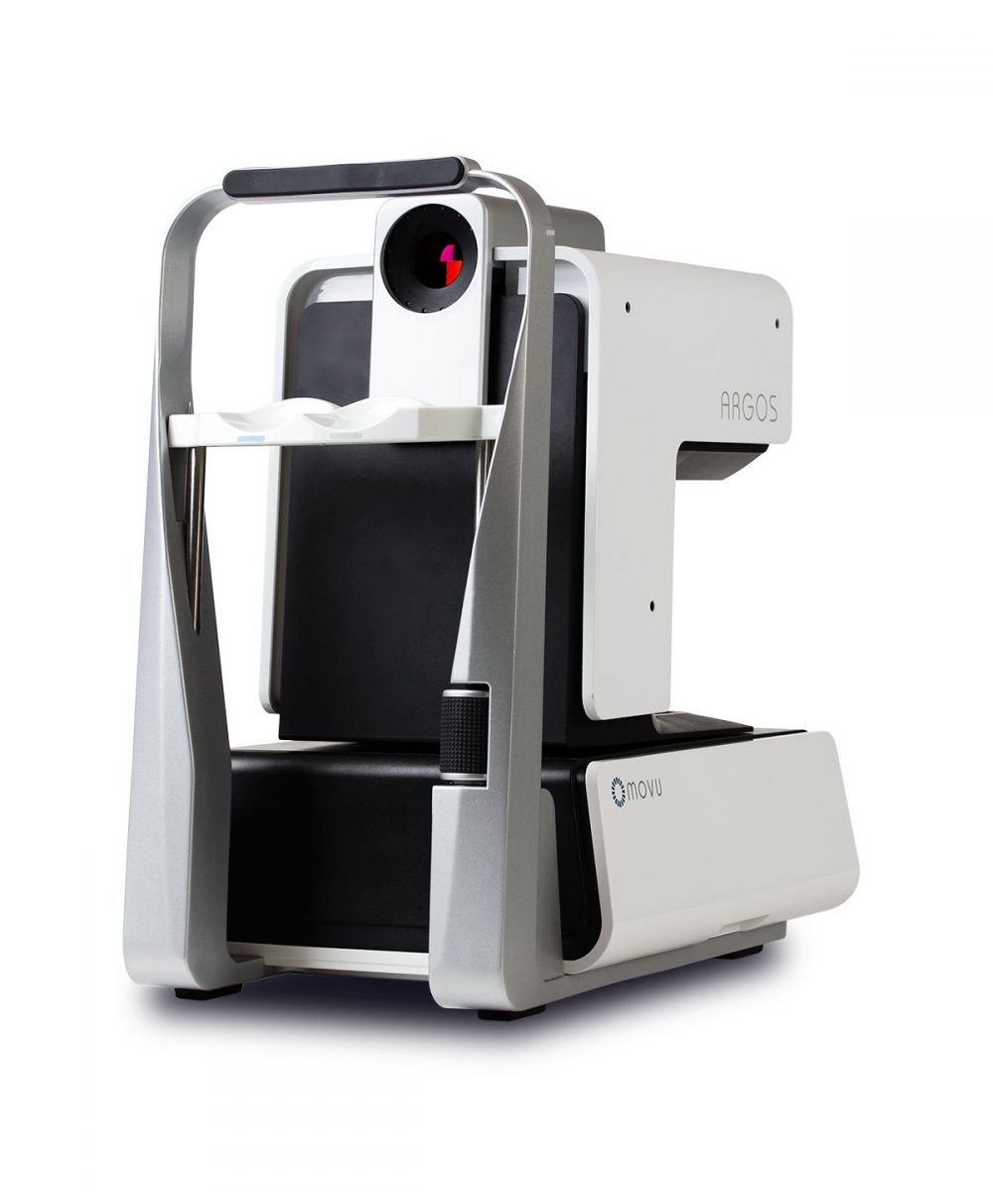
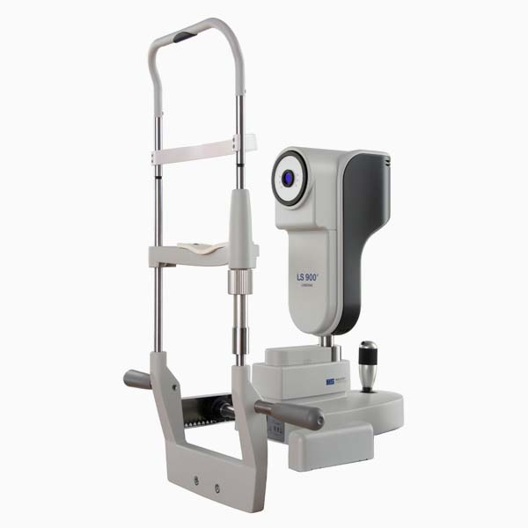
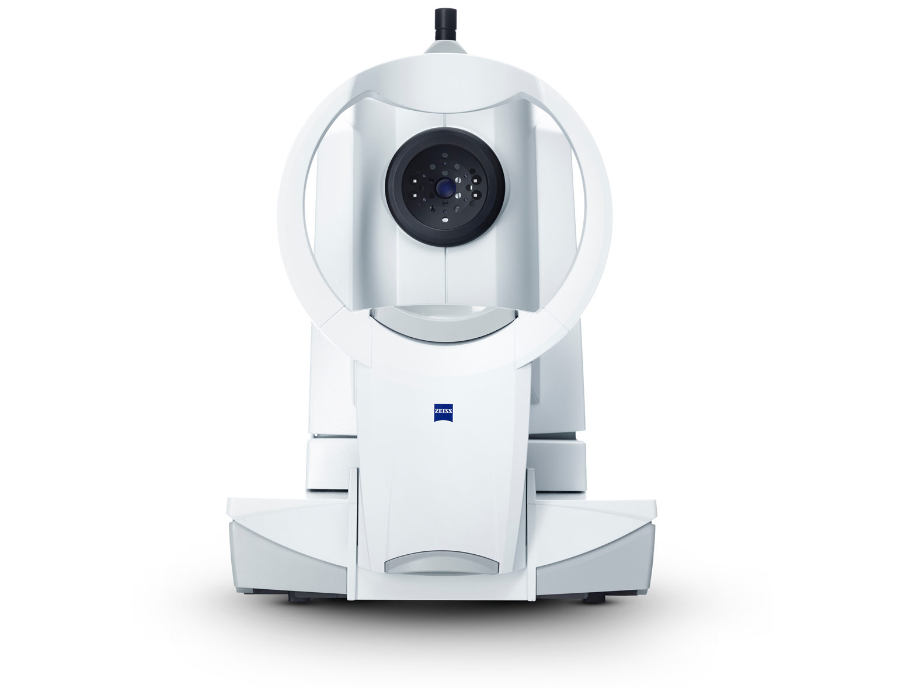
Biometry

Slide 9
Biometry
Optimize A constants- The devices allow for input of post-op refractive data to optimize calculations for each IOL
Post-operative outcomes analysis- Can be performed with software to help optimize A constants and review trends. Ie- Zeiss Veracity
Consistently using a specific formula can help develop a surgeon specific IOL nomogram with that formula

Slide 10
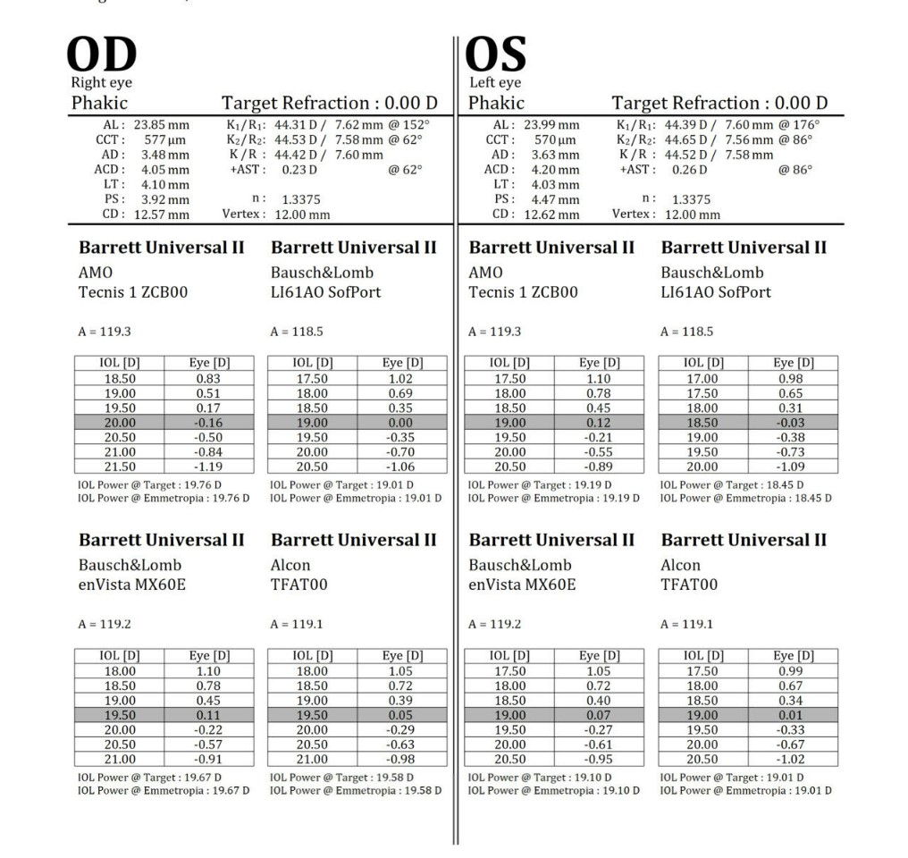
Biometry

Slide 12
Topography
An essential part of cataract surgery
If you want to correct astigmatism, you must do topography
Multiple different devices
Gauge the quality and axis of the astigmatism
I get topography on all my pre-op cataract patients

Slide 13
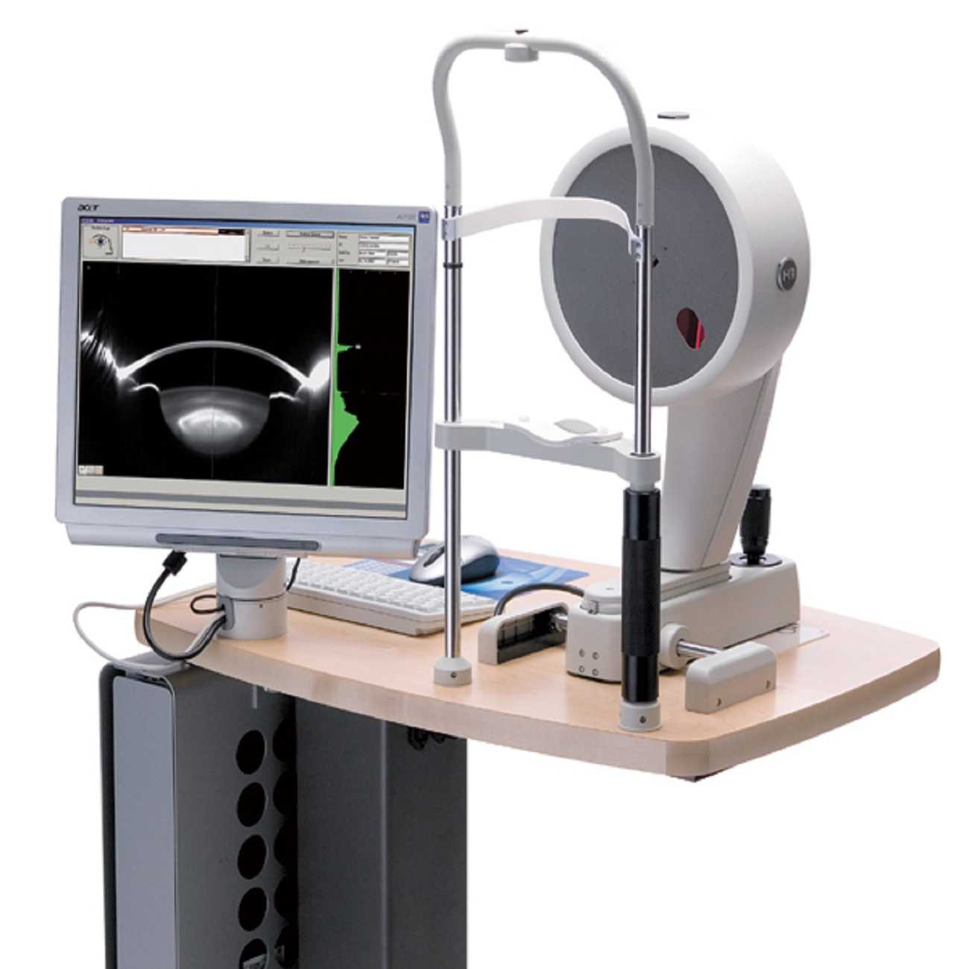
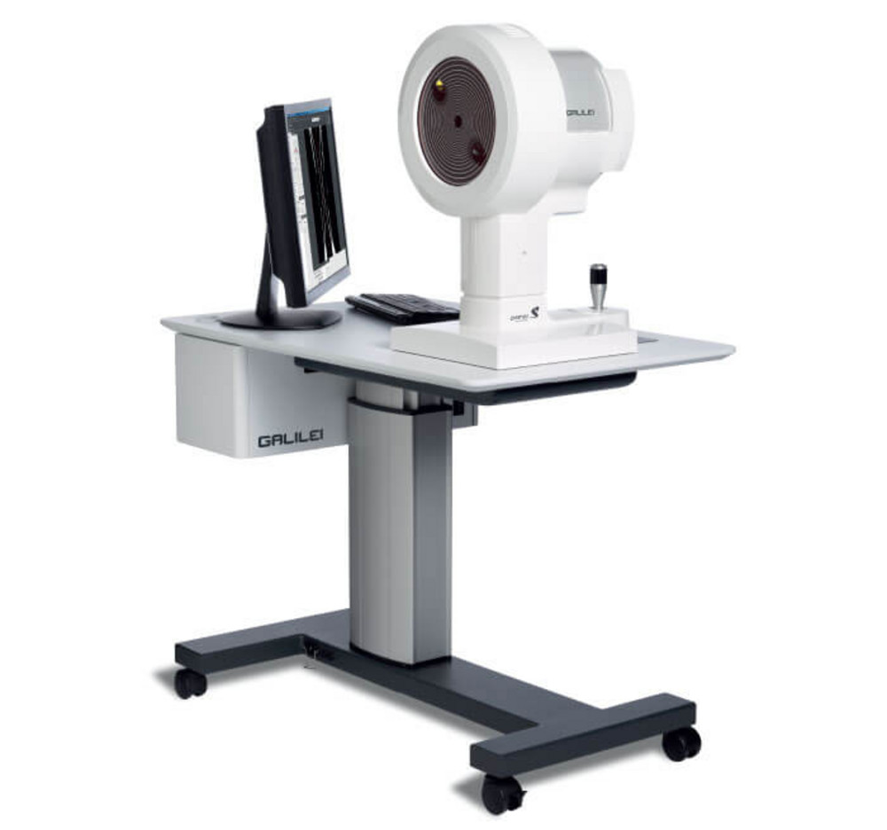

Slide 14
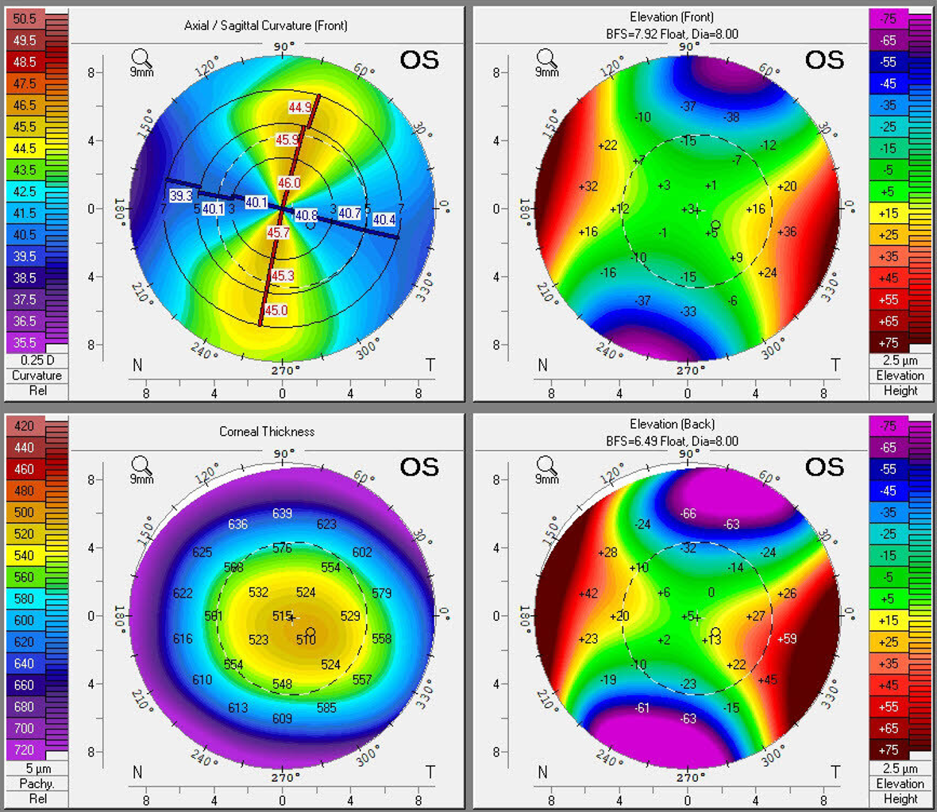

Slide 16
Refractive Cataract Surgery Results
Top performing formulas
Barrett Universal II, Kane, Hill-RBF, Olsen, Holladay 2
These formulas each achieve a spherical equivalent refractive result +/- 0.50 Diopters 70% of the time

Slide 18
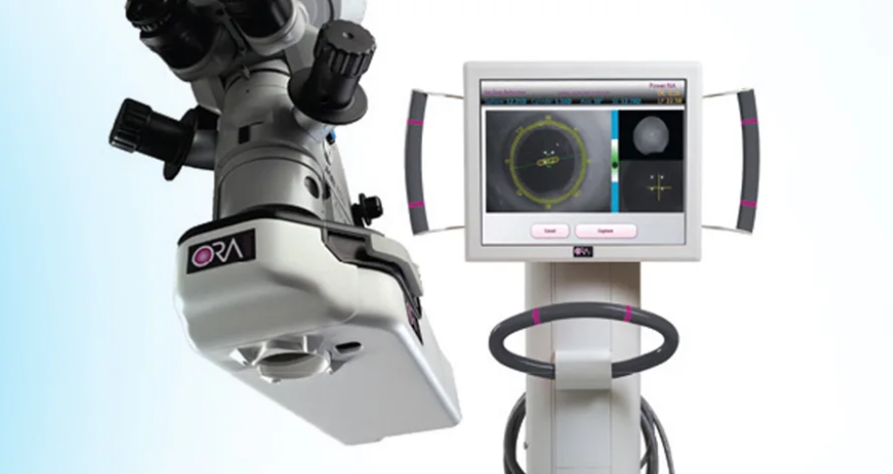
Intra-operative Aberrometry
ORA uses wavefront aberrometry data during the surgical case (specifically taken when the eye is aphakic) to measure the refractive power of the eye and suggest the most appropriate IOL
Can verify toric IOL orientation
Can verify IOL power post implantation

Slide 20
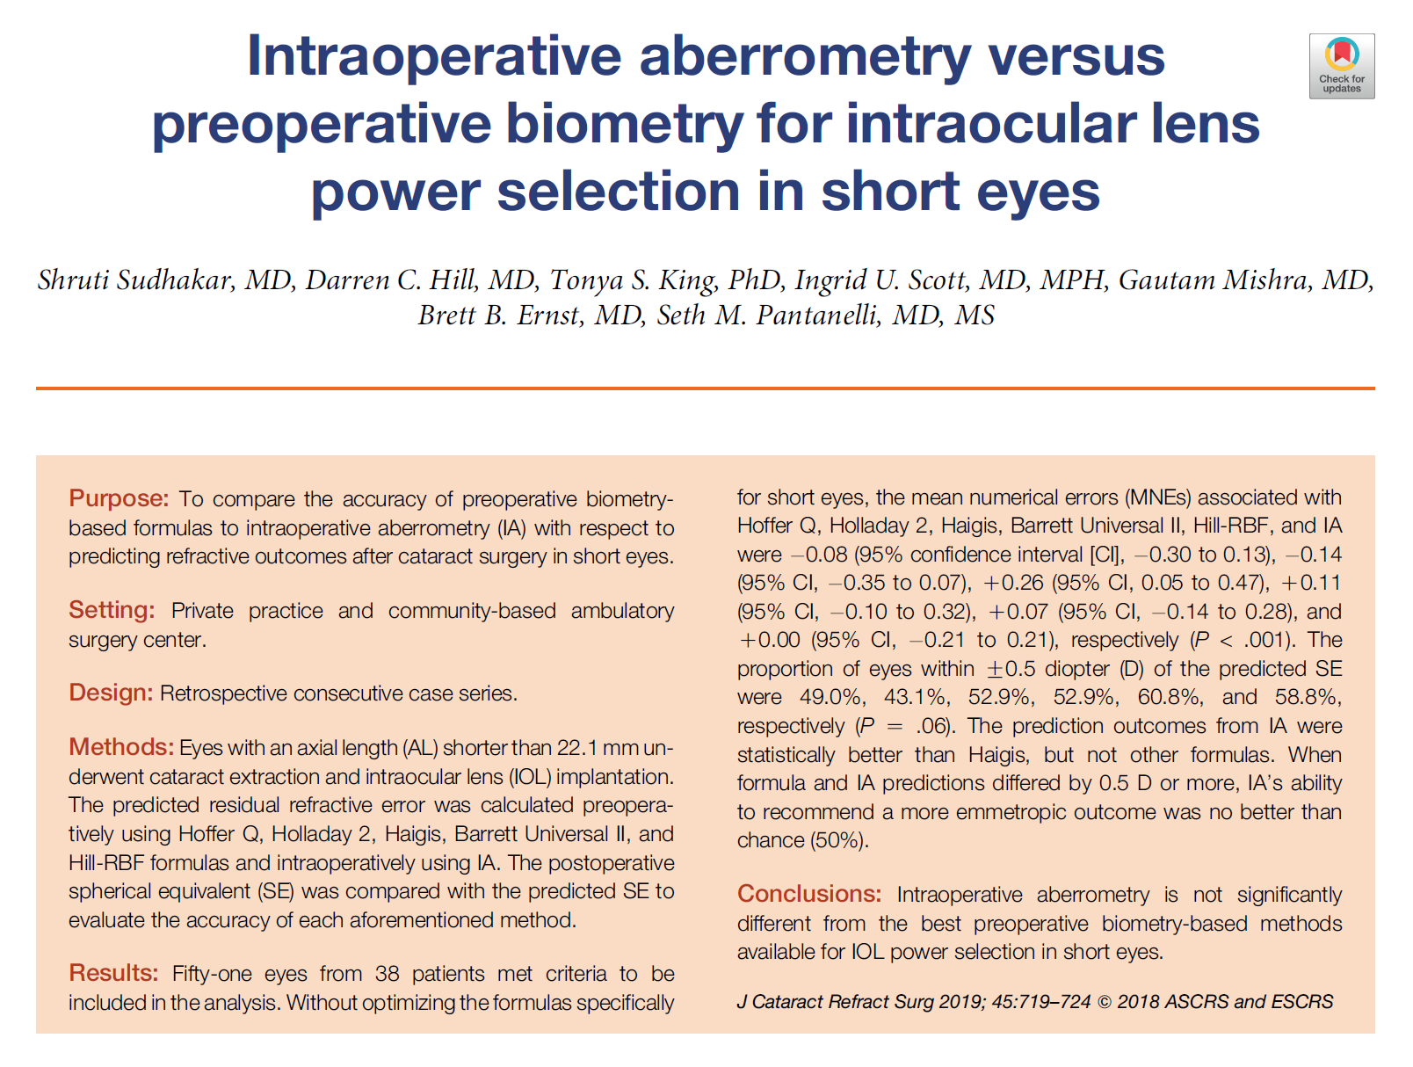

Slide 21
Astigmatism Management
Intra-op
On axis incisions
Relaxing Incisions- Blade or Femtosecond laser assisted
Toric IOLs
Post-op
Laser vision correction
Light Adjustable Lens

Slide 22
On Axis Incisions
Incision placed on the steep axis to reduce the astigmatism
Assuming surgically induced astigmatism (SIA) will be predictable

Slide 23
SIA- Double Angle Plots with 2.8mm incision

Slide 24
Relaxing Incisions
LRIs- Limbal Relaxing Incisions
CRIs- Corneal Relaxing Incisions
AK- Astigmatic Keratotomy
Partial thickness arcuate incision on the steep axis of the astigmatism
The smaller the optical zone, the larger the effect
Carry over from manual RK/AK using blades
Currently popularly done with a femtosecond laser

Slide 25
Pros of LRIs
Can reduce astigmatism in small, unpredictable amounts

Slide 26
Cons of LRIs
Cut corneal nerves
Inaccurate
Unpredictable over time
Can induce irregular astigmatism- Especially AK
Induce neurotrophia
Can make keratoconus worse
Antiquated method that will eventually be history (like RK)

Slide 27
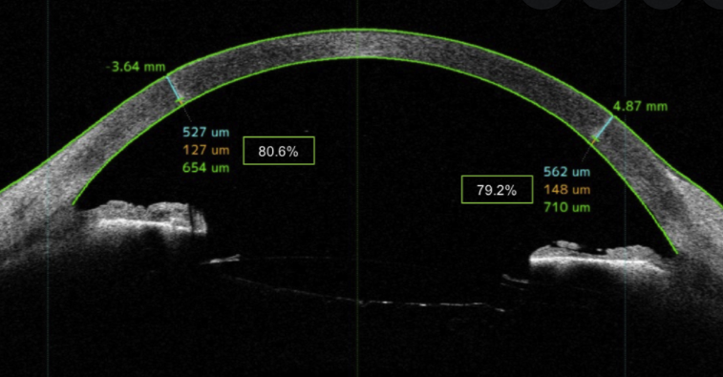
Toric IOL vs. LRIs

Slide 29
Toric IOL vs. LRIs
Journal of Cataract and Refractive Surgery 2021
Toric intraocular lens implantation vs. femtosecond laser-assisted arcuate keratotomy for correction of moderate astigmatism in cataract surgery
Conclusion- Toric IOL implantation showed better results in correcting moderate astigmatism. Despite this, FSAK is shown to be a safe technique for reducing astigmatism.

Slide 30
Toric IOL vs. LRIs

Slide 31
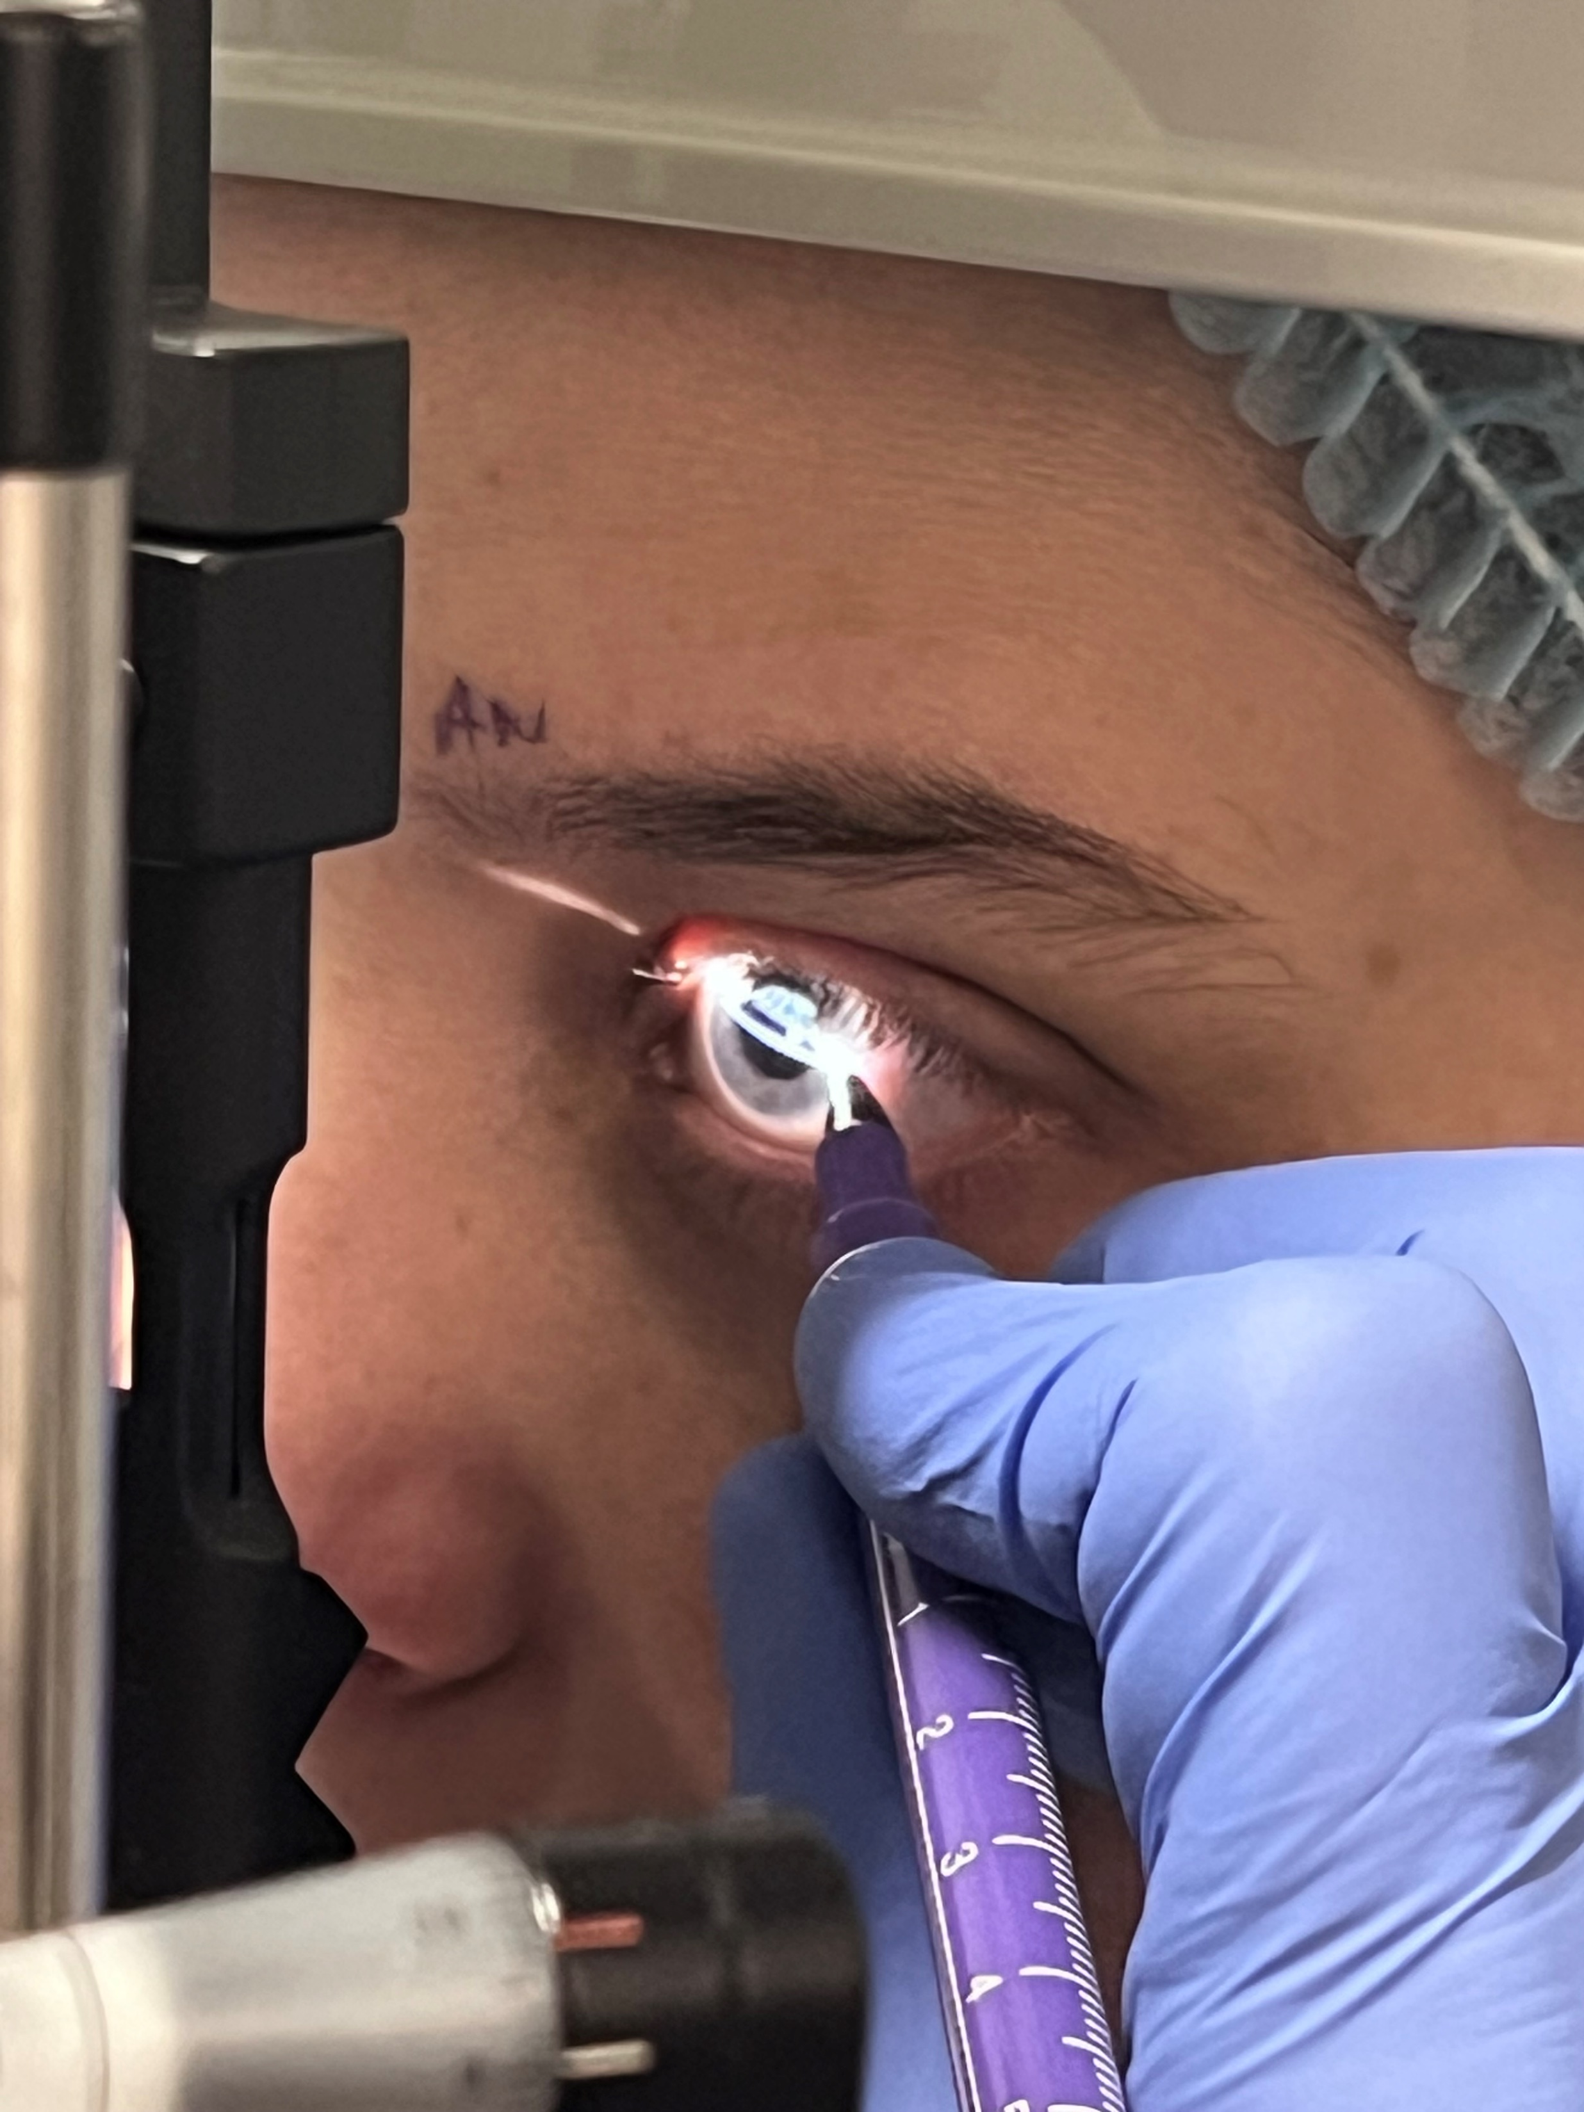
Toric IOLs

Slide 33
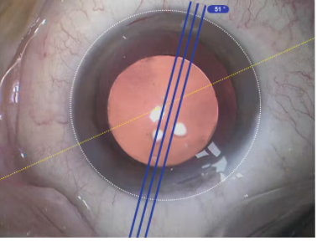
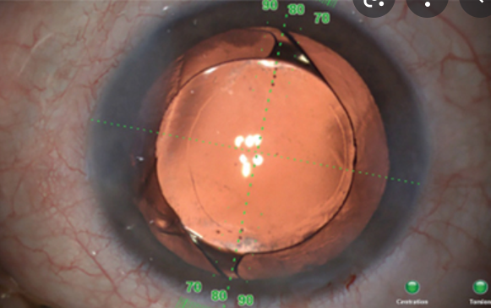
Toric IOLs- Guided Placement

Slide 34
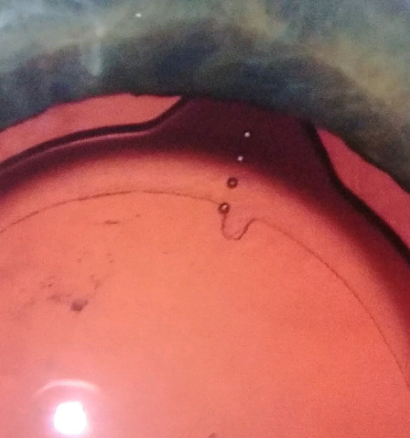
Toric IOLs
LENSAR IntelliAxis

Slide 35
Barrett Toric Calculator
Gives astigmatic results about 75% within 0.5D of intended target
Limiting factors are effective lens position and posterior astigmatism
Until we reach 100% all the time, there is room for improvement

Slide 36
Post-op Astigmatism Management- LVC
An effective refractive cataract surgeon must have an excimer laser
Refractive results with LVC are characteristically 95% within 0.5D
This is much more precise than the refractive results achieved with standard IOL formulas
Dr. Waite LVC enhancement rate for refractive cataract surgery patients in 2021 = 13%
No ORA, no femto, no LRIs, yes Movu Argos, yes Barrett, yes Pentacam

Slide 37
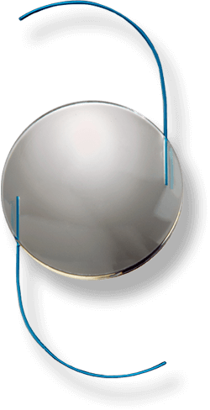
Light Adjustable Lens
Monofocal silicone IOL
Adjustable with UV light after surgery
Macromers in the silicone shift and change the shape of the IOL
Adjustable +/- 2 diopters sphere
Adjustable up to 2 diopters of cylinder
Multiple adjustments are possible
Final refraction is locked in place

Slide 38
Light Adjustable Lens

Slide 39
Light Adjustable Lens

Slide 40
Light Adjustable Lens
Amazing optics with a 3-piece silicone IOL
LASIK like predictability
Presbyopia correction is with blended vision
Limited to a monofocal IOL platform
Unable to use diffractive optics

Slide 41
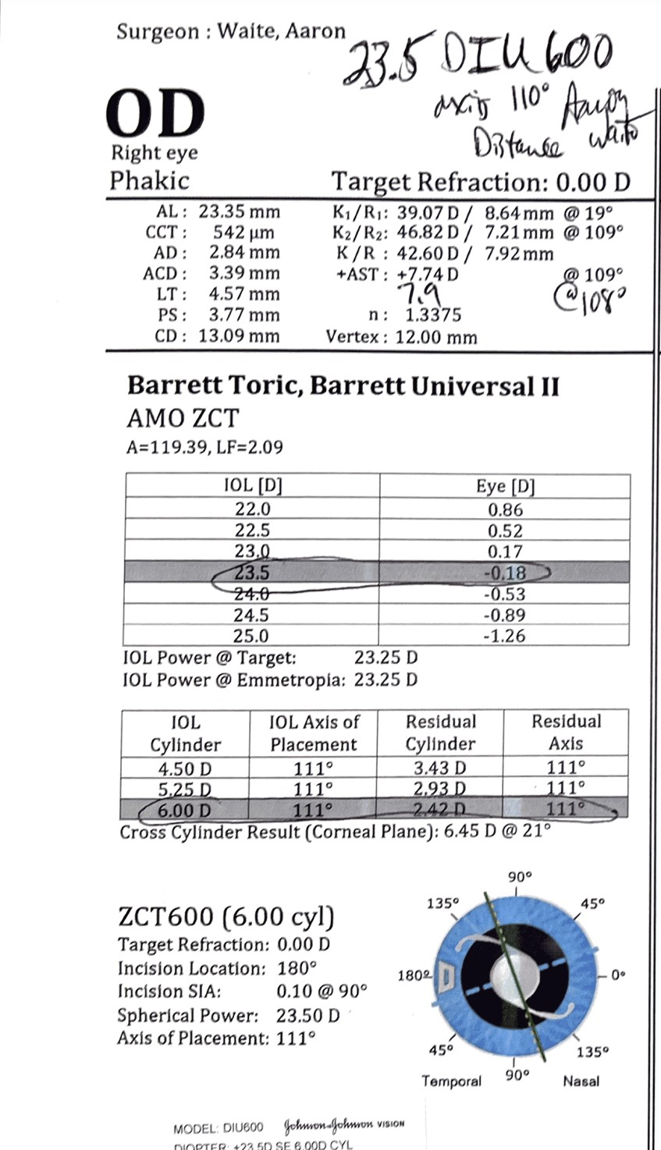
LAL Limits
+0.75 – 2.00 X 26
Post-op refraction with highest toric power IOL. 6D at IOL plane = 4.11D at the corneal plane

Slide 42
With-the-Rule vs. Against-the-Rule
More toric correction will be needed for against-the-rule astigmatism

Slide 43
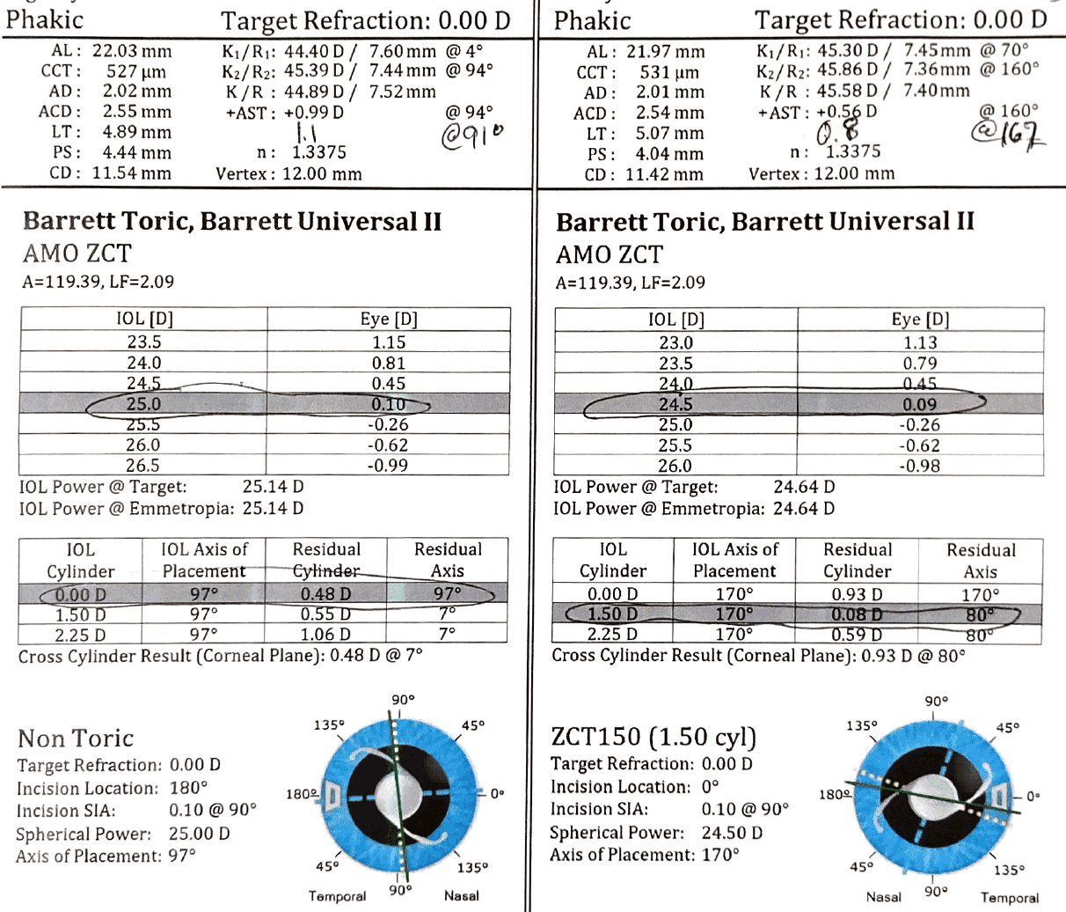

Slide 44
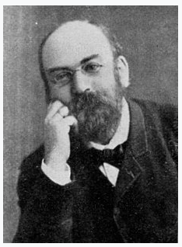
Posterior Corneal Astigmatism
Louis Javal- French ophthalmologist (1839-1907)
Javal’s Rule estimated an additional 0.5 diopters of against-the-rule astigmatism
Est. ocular astigmatism = corneal astigmatism(1.25) + (-0.50 X 90)
He assumed it was due to lenticular astigmatism
The posterior cornea acts as a low power minus lens which in most cases creates plus power along the horizontal meridian
This creates about 0.5 D of against-the-rule refractive astigmatism

Slide 45
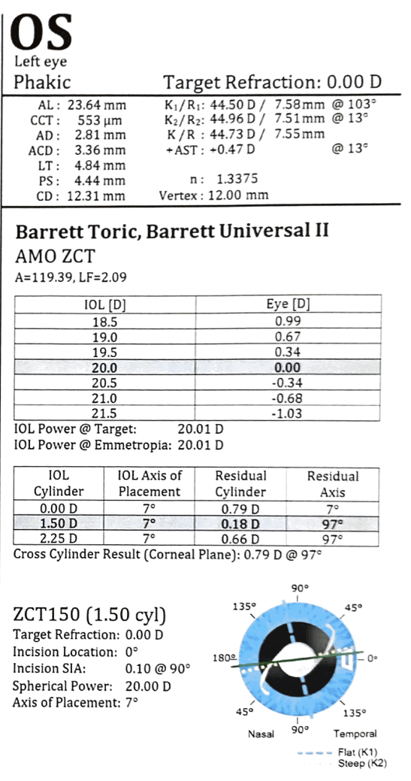
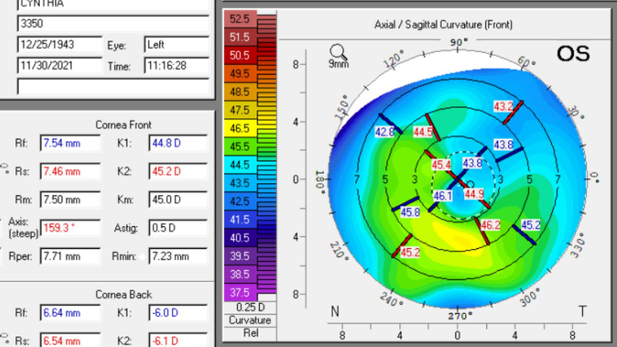
Topography ≠ Biometry

Slide 46
How to talk to patients
With cataract surgery, you will have the lens in your eye replaced
The new lens will last you the rest of your life
If you would like to function without glasses, now is the time to consider vision correction
The lens calculations are excellent, but they are not perfect
Sometimes there is a small prescription left over
This happens about 15% of the time, if it happens in your eye, it can be corrected to improve the focus

Slide 47
Summary
Astigmatism correction during cataract surgery is the norm
Toric IOLs and the Light Adjustable Lens are the most precise methods
Patients have excellent options for astigmatism and presbyopia correction with cataract surgery
Technology is always improving but right now is a great time to get cataracts

