Slide 1
Fundamentals of
Progressive Lens Design
-Pete Hanlin, ABOM

Slide 2
Disclosure
Walter “Pete” Hanlin employed by
Essilor of America.

Slide 3
Overview
Practical Limits of Progression Length
The Importance of Binocular Width
Positioning the Near
Control of Aberration & Magnification
Simultaneous Vision
Fitting & Troubleshooting PALs

Slide 4
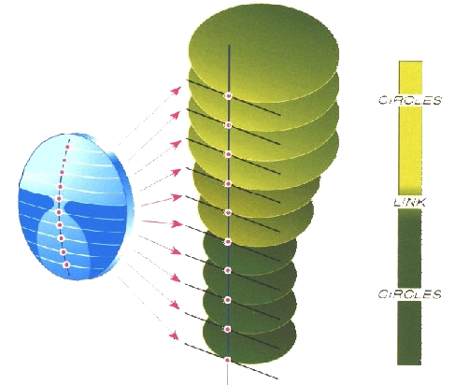
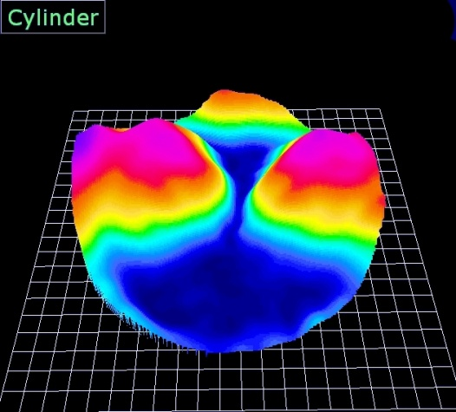
Progressive Addition Lenses
N
o
+
D
1959
2018

Slide 5
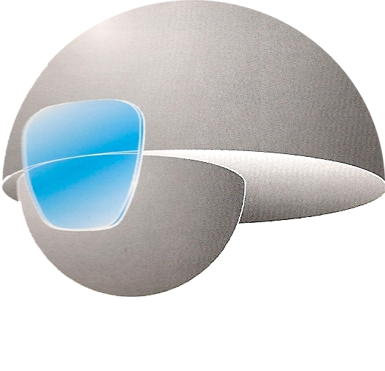
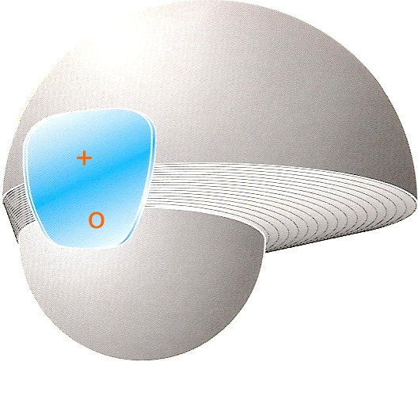
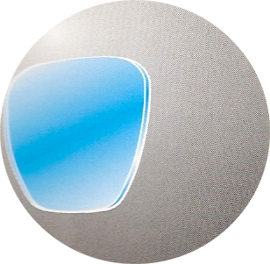
Correction of Presbyopia
Ophthalmic Options
NVO (Single Vision)
Segmented Lens (Bifocal)
Progressive Addition Lens (PAL)

Slide 6
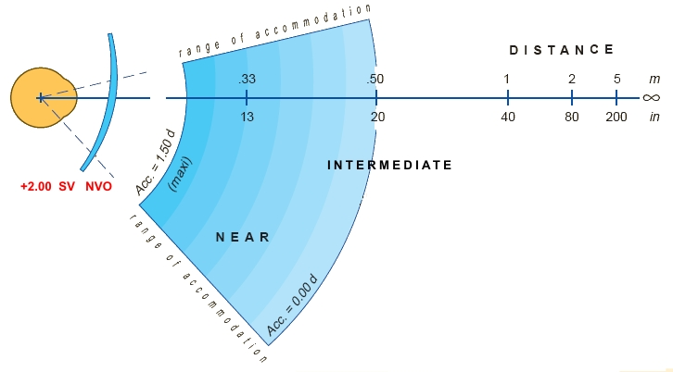
Correction of Presbyopia
NVO lenses provide
Wide fields of vision
Single focal length

Slide 7
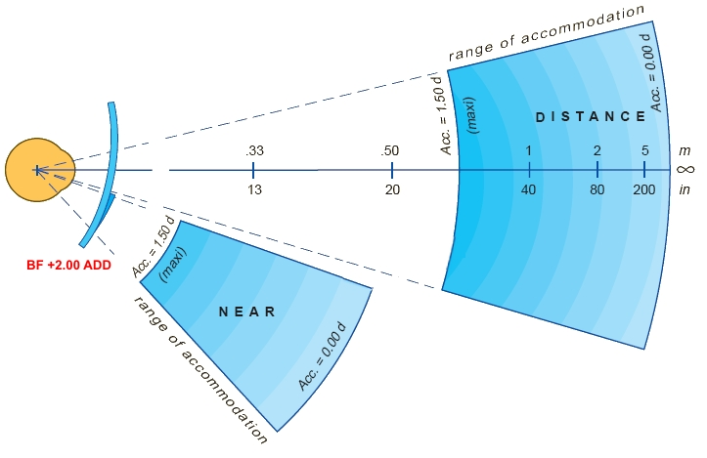
Correction of Presbyopia
Bifocal lenses provide
Wide fields of vision
Two focal lengths
A "focal gap" exists from 20-26"

Slide 8
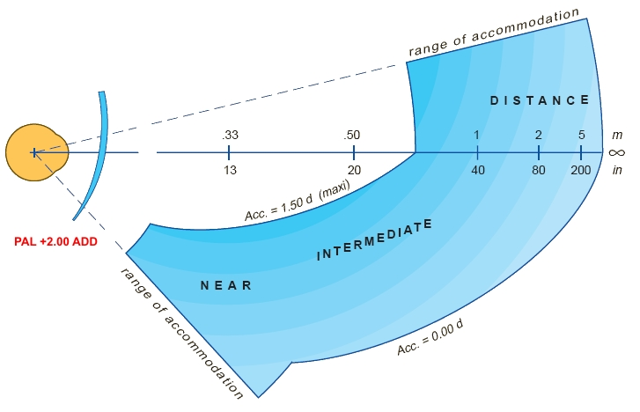
Correction of Presbyopia
Progressive lenses provide
Varying fields of vision
Infinite focal lengths

Slide 9
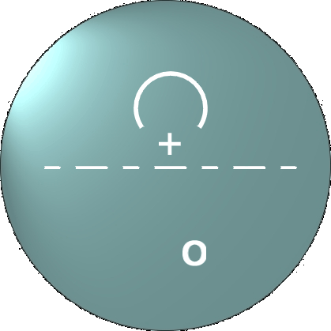
PAL Design Fundamentals
A PAL must balance numerous requirements
Vertical (progression length)
Horizontal (central zone width)
Foveal Vision (central zone sharpness)
Near Vision (inset)
Peripheral Vision (binocularity)

Slide 10
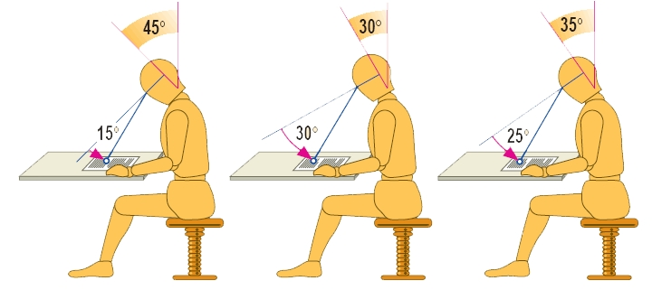
Progression Length
Natural reading posture must be preserved
Head tilts down 45°
Eyes vertically scan 15° (4.5”)
Maximum downward eye gaze must be < 25°
No Eyewear
Poor Design
Good Design
4.5”
9.0”
7.5”
2° of eye rotation = 0.85mm movement @ lens surface = 15mm movement @40cm

Slide 11
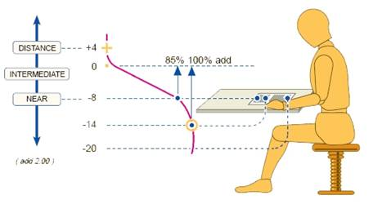
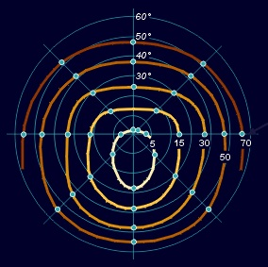
Progression Length
The ideal progression length is around 11.5mm to 85% of the ADD power
>12mm requires eye to look downward >25°
<12mm increases peripheral astigmatism
Why is 85% of the ADD important? Because the wearer requires 85% of ADD to see the top of a normally situated page.
Notes:
The "natural reading posture" of a person who does not wear correction uses a downward gaze achieved almost solely through head movement. The subject looks down at an angle of about 45 degrees, and uses eye movement primarily for scanning the length of the document. Once the head makes its initial movement, it rarely varies from that position by more than 5-10 degrees.
Most progressives require the wearer to reduce the amount of downward head gaze- relying instead on eye movements. This creates an unnatural posture in which the eyes are looking downward 30 degrees or more. Additionally, the head must be moved when moving from the top to the bottom of a printed page. Although most wearers will eventually "get used" to this position, it will never feel completely natural.
All Varilux progressives allow the wearer to move the head downward by 35 degrees or more. The result is less than 25 degrees of downward eye gaze. This is important for reasons described in the next slide.

Slide 12
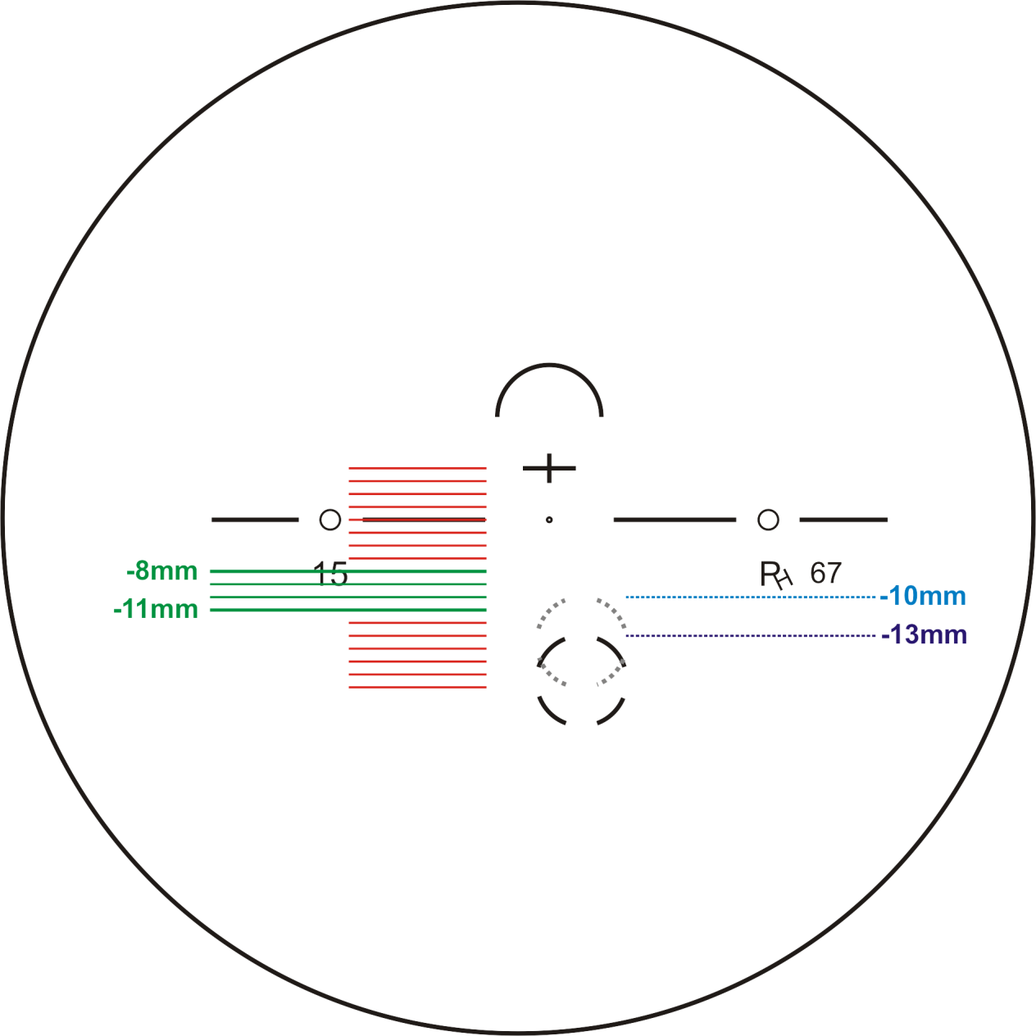
Progression Length
Progression <8mm results in unusable intermediate at +2.00 ADD
Progression 8-11mm required for functional intermediate & near zones
Progression >12mm results in uncomfortable near zone at +2.00 ADD
Notes:
Variable corridor length has recently become a popular “customization” feature. The concept is simple- the optician can select a shorter progression length to increase reading area, or a longer progression to increase intermediate area.
Unfortunately, many variable corridor PAL products provide a range of lengths that can negatively impact intermediate or near performance. Generally speaking, to ensure a progressive lens provides optimal vision in all zones, the corridor length must be between 8-12mm (from FRP “fitting cross” to the point where 85% of ADD is reached). This is illustrated in detail in the following slides.

Slide 13
Progression Length
+
+
+
5mm
pupil
0.33D / mm
0.25D / mm
1.65D total
1.25D total
0.18D / mm
0.90D total
6mm prog
11mm MFH
8mm prog
14mm MFH
Progression <8mm +2.00 ADD
= useless intermediate
11mm prog
17mm MFH
Notes:
Shortening the progression does provide easier access to the near zone. However, for the intermediate zone to remain usable, the progression should not be shorter than 8mm. As the progression length shortens the “rate of change” increases. For example, a +2.00 ADD lens with a 6mm progression (which is available from numerous manufacturers) has a rate of change of 0.33D per millimeter. Considering the pupil will be around 5mm in diameter, this means the beam of light entering the eye through such a lens will vary by 1.65D from the top to the bottom. As a result, the eye will be unable to bring ANY intermediate distance into focus.
If the progression length is shorter than 8mm, most patients will not have functional vision through the intermediate and would be better served with a blended bifocal or other lens that contains only distance and near power.

Slide 14
Progression Length
25° = 12.5mm
no muscular effort
>25° = >12.5mm
strain
Progression >12mm +2.00 ADD
= uncomfortable near
Notes:
If the progression is over 12mm long, the wearer will not be capable of achieving comfortable near vision. The reason has to do with the physiology of the eye. The ocular muscles are designed to allow the eye to gaze anywhere between 0 and -25 degrees (25 degrees downward gaze) with minimal or no effort. That is, the eye can comfortably gaze up to 25 degrees downward indefinitely with no discomfort or “strain.”
Every 2 degrees of rotation moves the line of sight approximately 1mm across a lens surface. Therefore, 25 degrees of downward rotation places the line of sight 12.5mm below the fitting cross. If the eye must rotate farther than 25 degrees downward to read, the ocular muscles will have to strain to maintain the reading position- making near vision uncomfortable (especially for extended periods of reading).
If the progression length is longer than 12mm, near vision will be uncomfortable.

Slide 15
Progression Length
INTERMEDIATE NEAR
+
5mm
pupil
0.18D / mm
25° = 12.5mm
0.90D total
no muscular effort
11mm prog
17mm MFH
Progression 8-12mm = optimal vision
Notes:
In conclusion, although opticians frequently express the desire to “have a knob to turn” (such as the option to select progression length) it is important to have a solid understanding of the optics and physiology involved in the function and wear of a progressive addition lens.
Varilux® lenses (all new range products) are available with automatically varying progression lengths which range between 8-11mm based on fitting height. Opticians may also manually select a progression length, but this is not a recommended practice. The manually selectable progression lengths are described by the minimum fitting height they support (i.e., selecting a “14mm progression” provides a progression that will support a minimum fitting height of 14mm- and will have a progression length of around 8.5mm). Progression lengths are available in 1mm increments between 13-16mm (which results in actual corridor lengths of 8-11mm).

Slide 16
Central Zone Width
Foveal vision width is only 2° wide
The area of the lens used for foveal vision must provide the sharpest vision possible

Slide 17
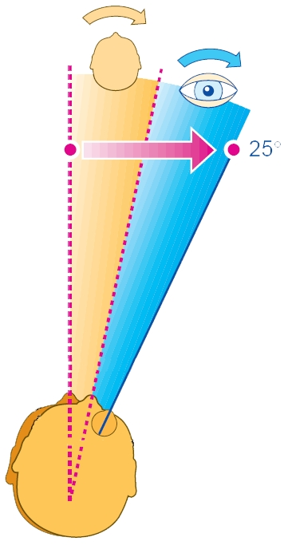
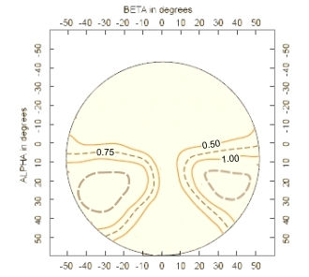
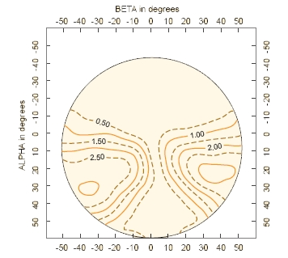
Central Zone Width
PALs must provide binocular visual width
Central 24° should have tolerable levels of balanced astigmatism
13°
12°
+
+
+1.00 ADD
+2.00 ADD

Slide 18
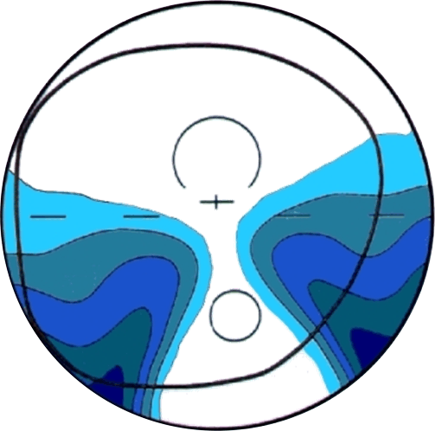
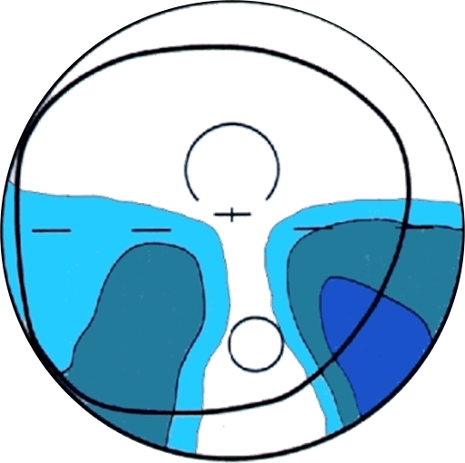
Central Zone Width
Contour Plots cannot be used to predict PAL performance
Both of these lenses are ADD +2.00. Which one has less astigmatism? Which one has a wider intermediate? Which one is preferred by wearers?

Slide 19
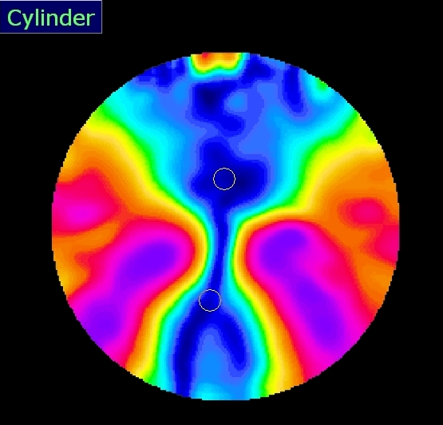
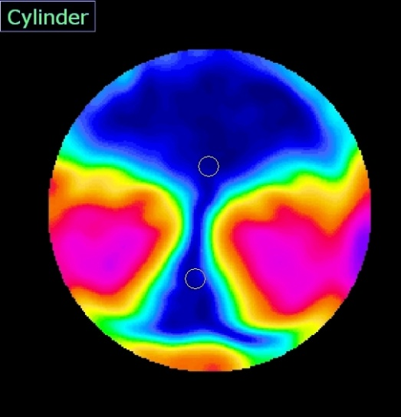
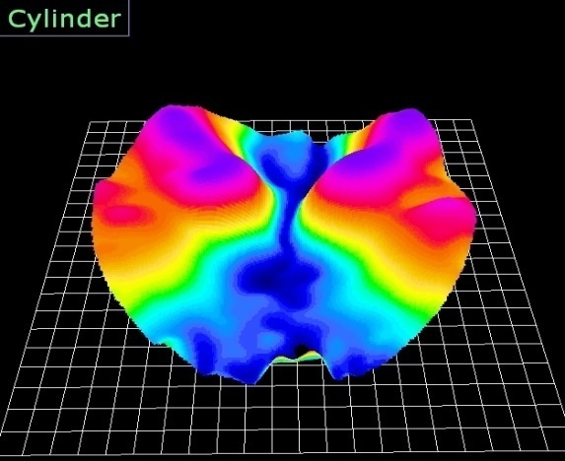
Central Zone Width
Contour Plots cannot be used to predict PAL performance
Dist Comfort – 0.211
Dist Width – 1.000
Near Comfort – 0.547
Near Width – 0.627
Change Focus – 0.029
Overall – 1.000

Slide 20
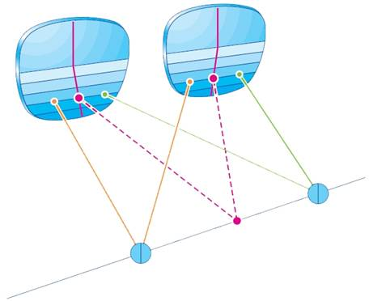
Binocularity
The optics of a PAL must be similar in every viewing position
The eyes must work together to maintain stereopsis (depth perception)
Notes:
A progressive must also not interfere with binocular vision. When the eyes are presented with disparate images, one eye is "suppressed." The result is the loss of stereopsis, or depth perception.

Slide 21
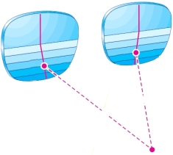
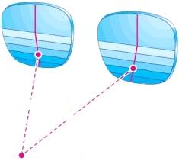
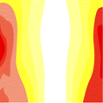
Binocularity
Imbalanced astigmatism will disrupt vision
Dissimilar Similar
Balance of astigmatism throughout the periphery ensures preservation of stereopsis- alignment of astigmatic axes further enhances binocularity.
Notes:
Varilux designs support binocular vision by providing "balance." This is important because when the eyes view through the peripheries of the lenses they are looking through opposite sides of the design. If the optics of each lens are not similar, binocularity is challenged. The images show the level of difference between each point in the lens. Each image represents the level of similarity throughout the lens. A pair of plano SV lenses would be primarily white across the entire graph. The lenses on the left represent an unbalanced design, the lenses on the right represent Varilux Panamic (this design concept was patented during development of Varilux Panamic).

Slide 22
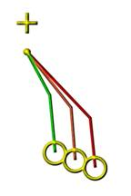
Near Vision Positioning
The near zone must be optimally placed
Reading power must be vertically accessible
Near zone must be centered in front of the eye
Notes:
Even the "widest" progressive designs have a spherical reading zone that is much narrower than a FT28 bifocal. To ensure the wearer receives a suitable width of clear near vision, the reading area must be centered in front of the eye when the wearer is viewing at near. Essilor progressives accomplish this by employing a variable inset. The primary factors used to determine the correct inset are the focal length of the ADD (which determines the optimal reading distance and therefore the amount of convergence). The amount of prism generated by the distance Rx and ADD power is also taken into account (since prism influences convergence as well).
Subsequently, all Varilux designs feature an inset that ranges from under 2mm per eye to over 4mm.
The concept of a varied inset was patented during the development of Varilux Panamic.

Slide 23
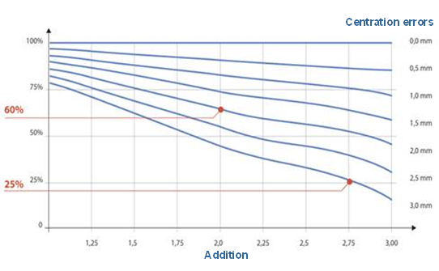
Near Vision Positioning
A 1mm error in positioning can result optimal near viewing area by 20-25%...

Slide 24
Near Vision Positioning
Optimization by ADD power
+1.00 inset
2.09mm
Low ADD powers have longer focal lengths- allowing the wearer to perform near tasks at a greater
distance
Lower ADD powers (and myopes) require smaller insets...

Slide 25
Near Vision Positioning
Optimization by ADD power
+3.00 inset
3.05mm
Higher ADD powers (and hyperopes) require larger insets...
High ADD powers create shorter focal lengths- requiring the wearer to converge further to view near objects

Slide 26
Near Vision Positioning
Rate of progression determines vertical position of intermediate/near zones…
+
FRP
(Fitting Cross)
O
Near Verification
Circle
+1.00
+2.00
+3.00

Slide 27
Near Vision Positioning
Higher ADD powers require quicker access
Horizontal placement should account for:
Prismatic effects of Distance Rx & ADD power
Convergence
Varied inset and power profile center reading power in front of the eye.
0.75
1.00
1.25
1.50
1.75
2.00
2.25
2.50
2.75
3.00
3.25
3.50
BASE ONE
1.81
1.92
1.98
2.09
2.29
2.29
2.29
2.29
3.05
3.05
3.05
3.05
BASE TWO
1.94
2.03
2.09
2.09
2.29
2.29
2.29
2.29
3.05
3.05
3.05
3.05
BASE THR
2.09
2.09
2.09
2.09
2.29
2.29
2.29
2.29
3.05
3.05
3.05
3.05
BASE FOUR
2.69
2.71
2.72
2.74
2.80
2.95
3.11
3.21
3.51
3.72
3.90
4.10
BASE FIVE
2.92
2.94
2.97
2.99
3.00
3.04
3.29
3.39
3.70
3.90
4.17
4.30
myope
emmetrope
hyperope
Notes:
Even the "widest" progressive designs have a spherical reading zone that is much narrower than a FT28 bifocal. To ensure the wearer receives a suitable width of clear near vision, the reading area must be centered in front of the eye when the wearer is viewing at near. Essilor progressives accomplish this by employing a variable inset. The primary factors used to determine the correct inset are the focal length of the ADD (which determines the optimal reading distance and therefore the amount of convergence). The amount of prism generated by the distance Rx and ADD power is also taken into account (since prism influences convergence as well).
Subsequently, all Varilux designs feature an inset that ranges from under 2mm per eye to over 4mm.
The concept of a varied inset was patented during the development of Varilux Panamic.

Slide 28
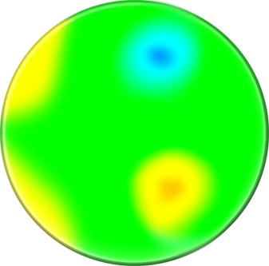
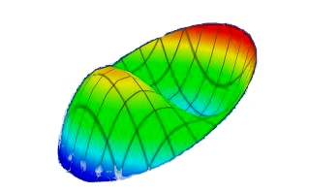
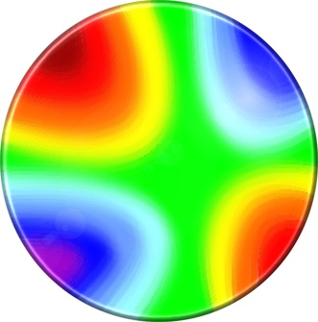
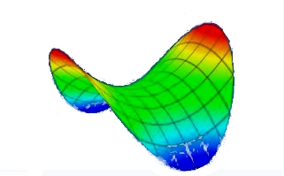
Central Zone Sharpness
The primary aberrations in a PAL are:
HOAs (central zone)
Astigmatism (peripheral zone)
COMA
ASTIGMATISM

Slide 29
Central Zone Sharpness
HOAs are minute aberrations which decrease image sharpness- (and CSF)

Slide 30
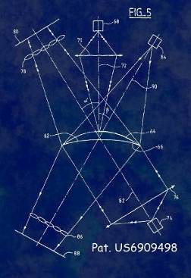
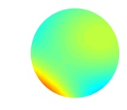
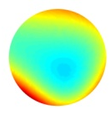
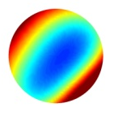
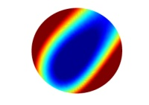
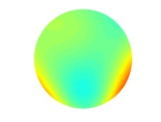
Central Zone Sharpness
Requirements for reducing HOAs
Equipment capable of analyzing the wavefront
Calculations capable of reducing HOAs
Wavefront
Corrected
Uncorrected
Uncorrected

Slide 31
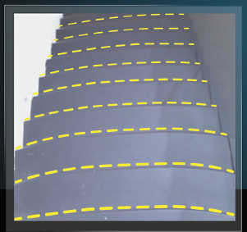
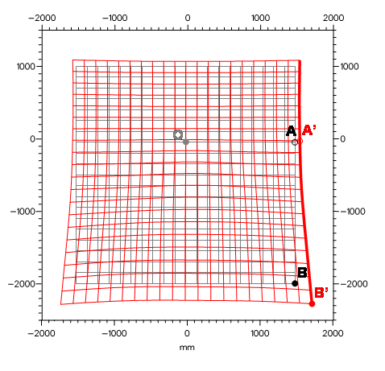
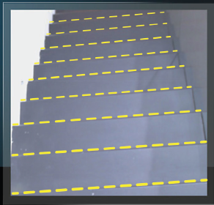
Management of Swim
Swim perception is caused by changing levels of magnification across a progressive design.

Slide 32
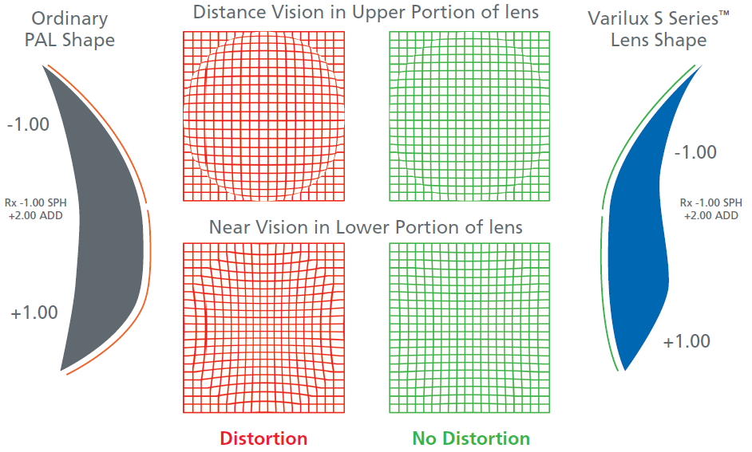
Management of Swim
Magnification is a function of lens shape (flatter shapes create less magnification).
Traditional Front
Surface PAL
Dual-Surface
Format PAL

Slide 33
Management of Swim
A single surface can be optimized for focus or distortion...
Management of Distortion
Patient's Blurred Vision
Controlled Correction
Management of Focus

Slide 34
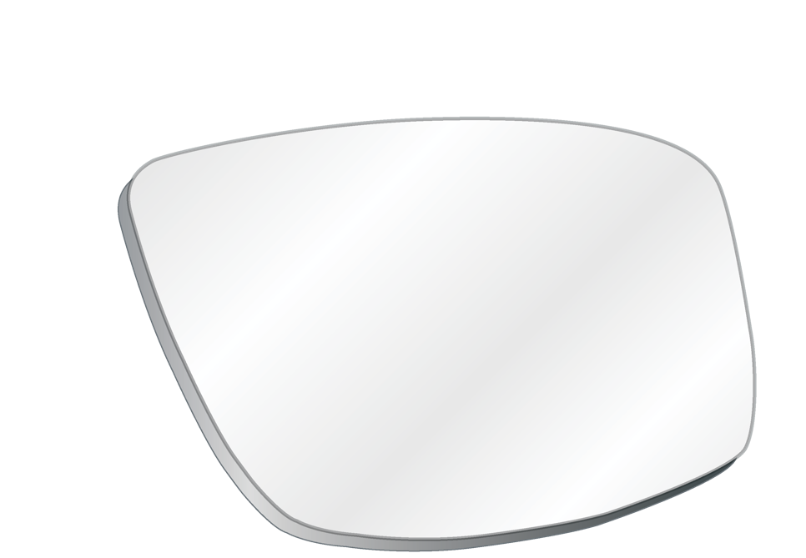
Simultaneous Vision
Progressive lenses seamlessly vary power to provide a decreasing focal length from distance to near...
Plus power increases from distance to near
Focus changes as gaze moves up and down the lens
Each area of the lens provides a single focal length
INTERMEDIATE VISION
FAR VISION
15% Add
60% Add
NEAR VISION
85% Add
100% Add

Slide 35
Simultaneous Vision
Rate of change and length of progression has been used to “customize” designs to different needs & requirements...
Decreasing focal lengths make near & intermediate a “zero sum”
Shorter progression = >near and <intermediate
Longer progression = <near and >intermediate
INTERMEDIATE VISION
FAR VISION
15% Add
60% Add
NEAR VISION
85% Add
100% Add

Slide 36
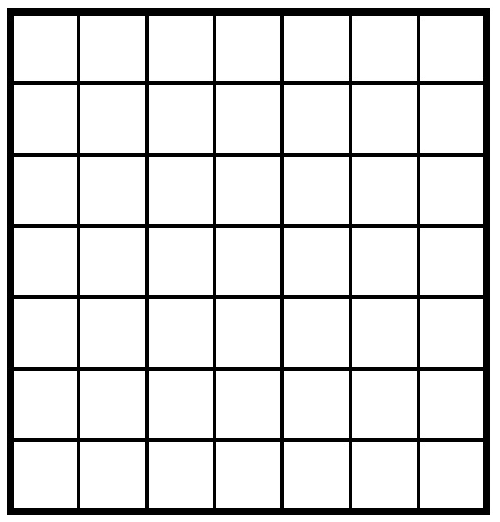
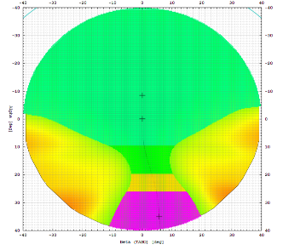
Simultaneous Vision
Multiple controlled powers can be used to provide simultaneous focus over a range of focal lengths...

Slide 37
Simultaneous Vision
Simultaneous vision reduces the need to shift gaze or head position to focus on near and intermediate objects...

Slide 38
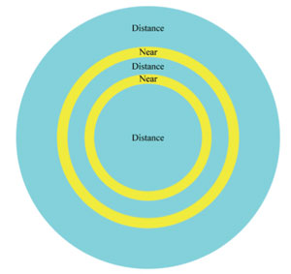
Simultaneous Vision
Simultaneous vision reduces the need to shift gaze or head position to focus on near and intermediate objects...
The simultaneous design concept is found in contact lenses.
Simultaneous PALs work on the same principal- but provide sharper vision (because simultaneous powers in a PAL only vary by 0.12-0.50D).

Slide 39
Avoiding PAL Problems
To ensure proper positioning:
Pre-adjust the frame
Measure monocular Fitting Heights
Measure monocular PDs
Verify cut-out

Slide 40
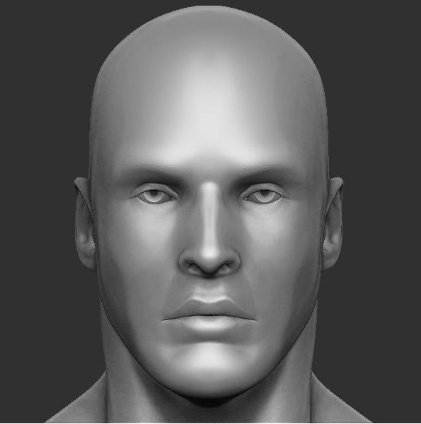
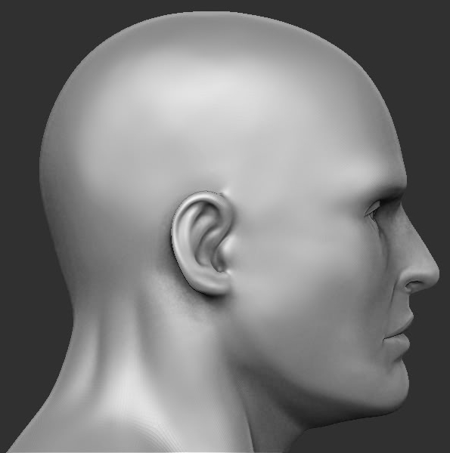
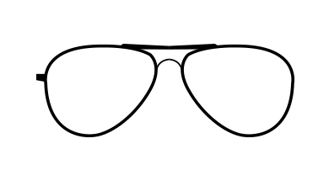
Pre-Adjust Frame
Adjust the frame prior to taking measurements.
The frame should sit evenly- with contact points at the nose pads and tops of ears.

Slide 41
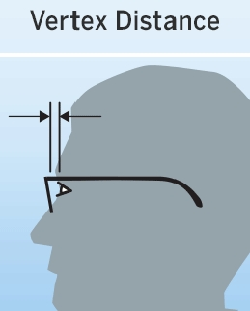
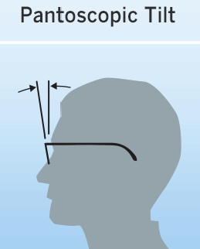
Pre-Adjust Frame
Ensure optimal positioning of lenses…
Optimal = 10-14mm
Average = 12mm
Small vertex is ideal
Optimal = 8°-12°
Average = 8°
Avoid negative panto
Optimal = 4°-12°
Average = 7°
Avoid negative wrap

Slide 42
Measure Fitting Heights
Measure fitting height from pupil center to bottom of “box.”
X
N
N
Pay attention to frame shape (meeting MFH does not guarantee reading area is available)!

Slide 43
Measure Fitting Heights
Be sure to measure BOTH eyes monocularly.
Fitting height is sometimes different for each eye.

Slide 44
Measure Monocular PDs
A Corneal Reflection Pupilometer (CRP) is indispensable for fitting…
Ensure your CRP is accurate!

Slide 45
Measure Monocular PDs
accurately
With both eyes set at “30mm,” the distance between the wires should be 60mm.
If the CRP is off by ≥1mm, the CRP needs to be recalibrated.
(On this CRP, setting the eyes at “29mm” and “30mm” results in a reading of 60mm.)

Slide 46
Troubleshooting PALs
Difficulty NEAR
Incorrect fitting height
Incorrect PD and/or inset
Progression cut off
Incorrect ADD/Rx
Progression too long
Poor binocularity
Difficulty INTERMEDIATE
Incorrect PD and/or inset
Incorrect fitting height
Progression too short
Incorrect ADD/Rx
Difficulty FAR
Incorrect fitting height (high)
Incorrect ADD/Rx
Progression too soft
Poor binocularity
Insufficient wrap
Difficulty TRANSITION
Incorrect PD and/or inset
Poor binocularity
Insufficient wrap
(“Pulling” is almost always a binocularity issue)

Slide 47
Pete Hanlin, ABOM

