Slide 1
Optical Crosses I don’t get it.

Slide 2
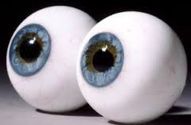
The things we say..
OD - Oculus Dexter
Right eye
OS - Oculus Sinister
Left eye
OU - Oculus Uniter
Both Eyes

Slide 3
The things we say…
Myopia- Nearsighted
Hyperopia - Farsighted
Spherical
Spherocylinder
Astigmatism
Simple
Compound
Hyperopic
Myopic
Mixed
Oblique

Slide 4
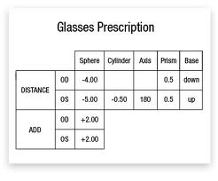
Things we MUST watch
In the Written Prescription
Decimal Points
Zeros for power
Axis

Slide 5
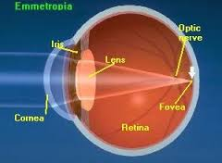
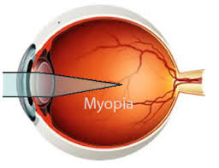
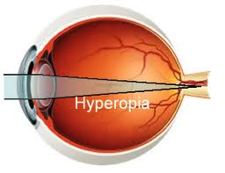
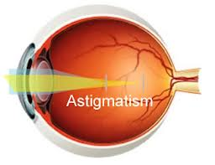

Slide 6
Optical Cross
OD
OS
90
90
180
0
180
0

Slide 7
Minus Spheres
OD -2.00 Sph OS -2.50 Sph
What kind of lens is prescribed?
Myopia, nearsighted
What will the lens cause the light rays to do?
Diverge

Slide 8
Minus Spheres
OD -2.00 sphere OS -2.50 sphere
-2.00
-2.50
-2.50
-2.00

Slide 9
Minus Spheres
OD -2.00 Sph OS -2.50 Sph
What happens in a frame with a large eye size?
Watch thickness
If this is a first prescription, what will the patient notice?
Objects appear smaller
Patient feels taller

Slide 10
Plus Spheres
OD +1.50 Sph OS +1.50 Sph
What kind of lens is prescribed?
Hyperopic, farsighted
What will the lens cause the light rays to do?
Converge

Slide 11
Plus Spheres
+1.50 sphere OU
+1.50
+1.50

Slide 12
Plus Spheres
OD +1.50 Sph OS +1.50 Sph
What happens in a frame with a large eye size?
Watch thinness
If this is a first prescription, what will the patient notice?
Objects appear larger
Patient feels shorter

Slide 13
Lenses for Astigmatism
OD +2.00 – 0.75 x 094 OS +1.75 – 0.50 x 083
What type of ametrope is this correcting?
Compound Hyperopic Astigmatism
What kind of lens is this?
Spherocylinder

Slide 14
Lenses for Astigmatism
OD +2.00 – 0.75 x 094 OS +1.75 – 0.50 x 083
+2.00
+1.75
+1.25
+1.25

Slide 15
Lenses for Astigmatism
OD +2.00 – 0.75 x 094 OS +1.75 – 0.50 x 083
What happens in a frame no eyewire?
Watch edge thinness
If this is a first prescription, what will the patient notice?
Objects appear larger
Patient feels shorter

Slide 16
Lenses for Astigmatism
OD -5.50 -0.50 x 004 OS -5.00 -0.25 x 178
What type of astigmatism is this?
Compound Myopic

Slide 17
Lenses for Astigmatism
OD -5.50 -0.50 x 004 OS -5.00 -0.25 x 178
-6.00
-5.25
-5.50
-5.00

Slide 18
Lenses for Astigmatism
OD -5.50 -0.50 x 004 OS -5.00 -0.25 x 178
Where is the thickest part of each lens?
180 degrees
What would you want to do when selecting a frame?
Center the optical center horizontally

Slide 19
Lenses for Astigmatism
OD -2.25 -2.25 x 005 OS -1.75 -1.75 X 175
What type of astigmatism is this?
Compound Myopic
Where is the light focusing in the eye?
One on the retina, one in front of the retina

Slide 20
Lenses for Astigmatism
OD -2.25 -2.25 x 005 OS -1.75 -1.75 x 175
-4.50
-3.50
-2.25
-1.75

Slide 21
Lenses for Astigmatism
OD -2.25 - 2.25 x 005 OS -1.75 -1.75 X 175
Where is the thickest part of the lens
180 line at the edges

Slide 22
Lenses for Astigmatism
OD +3.00 – 6.00 x 180 OS +2.50 – 5.00 x 180
What type of ametrope is this?
Mixed
Where is the light focusing in the eye?
One in front and one behind

Slide 23
Lenses for Astigmatism
OD +3.00 – 6.00 x 180 OS +2.50 – 5.00 x 180
-3.00
-2.50
+3.00
+2.50

Slide 24
Lenses for Astigmatism
OD +3.00 – 6.00 x 180 OS +2.50 – 5.00 x 180
Would you fit this patient in an aviator shape frame?
Where is the thinnest part of the lens
45 line at the edges

Slide 27
Questions

