Slide 1
How to Be A Rockstar!
Management Excellence

Slide 2

Be a Leader Not a Boss
Bosses:
Create fear
Drive people
Say “do”
Relies on authority
Fix blame
Knows all
Makes work drudgery
Say “I”

Slide 3

Be a Leader Not a Boss
Leaders:
Create confidence
Guide people
Say “Let’s do”
Relies on cooperation
Correct mistakes
Ask questions
Make work interesting
Say “We”

Slide 4

Clearly Define Duties
70% of staff
do not clearly understand
what is expected
of them…

Slide 5
Your Staff
Write down the name of each staff member

Slide 6

Determine job titles
Front Desk Coordinator
Tech
Optician
Office Manager
Chief Cook and Bottle Washer
Trouble maker…

Slide 7

Clearly Define Duties
Determine duties
  Job descriptions
Establish priorities
  Critical to execution of duties
Meet one on one with staff

Slide 8

Effective Training
50% of staff say they don’t feel properly trained to perform their duties.
How do you train?

Slide 9
Effective Training
Determine performance deficiency
  Why does it exist?
  How to fix?
    Mentor - shadow
    Classroom
    Text books
    Auditory – Visual – Tactile
  Follow-up weekly - critical

Slide 10

Value of Good Employees
Less than 30% of supervisors have performance objectives for their staff.

Slide 11
Value of Good Employees
How do you plan an objective?
S M A R T E R

Slide 12
Performance Agreement
S – specific
M – measurable
A – agreement with the staff member
R – realistic
T – time defined
E – extra effort
R – related to practice goals

Slide 13
PERFORMACE AGREEMENT
Vague
  Work harder
  Make patients happier
  Save money
  Be a team player
SPECIFIC
  Increase revenue
  Fill appointment book
  Reduce inventory
  Arrive on time

Slide 14
PERFORMANCE AGREEMENT
MEASURABLE
  Increase revenue by 10%
  Ask every patient if family members need appointment
  Decrease frame inventory to volume one quarter our patient volume
  Arrive 15 minutes before the first scheduled patient

Slide 15

PERFORMANCE AGREEMENT
AGREEMENT
  Staff agreement
    Commitment or De-motivated
    Remember to motivate and involve staff in the process

Slide 16
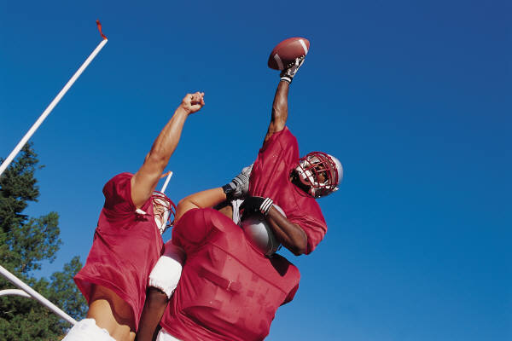
PERFORMANCE AGREEMENT
REALISTIC
  Aim high but reasonable
  Evaluate staff:
    Experience
    Training
    Previous behavior
    Demonstrated capabilities

Slide 17

PERFORMANCE AGREEMENT
TIME DEFINED
Increase revenue by 10% -
each month - 11/30
Ask every patient if family members need appointment
  daily report volume at 11/30 meeting
  Decrease frame inventory to volume one quarter our
  patient volume –
  December 31
  Arrive 15 minutes before the first scheduled patient –
  effective immediately

Slide 18

PERFORMANCE AGREEMENT
TIME DEFINED
  Daily check in
  Weekly report
  Monthly meeting

Slide 19

PERFORMANCE AGREEMENT
EXTRA EFFORT
  “Instill in your staff the idea that they should go
  beyond the ordinary objectives”
  Jack Welch CEO – GE

Slide 20

PERFORMANCE AGREEMENT
RELATED TO PRACTICE GOALS
  74% of staff do not understand the practice objectives
    Mission Statement
    Goals
    How is your practice different
  The more staff understand the value of what they are doing, the more motivated they are to do well.

Slide 21

How do you get it done?

Slide 22

Monitoring
Direct observation
  Stop
Time logs
  Look
Feedback
  Listen

Slide 23
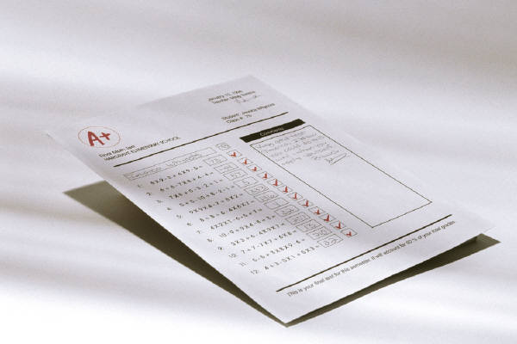
Monitoring
Documenting
  Written report – manager log
    Facts not subjective
    Positives and negatives

Slide 24


Monitoring
  Rewards
    Autonomy
    Responsibility
    Flexible schedule
    Awards
    Gifts
    Money
Feedback to employee
  Frequency
    Daily
    Weekly minimum

Slide 25

Monitoring
Punishment
  Demotion
  Decrease in authority
  Decrease in compensation
  Termination

Slide 26

Results
The value of a job well done
  Patient satisfaction
  Practice growth
  Pleasant work environment

