Slide 1
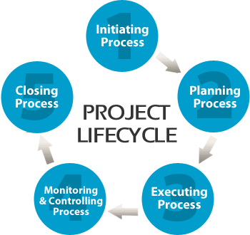
How To Implement Organizational Change 2 hours
Lynn E. Lawrence, CMSgt(ret), USAF
CPOT, ABOC, COA, OSC

Slide 2
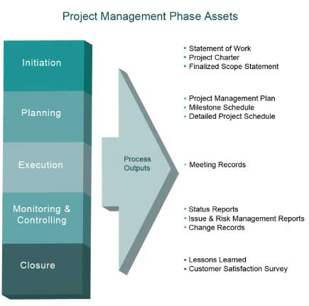
Objectives
Identify The Need For Change
Strategic Leadership/Management
Explain why change is so difficult
Why And How To Manage A Project
How To Implement A Project Schedule
Monitoring/Controlling The Project
Readjusting
Finalizing the change

Slide 3
Exercise: Part 1
Write down the last bad change that occurred in the office where you work

Slide 4
The Basics – Start to finish
What do you want to do
How do you plan to do it
Operational, marketing, deployment
What resources will you need
Cost (operational + capital)
Required resources (equipment, manpower, supplies, space, etc.)
How long will it take
How will you monitor and control it
Mitigate the risk involved
What are the deliverables that identify task completion
How will you close the project

Slide 5
Attributes of a Project
Driver – Why are we doing this?
Source – Who decided to do this project?
Customer – who will benefit from this project?
Degree of certainty – what we know now/later impact
Expected outcome – what is expected/how will it be measured… profits, market impact

Slide 6
Project Attributes Cont…
Organizational reach – what areas will be involved?
Scope – how big is it?
Degree of complexity – the extent integration is needed with other projects or areas
Strategic level – strategic or tactical, how does this integrate into the overall strategy of company?

Slide 7
Phases of A Project
Initiating
Planning
Execution
Monitoring Control
Closing (sealing the deal)

Slide 8
Identifying The Need For Change
Organizational Direction
Mission
Vision
Goals
Strategic / Operational Strategy
Where does the propose change fit into the organizational strategic and operation plan
Where does the change fit into the plan?

Slide 9
Establishing The Need For Change
Problem-Driven – overgrown your space
Problem is a gap between a actual and desired conditions
Opportunity-Driven – equipment (market trends)
Opportunity is a gap between current conditions and a desired future state
Mandate-Driven – compliance (HIPAA, OSHA, Insurance)
No options exist, a deficit needs correction, a legal or moral issue

Slide 11
Why is change so difficult?

Slide 12
Who is in charge?

Slide 14
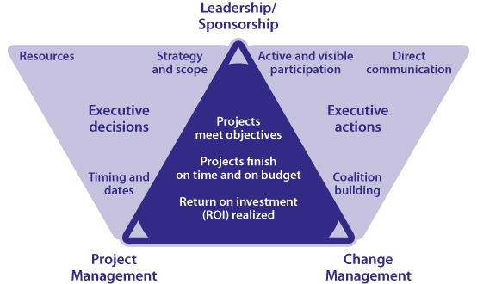
John Kotter’s “Leading Change” Book
Eight steps to change:
1. Establish a sense of urgency.
2. Create a guiding coalition
3. Develop a vision and strategy
4. Communicate the change vision
5. Empower broad-based action
6. Generate short-term wins
7. Consolidate wins and produce more change
8. Anchor new approaches into the culture.
Notes:
Without the first three steps, there is rarely a solid enough foundation to bring about lasting change. Here's what I've learned about the needed preparation before changes are introduced and the "vision is cast."
Establishing a sense of urgency means that people in the church recognize that there's a real problem. Until they sense "Something's got to be done," too often a congregation will live in denial.
A guiding coalition
It's equally important to have a diverse group, a "coalition," develop and plan the possible changes. Unfortunately, it took me awhile to realize the importance of this. In my enthusiasm, I have often run way out in front of my congregation and beckoned them to follow.
Develop both vision and a strategy
Vision and strategy are easier to accomplish when there is a sense of urgency that is widely recognized, and is getting the attention of a guiding coalition. But in addition, there must be clarity of both the purpose and the process.

Slide 15
Kurt Lewin’s 3 Step Organizational Change
Unfreeze the current situation – make them want to change their behavior … what precipitated the need?
Create change – establish new behaviors – movement takes place after employee buy-in to the change
Refreeze – making new behaviors stick -

Slide 16
The Heart of the Organization
Core Values
Ethical Leadership
Problem Solving
Diversity
Readiness Levels
Stress level

Slide 17
Core Values
Integrity – is accountability, honesty, humanity, openness, and courage
Service before self – identifies discipline, faith in the system, rule following
Excellence in everything – sense of community, personal excellence, operational excellence

Slide 18
Ethical Leadership
Provides direction
Sets an example for subordinates
The cornerstone of character
Prudence first, justice second
Professional relationships which are critical to good order and discipline

Slide 19
Exercise: Part 2
What was the result of the bad change?

Slide 20
Preparing Leadership

Slide 22
Problem Solving
General statement
Analyze the problem – gather data, no action at this time
What is the desired impact
Possible solutions – avoid judgment, brainstorm
Select the best possible solution
Develop a plan of action
Implementation/evaluation
Those affected by the change must be represented

Slide 23
Employee Readiness Levels
R1- unwilling/unable …insecure
R2 willing/unable … confident
R3 unwilling/able … insecure
R4 willing/able … confident

Slide 24
Expect Resistance To Change
Logical
The unknown
Something new
Uncomfortable with change
Illogical
The doesn’t make sense
This is the way we have always done it
Group-based
We don’t want to do it
Perceived resource issues
Burger King Mentality
The need for communication:
How receptive would you be if you heard through the grapevine that someone you didn't know was going to redesign your job and possibly do away with it without asking for your input?

Slide 25
How not to make change!
Provide visionary leadership that enables the process, rather than top-down, command-and-control micromanagement that inhibits it
From the bottom up
Without leadership/management control

Slide 26
Stress Levels
Physiological: effects on the body
Psychological: effects on the mind
Behavioral: outward manifestation
Extra-organizational: family, financial, marital

Slide 27
Personal Profile System
Recommend personality testing …
Dominance – impatient, stubborn, poor listener, controlling
Influence – crushed if not liked, social butterfly, optimistic
Steadiness – team-player, harmonious, stable, loyal, helping
Conscientious – motivated by recognition of work, rewards, compliance, quality, accuracy

Slide 28
What is the plan?
The plan must be connected to the vision and mission of the organization
The focus must not be 100% inward, but must have an outward focus as well
Must be communicated on the planning side to those being impacted

Slide 29
Exercise: Part 3
Why was the change necessary?
What difficulties do you anticipate in making the change?

Slide 31
Who are the CAST: make your own slide
Champions: Those that believe in and want the change, but may lack the sponsorship to drive it
Agents: These will have the implementation responsibility. Performance is evaluated on the success of implementation
Sponsors: Authorized and demonstrate ownership for the change or reinforce the changes at the necessary levels
Targets: Change behavior, emotions, knowledge, perceptions, etc.

Slide 33
Project Management
Project Management is doing the right thing in the right way
We need to see the problem or need to develop a solution
What are the drivers of the project
Every proposed project is not the right solution
What are the opportunities for improvement
What are we doing to prevent future problems

Slide 35
Questions that must be answered:
Why the need for Change?
What is the expected benefit of Change?
How will the change be implemented?
Who will monitor the change?

Slide 36
Exercise: Part 4 – Contrast good vs bad
What was the outcome? Did you abandon or modify your efforts?

Slide 37
Organization
Motivation
Morale
Rewards
Change management
Values
Decision analysis
Design/ norms
Problem solving/ conflict resolution

Slide 38
Organizational Norms/Design
Positive norms that supports the organizations goals: hard work, loyalty, quality, customer focused
Negative norms that detract from the organizational goals: criticism of the company, absenteeism, low productivity
Design includes: strategy, environment, size, technology, matrix, communication, worker input

Slide 39
Exercise Part 5 Application of principles
What went wrong in your original office scenario? How was the need for change addressed?

Slide 40
Decision Analysis
Decision statement
Must vs wants
Must- cannot deviate from requirements
Wants – desired state
Compare alternatives – generate ideas through brainstorming
Conduct risk analysis – if alternative don’t fit start over

Slide 41
Exercise: Part 5
Write down the last bad change made in the office where you work

Slide 42
Problem Solving
General statement – expectations
Analyze the problem – gather data
Possible solutions: avoid judgment
Select best solutions: must/wants
Establish end state, risks analysis
Develop plan of action
Steps, timelines, Gantt chart
Implementation/evaluation
Free float if necessary

Slide 43
Monitor Change
Communicate expected positive results of the change to the people making it.
Reward change. Positive change in behavior is more likely when correct performance is rewarded than it is when incorrect performance is punished.

Slide 44
Quality Control and Periodic Review
Evaluate if the need for change has been met, how it was implemented, and regularly review the change requirements

Slide 45
Motivation/Morale/Rewards
Systemic
Everyone gets the same thing
Supervisory
Leadership driven
Personal
For the individual on individual efforts

Slide 46
Conflict
Assertive
Competing: quick decisive
Collaborating: win-win, incorporate, no compromise
Non-assertive
Compromising
Accommodating – social credit
Avoiding – trivial issues, will not satisfy concerns, disruption vs benefits

Slide 47
Change
Unfreezing
Creating a need for change
Technology, tasks, structure, people
Changing
Action takes place, tests, monitor, review
Refreezing
Locking in expected outcomes
Reinforce norms
Study lessons learned

Slide 48
Project Success Factors
Clear and Shared Purpose and Goals
Motivated project team and stakeholders
Unfailing customer orientation
Adequate support and resources
Clear roles and responsibilities
Attention to planning
Standardization can add value

Slide 49
3 Cautions to Standardization
One size does not fit all (no cookie-cutter approach)
Introduces a higher degree of accountability, this makes some people uncomfortable
People always resist change that takes them out of their comfort zone

Slide 50
Keys To Success
Explaining why the change is necessary
Convincing people that the change will benefit them
Involving the stakeholders in the design of the new process
Identify the need to manage the project
Providing the necessary guidance/oversight
Effective project management

Slide 51
Eye Care is a Hyper-Competitive Market
The industry is being pressured to adapt evolving technologies. Treatment of ocular conditions has been enhanced by the creation of innovative technologies. These technologies enhance treatment and patient education opportunities. The concern in the field, patient’s are becoming more tech savvy, so they learn about new technology before their Eye Care Professional can budget for it. ECPs must project for technological advancements in advance.
The Effective Project Manager

Slide 52
Benefits and Challenges to Project Teams
Benefits:
Creativity: more ideas
Synergy/ cross pollination of ideas
Motivational energy is positive, team will work harder
Expanded workforce for project completion
Working in teams provides opportunities for individuals to develop new competencies
Challenges:
Creativity: ideas are not the best
Conflict may arise
Must convince team project is worthwhile
When functional managers refuse to release resources
Appropriate professional develop for team members can create issues
The Effective Project Manager

Slide 53
3 Types of Project Managers
Visionary and Detailed-Oriented
Balances leadership and management as needed for the Big Picture
Tech Savvy and Politically Astute
Has sound technical ability, but may lack interpersonal skills to lead others
Disciplined and flexible
Formalization of the project supports discipline, but if it is over-the-top it will reduce agility of process
The Effective Project Manager

Slide 54
An Effective Project Manager
Quote: “Leadership is the art of getting someone else to do something you want done because he wants to
Dwight D. Eisenhower
Personality Traits of an effective leader:
Energy level commensurate c task
Tolerance for stress
Self-confident
Internal locus of control
Emotional stability and maturity
Personal integrity
Moderate to high achievement orientation
The Effective Project Manager

Slide 55
A Project Manager: Must Be A Balanced Leader
Balance leadership and management
Technical savviness, interpersonal skills, political astuteness
Discipline and flexibility

Slide 56
Managers Essential Skills
Communication – proper exchange of information
Listening – foundation of two-way communication
Sending Information
The Effective Project Manager

Slide 57
Communication Strategy
Determine the objective
Develop a picture of the audience
Choose the most suitable channel for your message
Develop the communication
Evidence
Arrangement
Clear plan and follow it

Slide 58
Accountability / Communication Matrix
Name of the project/task
Stakeholder | Required resources | Frequency of communication | Medium/ how will we communicate
Premiere Eye Care Owner | Funds for compliance items and the training | Monthly | Staff meeting
Responsible creating report: Eye Know-You |  | Person responsible for sending report: My Job Isontheline

Slide 59
Problem Resolution
Evaluate the process
Find the objective standard
Identify the problem
Separate the person from the problem
Documentation
Timing consideration
Potential solutions
Conflict management

Slide 60
Caution: Multi-Tasking Is Not Efficient
start prioritizing tasks daily. In my opinion, multitasking is definitely overrated. The better path is to prioritize the project tasks that lie ahead and go after them one at a time.. Yes, you will always have to multitask from time to time, but I don't believe it should be your life-plan as a project manager If you do, too often you find yourself at the end of the day with twelve unfinished tasks and at least three of them are probably at the emergency level by now. Not a good plan
I don’t feel anything was accomplished today

Slide 61
Conflict Defined…
A state of disharmony among incompatible persons, ideas, or interest
Not all conflict is bad, it can play a powerful and positive role in team success
When mishandled or misunderstood, it can compromise or destroy a team

Slide 62
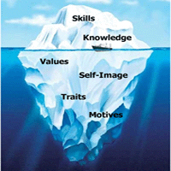
Sources of Conflict With Change
All related to divergent views regarding the project or tasks or a basic misunderstanding
Task-related
Resource-related
Procedural-related
Inter-personal relationships
Personality differences
Long-standing animosity
Iceberg Theory: Finding the underlying cause

Slide 63
Conflict Resolution Styles
Focus on Roles and Goals!!!!
Compromising – give and take
Smoothing – avoidance/agreement
Forcing – command and control tactic
Withdrawal – avoiding potential agreement/ignore the problem
Problem Solving – facing the problem head-on

Slide 64
Remember Leaders
Focus on the mission of the organization, the roles of the individuals, and the project team purpose and goals. Leadership will be a critical aspect of resolving conflicts, because their role is influencing the team to accomplish its purpose. A failure of leadership can invoke team failure. Leaders have to be the final decision makers.

Slide 65
GroupThink
When everyone is so happy that they will overlook things that need to change, but are unwilling to address the issues

Slide 66
Portfolio Options
What is a portfolio?
What is in a portfolio?
How to manage your portfolio

Slide 67
Work Breakdown Structure
WBS is the blueprint of the plan
Break elements down into manageable tasks
Make sure team is a part of this
Know your SME
Keep project into manageable steps
Assign responsibility
Consider the size of the project
Mind mapping / brainstorming
Project Accountability

Slide 68
Uncertainties
The source can be identified as a financial source, a technical source, a business environmental source, a social source, and an external or natural environmental source.
The outcome is the consequence of a potential risk. This can be manageable issues and can also be found in situations that are very difficult to control
The likelihood is what happens when the team does its best to predict a possible outcome.
There are many potential risks a project team may face. To properly prepare for this, it is important that project teams look at the various uncertainty possibilities: source, outcome, and likelihood

Slide 69
How To Implement Change

Slide 70
Reaching Your Goals!
Define what reaching your goal means
Performance indicators
Communications
Tangible results
Customer satisfaction
Employee acknowledgment
What will project closure look like?

Slide 71
Review

Slide 72
Credits
Managing Projects, A Team Based Approach, Karen A. Brown, Nancy Lea Hyer
Boria, B. (2007). Before you introduce change: "Vision casting" isn't step one, or even step two. Leadership, 28(2), 79-81.
Finnie, B., & Norris, M. (1997). On leading change: A conversation with John P. Kotter. Strategy & Leadership, 25(1), 18-21.
Heffes, E. M. (2009). You need urgency now! Financial Executive, 25(1), 20-23.
Hemmingsen, C., Johanning, H., & Lee, J. Y. (2010). Change management: Common failures and a checklist for improvement. Pharmaceutical Technology Europe, 22(5), 50-53.
Laurie, J. (1990). The ABCs of change management. Training & Development Journal, 44(3), 87-89.
Levasseur, R. E. (2001). People skills: Change management tools - Lewin's change model. Interfaces, 31(4), 71.
Nickitas, D. M. (2013). Methods, measures, and metrics of nurse staffing: Uncovering the evidence. Nursing Economics, 31(5), 213.
Woodall, J. (1996). Managing culture change: Can it ever be ethical? Personnel Review, 25(6), 26.

Slide 73
Thank you
martralyn@msn.com

