Slide 1
“Sounds like a good idea, let’s try it.” VS “We’ve tried that…it won’t work here.”
Cherishing Change
Allow Everyone to Soar!
www.EyeSystems.info Mary E. Schmidt, ABOC, CPO mary@EyeSystems.info

Slide 2
Learning Objectives
Identify staff most receptive to change.
Create an atmosphere that embraces change.
Understand your role in making change last.
Learn why change is critical to the health of the practice.

Slide 3
“It is not the strongest species that survive, it is not the most intelligent, but the most responsive to change.”
Charles Darwin
Those that don’t change will go the way of the dinosaurs.

Slide 4
Why Bother?
Focus
Direction
Momentum

Slide 5
4 Point Checklist
Team agreement
Establish current benchmarks
Determine new milestones
Assign accountability

Slide 6
ATMOSPHERE
Celebrate errors = learning opportunities
Correct mistake = no blame
Encourage collaboration = no “it’s mine”
Reward creative thinking
Hire and promote problem solvers!

Slide 7
LIFELESS
Different standards for different people
Reward error-free days
Complex systems for change
Shoot the messenger attitude
Management plays it safe

Slide 8
LEADERSHIP
Notes:
A leader you must be calm.

Slide 9
Cherishing Change
Allow Everyone to Soar!
T
F
S
A
F

Slide 10
Team Agreement - STAFF
SHOCK
RESPONSE:
Empathize with their feeling of loss, distress, disgust, surprise, grief.
Give them information on WHY change is important.
Give them time to process.
Ask questions – once they have come to grips with the news.

Slide 11
Team Agreement - STAFF
CONFUSION
REPONSE:
Give them as much information as possible.
Keep focused on short term goals but aware of the big picture.
Be reassuring
Help develop a strategic plan for change
Help them not overreact to rumors..

Slide 12
Team Agreement - STAFF
DENIAL
RESPONSE
Don’t expect large leaps in acceptance.
Give them time.
Help them see risks of denial...
Rotary phones
Paper appointment books
Ditto machines

Slide 13
Team Agreement - STAFF
HOSTILITY
RESPONSE
Put yourself in their shoes. Where is their anger coming from?
Allow them to vent.
Empathize with anger but keep in under control. “It’s okay to be angry but it is not okay to shout.”
Listen and validate.
Don’t take it personally.

Slide 14
Team Agreement - STAFF
RESPONSE
Don’t ask them to stop.
Feed them information constantly.
Keep them informed on timelines.
Don’t give them advice.
Give some control - the more cooperative they will become.
RESISTANCE

Slide 15
Team Agreement - STAFF
SADNESS
RESPONSE
Encourage them to discuss their feelings & what is triggering them.
Help them manage thinking patterns and feelings.
Encourage them to take care of themselves, rest, exercise, healthy diet.

Slide 16
Team Agreement - STAFF
STRESS
RESPONSE
Help them find a support network, family, work mentors, co-workers and friends. If necessary professional help.
Suggest stress reduction options, meditation, relaxation tapes, breathing techniques.

Slide 17
Possible Pitfalls
Underestimating the time needed

Slide 18
Possible Pitfalls
Unexpected problems

Slide 19
Possible Pitfalls
Poorly coordinated activities

Slide 20
Possible Pitfalls
Competing distraction

Slide 21
Possible Pitfalls
Inadequate capabilities or lack of skills

Slide 22
Possible Pitfalls
Lack of support for change

Slide 23
Possible Pitfalls
Unclear goals or objectives

Slide 24
Possible Pitfalls
Lack of involvement by others

Slide 25
Possible Pitfalls
Dismissing need outright

Slide 26
Possible Pitfalls
Uncontrollable events (life does happen)

Slide 27
Atmosphere
People
Next a system for change…

Slide 28
Establish Current Benchmarks
What needs to change?

Slide 29
Establish Current Benchmarks
Where can we improve?
Notes:
Big picture and little picture

Slide 30
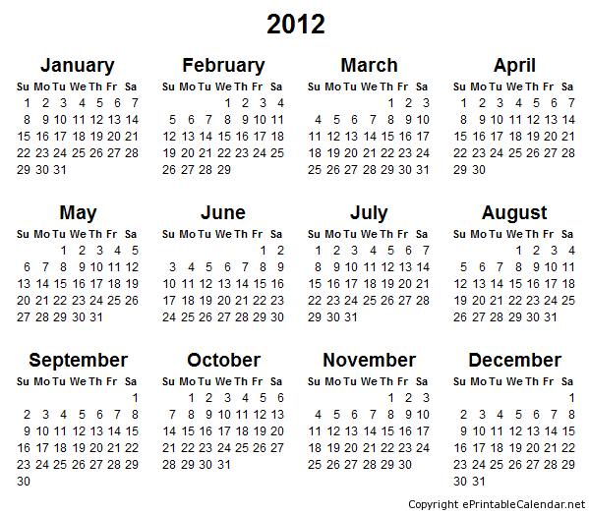
Establish Current Benchmarks
When do we change?
Constantly – just not all at once

Slide 31
Making Change Stick
How do we change?

Slide 32
Making Change Stick
Who is willing to change?

Slide 33
QUIZ

Slide 34
Must Do’s
Determine your practice strengths
Determine your practice weaknesses
Evaluate Yourself
Critique Staff
Establish a plan
Set a timeline

Slide 35
You Now Can
Identify staff most receptive to change.
Create an atmosphere that embraces change.
Understand your role in making change last.
Communicate change is so important to your practice.

