Slide 1
Collagen Crosslinking for Corneal Ectasia
Zack Zavodni, MD
February 2018
The Eye Institute of Utah
University of Utah John A. Moran Eye Center

Slide 2
No financial interests

Slide 3
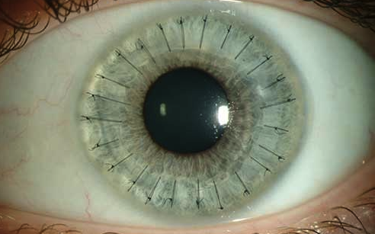
Notes:
How we can work together to make this a less common patient experience
As you know the goal of CXL is to strengthen the cornea to save our patients from the fate of a corneal transplant
Eye Bank Association of America has estimated more than 40% of the corneal transplants in the U.S.—or more than 6,800 transplants—could be avoided if an approved device for cross-linking were approved to treat keratoconus

Slide 4
Outline
Who and When to refer for crosslinking
How to counsel potential crosslinking patients
How does crosslinking work
How to care for the post-operative patient
Future directions for crosslinking
Notes:
Focus on your ability to identify patients in need of treatment, how to talk with them and how to take care of them after surgery

Slide 5
Who and When to refer for CXL
Corneal ectasia
  Keratoconus, PMD
  Post-LASIK
Markers of progression
  Manifest refraction, BCVA
  Topography
  Tomography
  OCT/epithelial thickness
Extent/stage of disease
Age
Notes:
Factors to consider when thinking about making referral
Just because someone has KCN doesn’t mean they are a good candidate
CXL stops progression so if you have a patient with documented progression they are a candidate
But that’s not the whole story…
Not always that easy, particularly new patient
AGE: very important for KCN review CLEK study: <20 yo most likely to progress to scarring
Concept of autocrosslinking from oxidative deamination with age
Approved for age 14
Extent of disease:
Mild and moderate disease is what you want, advanced disease with scarring is not
Crosslinking is only worth it if you have something to save
OCT has shown epi thinning as one of earliest markers

Slide 6
Case 1
44 year old male with KCN
No subjective change in vision
Old glasses from 2012: -6.00 + 6.00 x 7 (20/30)
2017:-6.75 +5.25 x 165 (20/25)
Notes:
Cases to exemplify when and who to refer

Slide 7
Notes:
So how manage this patient:
Age, mrx observe
RTC in 1 year for repeat imaging

Slide 8
Management Options
Refer for CXL
Refer for PKP
Recommend repeat exam and scans in 3 months
Recommend repeat exam and scans in 12 months

Slide 9
Case 2
16 year old with rapidly changing vision
No prior diagnosis or exam
Od: -3.50 +1.50 x 130 (20/20)

Slide 10
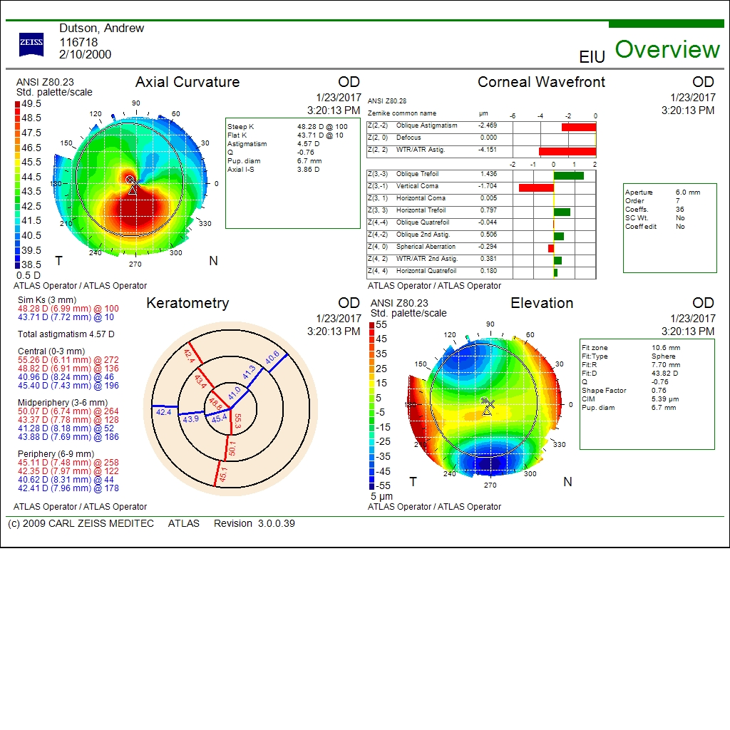

Slide 12
Management Options
Refer for CXL
Refer for PKP
Recommend repeat exam and scans in 3 months
Recommend repeat exam and scans in 12 months
Notes:
Here things are different, this is the slam dunk patent.
we have a young patient with KCN,

Slide 13
Case 3
29 year old diagnosed with KCN 10 years ago
OD
  Mild central scar and BCVA of 20/200
  Hard to appreciate big changes in VA
    “maybe getting worse?”
  Unable to wear CTL

Slide 15
Management Options
Refer for CXL
Refer for PKP
Recommend repeat exam and scans in 3 months
Recommend repeat exam and scans in 12 months
Notes:
Advanced KCN and scarring with limited vision potential…there is no utility to CXL in this case. I would refer him for a PKP.

Slide 16
Case 3 continued
29 year old diagnosed with KCN 10 years ago
OS
  1 year old glasses: -6.25 +1.50 x 60
  Mrx: -8.00 +2.75 x 36 (20/30) 2016, hybrid CTL 20/25
Notes:
Given this history the fact or worsening vision makes nervous for fellow eye,

Slide 17
Notes:
So here moderate disease but very functionl

Slide 18
Management Options
Refer for CXL
Refer for PKP
Recommend repeat exam and scans in 3 months
Recommend repeat exam and scans in 12 months
Notes:
Needs urgent CXL but didn’t get and now:

Slide 19
1 year later
  OS:
  Mrx: -8.00 +2.75 x 36 (20/30) 2016, hybrid CTL 20/25
  Mrx: -14.00 +4.00 x 50 (20/60) 2017 hybid CTL 20/30

Slide 20
June 2016
January 2017
Notes:
Unfortunately this guy didn’t do anything….

Slide 21
Case 4
31 year old male
Diagnosed with KCN in 2011
  Has OCD and unable to wear CTL
Intacs OD Jan 2014
Subjectively worsening vision OD:
  -4.00 + 5.25 x 160 (20/25) 2015
  -5.50 + 7.25 x 161 (20/25) 2017
Notes:
…with a change in his refraction

Slide 22
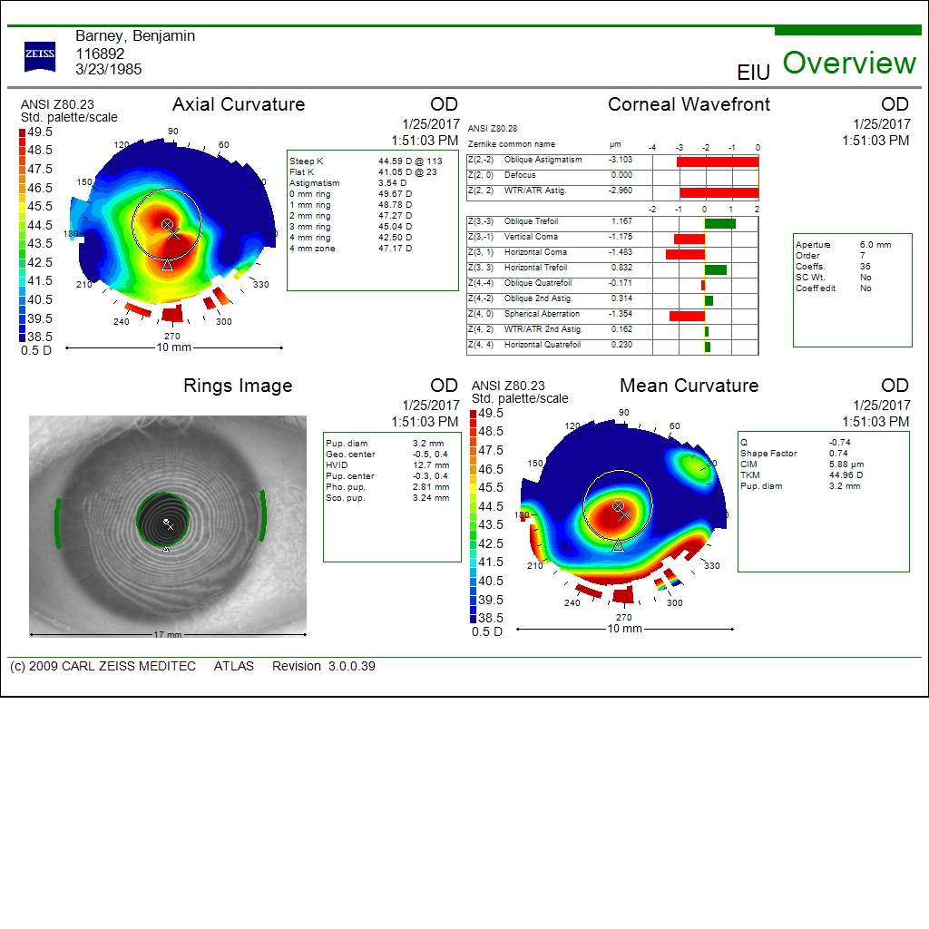
v
Notes:
On topography you can see an increase in his central steepening

Slide 23
Management Options
Refer for CXL
Refer for PKP
Recommend repeat exam and scans in 3 months
Recommend repeat exam and scans in 12 months
Notes:
Key point is that Intacs does not prevent progression and they need to be imaged just like all other patients

Slide 24
Other considerations with referral
Corneal thickness < 400
Prior herpetic infection
Prior history of poor wound healing/recurrent epi erosions
Pregnancy/breast feeding

Slide 25
Patient discussion topics
CXL has been around ~15 years
  Europe/Canada vs US
  FDA approval in 2016
  Insurance coverage
CXL strengthens the cornea to stop progression
Does not get rid of disease, will still require glasses/CTL but will likely change prescription
Success rates
Notes:
Changing gears…what do you tell a patient who you are sending for CXL:
Explain the pathophysiology of ectasia

Slide 26
Current research
Now in pubmed >500 citations
Limited long term follow-up; average 1 year data, <5 studies have cohort data beyond 3 years
Almost entirely single centered, nonrandomized, nonconsecutive
Varied means of outcome measurements: topography, tomography, higher-order aberrations, hysteresis
Varied irradiance protocols
  High vs low fluence
Varied disease states (moderate vs advanced KCN)
ASCRS Cornea Clinical Committee Meta Analysis JCRS 2015; 41:842-872
Notes:
To discuss the success you should be familiar with a bit of the research history:
=========
With overall very positive results…yet not with FDA approval. Why is that? The answer is it’s complicated and political but I’ll cover a few considerations that may be holding it back.

Slide 27
Data for FDA approval
As of April 2015, 4 published RCTs for standard epi off protocol
  90-100% success rate in halting progression
  Significant corneal flattening was noted in all studies
    reduction in Kmax ranging 0.62- 2.0 D
    significant improvement in BCVA
Notes:
Based on these trials: confidently tell you patients that the technology works

Slide 28
Patient discussion topics
CXL has been around ~15 years
  Europe/Canada vs US
  FDA approval in 2016
  Insurance coverage
CXL strengthens the cornea to stop progression
Does not get rid of disease, will still require glasses/CTL but will likely change prescription
Success rates
Risks
Notes:
Explain the pathophysiology of ectasia

Slide 29
Risks
Treatment failure 3.0-9.8% in first year following treatment
  Defined as continued progression with Kmax increase >1D or a drop in BCVA
Corneal haze/scar (~2-8% of patients)
  Most prominent at 1 month, typically fades over 12 months
Rare
  Infectious keratitis
  Corneal edema from endothelial failure

Slide 30
Patient discussion topics
CXL has been around ~15 years
  Europe/Canada vs US
  FDA approval in 2016
  Insurance coverage
CXL strengthens the cornea to stop progression
Does not get rid of disease, will still require glasses/CTL but will likely change prescription
Success rates
Risks
If no topo/tomographic data and older age expect serial imaging before surgeon makes decision
Notes:
Explain the pathophysiology of ectasia

Slide 31
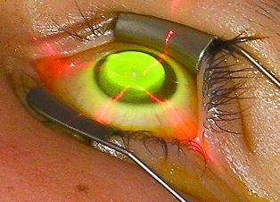
How does it work?

Slide 32
UVA
Riboflavin
Photochemical reaction: produces reactive oxygen species
Absorbs UVA radiation, helps prevent damage
to endothelial cells
Notes:
The key to crosslinking is the light sensitive molecule: riboflavin
Placed onto the cornea and penetrates diffusely. The cornea is they exposed to UVA light, which…
main factor required for effective crosslinking is adequate delivery of riboflacin to the stroma prior to UVA expsoure, the riboflavin serves as a photosensitizer for the production fo reactive oxygen specieis to create covalent bonds between collagen fibrils and it absorbs UVA radiation to prevent damage to the endothelial cells
Transmitted light power through the cornea is dependent onf the riboflavin concentrations
So for thin cornea a higher riboflavin concentration may provide protection to underlying endothlium
Excessive riboflavin concentration in the anterior stroma may act as a UV filter preventing deeper stromal crosslinking

Slide 33
Epithelium Off vs Epithelium On
Human studies of UV induced corneal crosslinking in 2003 in Dresden, Germany¹
FDA approved crosslinking in US is epi-off protocol
Appeal of epi on
  Less pain
  Faster recovery
  Lower risk of scar/haze and infection
Wollensak G et al. AJO 2003; 135:620-627
Notes:
Over the years a great source of debate has been how to get the riboflavin into the cornea.
What is the best way to apply riboflavin…
Traditional/original Dresden studies were with epi off
But there is great appeal

Slide 34
Transepithelial Crosslinking (Epi-on)
  Chemical disruption of epithelium
    Excess topical anesthetic
    BAK, EDTA, trometemol mixed with riboflavin
  Very long soak time (2hrs +)
  Iontophoresis (electrical current)
  Osmolarity
    Hypotonic solutions
340 Da
Riboflavin
180 Da
Epithelium
Notes:
The problem with epi on is it turns out it is hard to get riboflavin into the cornea as riboflavin is larger than what epithelial tigh junctions allow to pass.
Ways around this problem have included

Slide 35
Epi-On vs. Epi-Off
Efficacy of epi on vs epi off highly debated
Far fewer transepithelial studies: 10-15
  many show similar ability to halt progression as epi off
  However 3 studies with significant corneal steep, 1 study with a 50% retreatment rate (higher than any epi off study)
CXL demarcation line depth on OCT
  140 to 250 um (epi on) vs 280 to 330 (epi off)
A RCT head to head comparison will be required
Notes:
In spite of these efforts penetrattaion (or what we call imbibation) is not as good with epi on and as a result efficacy of epi on has been called into question.
although metanalysis by ASCRS in April 2015 showed

Slide 36
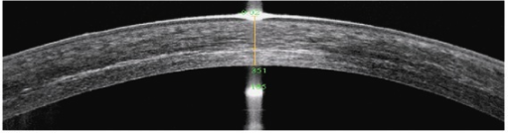
Notes:
OCT demonstrating demarcation depth

Slide 37
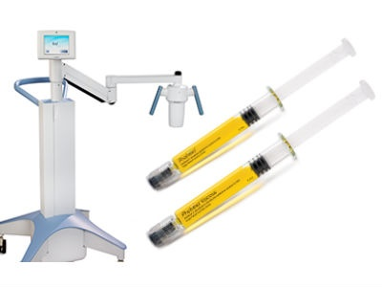
Current Crosslinking
FDA-approved epi-off protocol
  Approved for KCN (April 2016) and post LASIK ectasia (July 2016)
  Epithelial debridement
  Photrexa and Photrexa Viscous (Avedro) 30 minute application
  Avedro KXL System: 365 nm UVA light with power of 3 mW/cm² for 30 minute treatment
Notes:
Photrexa cost 4-500 that comes with a chip to turn on the light source so in essence there is a click fee
After riboflavin have to check for thickness of 400 and ensure auptake into the AC

Slide 38
Post-operative considerations
Pain
Initial drop in VA
Corneal haze/CXL striations
Steroid responders
  Similar to post PRK drops
Post-op exams and imaging
  Day 1, week 1, month 1, month 3, month 6, month 12
When to restart CTL wear and when to get a new CTL and glasses Rx
Notes:
Could we not comanage these?

Slide 39
Additional uses of CXL
Combo treatments
  CXL + Intacs
  CXL + PRK
    Athens protocol for KCN
  CXL + LASIK (LASIK Xtra)
Infectious Keratitis
Refractive crosslinking
  Photorefractive intrastromal crosslinking (PiXL)
Notes:
In conjunction with LASIK for people with RSB near 300 and for younger patients at higher risk of ectasia.
The concept of combo treatments is to reshape the cornea in an ideal configuration and then freeze it with CXL
Internationally most common is topo guided PRK with CXL to help reshape cone a bit (referred to as the Athens protocol)
Combo treatments and inherently limited by unpredictable refractive outcome of CXL
In use in Europe for small corrections (predominantly epi-on)Topography guided placement of high energy UV light to create a custom pattern of crosslinking. PiXL for KCN patients and even low myopes

Slide 40
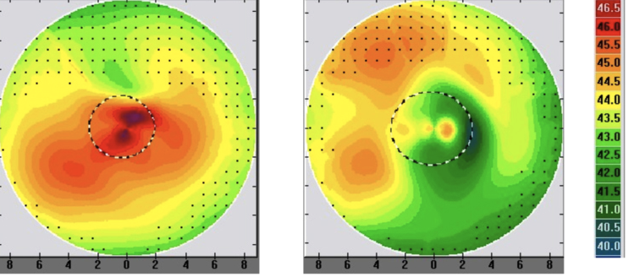
Epi-on Topo-guided PiXL
Courtesy of John Kanellopoulos, MD
Source: https://www.eyeworld.org/
Notes:
Directing high fluence UVA to only certain regions.
Has been used in conjunction with CXL treatment for KCN and even tried in a few patient with small myopic and hyperopic refractions

Slide 41
Thank You

Slide 42
Contact lens assisted CXL is effective for thinner corneas
Theoretically pulsed CXL should work better because you’re less likely to deprive oxygen (I don’t know if I believe this)
Notes:
8. jacob s, kumar da, agarwal a, basu s, sinha p, agarwal a. contact lens-assisted collagen cross-linking (cacxl): a new technique for cross-linking thin corneas. j refract surg 2014;30(6):366-372.

Slide 44
Notes:
As an aside we got these records a few weeks later confirming our suspicion

Slide 46
Transepithelial Crosslinking (Epi-on)
How to get riboflavin through epithelial tight junctions
  Chemical modification/disruption of epithelium
    Excess topical anesthetic
    BAK, EDTA, trometemol mixed with riboflavin
  Very long soak time (2hrs +)
  Iontophoresis (electrical current)
  Osmolarity
    Hypotonic solutions allow better penetration
Notes:
The problem with epi on is it turns out it is hard to get riboflavin into the cornea.
spurred by fact that epi debridement is the cause of most complications with CXL (including pain, infectious keratitis and potential woun healing difficulties) over past several years there has been a push to perform transepithelial crosslinking.
Riboflavin diffusion limited by epithelial tight junctions to allow for riboflavin absorption
Usually thought that epi junctions don’t allow molecules >180 Da but riboflavin has a size of 340 Da

